Slide 1
Weapons Training Battalion
Staff Non-Fire Brief

Slide 2
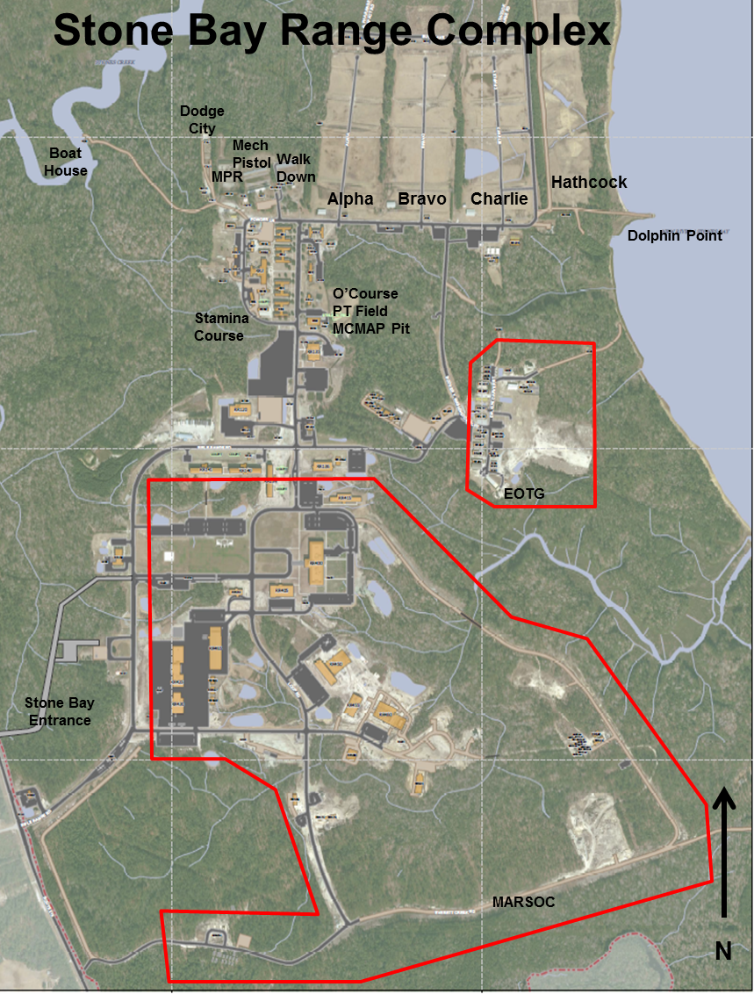
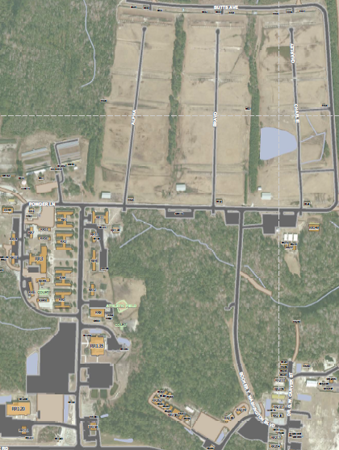
Orientation
Walk
Down
Pistol
SRR-64
Alpha
Bravo
Charlie
RR-44
Armory
RR-11
S-3
RR-1
Target
Shed
ISMT
RR-2
RR-4
MAGGIES GRILL
Shooters
Parking
Lot
Mess
Hall
PX

Slide 3
Staff Non-Fire Responsibilities
Command representative, responsible for everything your detail does or fails to do
Overall responsible for:
All coordination
Personnel and weapons accountability
Enforcing orders and regulations

Slide 4
?
Questions

Slide 5
Pre-Firing Agenda
Coordination
Planning Factors
The Detail Roster
Timeline
Next Tuesday
Next Friday
Range Breakdown
Recommendations

Slide 6
Coordination
PRIOR COORDINATION IS KEY
24 hours in advance can be worked with, day-of changes will not be entertained
Phone call is good, but always send a follow up email and ensure you receive a confirmation response. Call again if you don’t get one in a reasonable amount of time

Slide 7
Planning Factors
Size of your detail determines your requirements for:
Number of Corpsmen (3 per range)
Number of Coaches (1 CMC per 20 shooters, ~1 per 4 target points)
Number of Verifiers (Officers, SNCOs, or CMT qualified Sgts only)
Number of required verifiers will be finalized during Final Check In
If you fail to provide assigned requirements, we will drop shooters
Reserve weekends, weather, and other factors might result in a compressed firing week – STAY FLEXIBLE
Stock weapons: 10% extra
Accurately listed on Detail Roster

Slide 8
The Detail Roster
Correctly filled out with all information included
Shooters, EDIPIs, weapons, coaches (and coaches EDIPIs), corpsmen, and verifiers
Proper format
Microsoft Word document ONLY. Do not change the formatting.
http://www.lejeune.marines.mil/Units/WeaponsTrainingBattalion/S-3.aspx
Signed by the Commanding Officer or “Acting”, (by direction will not be accepted)

Slide 9
Timeline
Paperwork and billeting request due next Tuesday NLT 1430
Detail roster (Word Document ONLY)
Scanned copy of your Letter of Authorization (PDF, signed)
Scanned copy of your Preparatory Training Letter (PDF, signed)
Units that prefer to turn in a hardcopy must do so NLT check in on Friday
Check In next Friday*
Specific timeline for your firing week located on the cover page of your SNF packet
Failure to meet these timelines without prior coordination with WTBN S-3 will result in some or all of your shooters being dropped.

Slide 10
Timeline for Friday (Check In)
By 0730, SNF Checks Range Breakdown posted on Alpha Range Thunderdome
Once range is identified, SNF, Coaches, and shooters proceed to range for Range Brief at 0800
RSO/OIC pass out Weapon Custody Cards (DO NOT FILL OUT YET)
Once Range Brief has been conducted, Range Staff will brief the shooters on how to fill out their Custody Cards
SNF will verify Custody Cards for each shooter against their Detail Roster and sign Custody Cards
Once Roster has been verified and Cards have been signed, SNF will proceed to S-3 to correct their Detail Roster.
Shooters will head to the armory and stand-by for SNF .
SNF proceeds to armory with corrected/certified Roster and turns in weapons.
SNF/shooter/coaches/corpsmen can depart range complex once all individual units weapons are in armory.
Note: DO NOT SPEED THROUGH VERIFICATION PROCESS! It will slow you down in the long run! Identify all corrections before heading to the S-3.

Slide 11
Range Break Down

Slide 12
Billeting

Slide 13
Timeline (cont.)
 | Monday | Tuesday | Wednesday | Thursday | Friday
Prep Week 1 |  | 1000: SNF Brief
Prep Week 2 | Base Units NLT 1430: Email Detail Roster Scanned copy of Letter of Authorization Submit Billeting request | Base Units 0700 - Prep Training Non Base Units NLT 1430: Email Detail Roster Scanned copy of Letter of Authorization / Prep Training Letter Submit Billeting request | WTBN processes unit paperwork WTBN creates and submits chow requests |  | 0700: SNF Check in 0800: Range Brief Verify roster Fill out Custody Cards Roster Corrections with S-3 Weapons turn in NLT 1100: Barracks check-in
 | Unit preparatory training (“Grass Week”)
Firing Week | Block-In Brief Zero Weapons Table 1A practice | - Table 1A Practice | Table 1A Qual Table 2 | Table 2 UNQ Relay SNF Check Out
 |  | 1000: Verifier Brief conducted by range staff | Verify scores Contesting | Barracks check-out Weapons check-out Non-Fire check-out Verify scores Contesting
Admin Week |  |  | NLT 1630: WTBN runs scores
Legend: Non-fire responsibilities Coach responsibilities Verifier responsibilities WTBN responsibilities

Slide 14
Recommendations
Ensure LTI/PFIs are conducted properly
LOCKTITE on RCO under-screws is always a good idea
Scrub your rosters
Medical, Admin, or Legal issues – if they don’t need to or can’t shoot, don’t bring them out here
Back brief your S-3
Ensure they are tracking on all timelines and requirements
YOU have the most up-to-date information, not them
Range Support Vehicle for logistical support
Not required, but highly recommended
Only one allowed downrange at a time, coordinate between RSO, OIC, and other SNFs on your range

Slide 15
?
Questions

Slide 16
During Firing Agenda
SNF Responsibilities
Coaches and Verifiers
Qualification
Safety and Range Violations
Chow/Billeting
Recommendations

Slide 17
SNF Responsibilities
Check in with the Range House daily
Report your numbers and drops (last 5 of EDIPI, reason shooter was dropped)
Remain on the range unless:
Picking up chow
Escorting a dropped shooter
Attending a required brief
Always check out with the RSO/ROIC/Line Staff or Range CMT
Ensure all trash is bagged and disposed of in brown dumpsters only
Ensure no shooter leaves the range until dismissed by the RSO/ROIC
Ensure all coaches and corpsmen (if assigned) check in to the range house at 0500/0530 (depending on time of year)
All corpsmen are required to have a Unit 1 bag. WTBN does not provide medical supplies
Corpsmen are required to stay with the unit until dismissed from the armory

Slide 18
Coaches and Verifiers
Coaches
One additional coach per unit is authorized. Must be a Sgt or CMT
Coaches are assigned to specific shooters; no swaps without prior coordination
Required to:
Wear white headband, ear pro, and eye pro while serving as a coach
Be in good standing with the CMC Evaluation and Reporting Program
Check in with range personnel every morning at 0500/0530 (depending on time of year)
Coaches Evaluation Program
All coaches receive feedback from range personnel & MTU at the end of the firing week
Highest scoring coach will be selected as “Coach of the Week” by WTBN
Units may request copies of all evaluation forms from WTBN S-3
Verifiers
Must attend the Verifiers Brief (Tuesday of the firing week, time TBD)
Must remain on the range during qualification until all contesting has been completed

Slide 19
Qualification
Contesting
Must be at least a 7-point difference between:
Qualifying and not qualifying
A change in badges
Databook must be correctly filled out
Unq Relay
Unq relay conducted, time permitting
To qualify for the unq relay, shooter must have filled out databook
Plots, holds, calls, and weather. Coaches notes are highly recommended
MUST have attended the ISMT during the week
175 or higher (Range personnel can waive, BUT DO NOT HAVE TO)
Verifiers
Must stay on range until completion of contesting.
If a verifier assigned to a unit fails to show up, the ranking SNCO or Officer from that unit will be pulled from the detail to verify

Slide 20
Safety and Range Violations
Safety Violations (will result in outright drop from the range)
Aiming in behind the firing line
Negligent discharge
Crossing the red line in the pits
Flagging the line (w/ condition 1 weapon)
Range Violations (could result in outright drop from the range if multiple violations occur)
Leaving weapon or ammo unattended
Firing outside of range commands
Improper weapons handling
Failure to put weapon on “safe” after firing
Other
Integrity violations
Weapon malfunctions
Involved leadership prevents unnecessary drops!
Ensure you are policing your detail
SNFs are the only personnel authorized to appeal a decision made by range personnel
Notify RSO/ROIC if you wish to appeal on behalf of your shooter
Range CO and BN CO have the final say
COMMON SENSE APPLIES!!!

Slide 21
Chow
Stone Bay chow hall provides box meals as follows:
SNF picks up chows IAW schedule:
Recommend delivering morning chow during armory draw and range check in
Breakfast Chow pick up any time after 0500
Lunch chow pick up no earlier than 1030
Dinner chow pick up no earlier than 1430
 | MONDAY | TUESDAY | WEDNESDAY | THURSDAY | FRIDAY
BREAKFAST | X | X | X | X | UNIT
LUNCH | X | X | X | X | UNIT
DINNER | X

Slide 22
Chow (cont.)

Slide 23
Recommendations
Inspect your shooters weapons and gear to prevent unnecessary drops
Stay constantly engaged
The more engaged you and your leadership are, the less hands on range staff need to be
Familiarize yourself with range SOP chapter 5 (on website)
Enforce databook use
Personnel management
Stay engaged with coaches and verifiers, ensure they are where they need to be, when they need to be there
Have on hand:
Extra gear (databooks, ear pro, eye pro, slings, magazines, etc.)
CLP/rifle cleaning gear – enforce weapons maintenance

Slide 24
?
Questions

Slide 25
Post-Firing (Last Day of Firing)
Stage all gear outside of billeting, ensure that it is clean
Draw all weapons from the Armory (including all stocks) in the morning
Stage all vehicles in the gravel parking lot next to the armory only
Attend the 0900 (or “On-Call”) Check Out brief in S-3 classroom
Signatures required from Billeting, Armory, and Range. S-3 will be the last signature
Ensure you pick up afternoon chow
If assigned an area to police call, contact 910-440-2650 to get it inspected
Check out with S-3
Turn in SNF Binder, armory sheet, and critique sheet
You cannot complete checkout without filling out the critique sheet with feedback
Coach of the Week/High Shooter
Report to Range Company office, building RR-11 (bottom deck, center) to get picture taken

Slide 26
FAQ
Q: What form needs to be sent via email to Mr. Curci the Tuesday prior to firing week?
A: Detail Roster
Q: What format does the Detail Roster need to be sent?
A: Microsoft Word
Q: What time is the Detail Roster due by on the Tuesday prior to firing week?
A: 1430

Slide 27
FAQ
Q: Does all documentation need to be turned in on the Tuesday before Firing Week?
A: No, just the detail roster in Microsoft word format. All other documentation needs to be signed and can be brought in on the Friday before firing during the check in process.
Q: Where do I go to check in on the Friday before Firing Week?
A: See detail roster at Alpha Thunder Dome and then your respective range.
Q: Can I change any shooters on day of check in?
A: Yes, however an updated detail roster must be provided to S-3, it is also important to note that the rosters has already been sent to the chow hall and your shooter wont get fed by means of the chow hall and the responsibility will fall upon the individual unit.

Slide 28
FAQ
Q: What time, date, and location do the verifiers need to be at the range complex?
A: 1000, Tuesday (of Firing Week), at the range house of units respective range.
Q: Do all Unqualified shooters rate a UNQ relay?
A: Each unqualified shooter must shoot 175 or higher; Have a filled out data book; must have attended remediation with WTBN Marksmanship Training Unit (MTU) at the Integrated Simulated Marksmanship Trainer (ISMT). Can be waived by range personnel on case-by-case basis. Ownness falls on the shooter, data book usage, and use of the ISMT

Slide 29
?
Questions

Slide 30
References
MCO 3574.2L – Marine Corps Combat Marksmanship Programs
MCRP 3-01A – Rifle Marksmanship
MARADMIN 069/15 – Authorized individual weapons, optics, modular attachments and modifications for annual rifle and pistol training for FY 2013
WTBN 3000.3E w/ ch. 1 (WTBN Range SOP)
https://intranet.mcieast.usmc.mil/WTBN/Pages/default.aspx
Updates to firing weeks posted at the top, templates and documents located along the right hand side

Slide 31
Points of Contact
Operations Officer: 910-440-1600
Capt J. Harvey
joshua.s.harvey@usmc.mil
Operations Chief: 910-440-2687
MSgt B. Stanley
brian.c.Stanley@usmc.mil
Battalion Gunner: 910-440-2705
Gunner Pieratti
thomas.pieratti@usmc.mil
Range Company Commander: 910-440-2712
See Operations Officer
Marksmanship Training Unit: 910-440-2026/2027
SSgt P. Murphy
pamela.murphy@usmc.mil
Alpha Range: 910-440-2947
Bravo Range: 910-440-2943
Charlie Range: 910-440-2942
Armory: 910-440-2597
After Hours Contact: 910-358-1169
WTBN OOD
Mr. Frank Curci (S-3 Check-in)
910-440-2918
frank.curci@usmc.mil
Ensure Detail Roster is complete and as accurate as possible. Include EDIPIs for all shooters and coaches
Mr. Jim Moland (Billeting)
910-358-0793
jimmy.moland@usmc.mil
When emailing your billeting request, include your name, unit, POC, and number of shooters broken down by male and female

Slide 32
Questions?

