Slide 1
AA&E FAMILIARIZATION (High Explosives)
As required By MCO 8023.3
Qualification / certification

Slide 2
HANDLING
Loose/open boxes prohibited outside operating bldgs
Gun Ammunition
Avoid damage to rotating bands, bourrelets, points, caps, windshields, covers, fuze threads, painting, & ID markings
Considered defective if dropped 5+ feet (with or w/o fuze)
Examine if dropped <5 feet (w/o fuze)
RAP dropped 24+ inches considered defective
Fixed Ammo shall never be dropped, rolled, or thrown
Fixed Ammo dropped 5+ ft = move & break down
DO NOT break moisture resistant seals (Arty) until use
Protect Arty fuzes from hi temps & direct sunlight
DO NOT attempt to disassemble Arty Ammo

Slide 3
HANDLING
Rocket-Type Ammunition
Exercise care; use only equip specified for item
Protect from sources of hi temps (steam lines/direct sunlight)
DO NOT:
Break moisture resistant seal until use/inspection
Assemble prior to use
Remove/alter safety devices
Drop/handle roughly
Bend/deform
Remove propellant grain
Fuze, primer, detonator (or ctrs of) dropped 5+ ft: segregate
Bomb Type Ammunition
Possible to detonate if dented
Never drop, drag, tumble, walk, roll, or subject to shock
Nets only used to enclose pallets
JDAM dropped 18+ inches considered unserviceable

Slide 4
HANDLING
Ground-Type Rockets
Handle as rockets
Grenades
Ensure safety pins are in place before handling
Antitank-Type Land Mines
Handle as bomb-type ammunition
Mortar Ammunition
Rough handling can arm/break fuze & explode burster
Same hazards as loaded projectiles & fixed ammunition
DO NOT break moisture resistant seal until use/inspection
Only withdraw safety wire just before firing

Slide 5
HANDLING
Demolition & Miscellaneous A&E Items
DO NOT leave blasting cap containers uncovered
DO NOT disassemble blasting caps
Keep safety fuses away from temperature extremes
Avoid kinks in safety fuse
Military Dynamite
Protect from hi temps & sever drops/jolts
Commercial Dynamite/Blasting Agents/Gels
More hazardous in storage
May exude nitroglycerine
Deteriorates more rapidly than other HE
DO NOT store large quantities in NAVMC facilities

Slide 6
STORAGE
High Explosives
Mixed storage permitted if compatibility maintained
Shall not exceed 500k# N.E.W. in a mag/site
Stacked to allow inspection and air circulation; tops facing up
Adequate dunnage 1”+ off floor
Bomb-Type Ammunition
May be stored unpackaged or in crates/boxes/pallets or shipping bands in which shipped
SCG-D firing/arming devices must be stored in original packaging (or equivalent) & away from SCG-D bombs
Shall be visually inspected for presence of exudate in fuze cavities
[prior to storage in magazine] & [before transfer from magazine]

Slide 7
STORAGE
Grenades
Subject to accidental functioning from deterioration under unfavorable storage conditions
firing device is especially vulnerable to deterioration
Should be stored in their original packing containers
Should be stored separately whenever possible
Mortar Ammunition
“Light” (through 81mm) shall be stored similar as fixed ammo
“Heavy” (+81mm) shall be stored similar as bomb-type ammo
Rocket-Type Ammunition
Rocket heads/motors/unassembled rounds may be stored in their original shipping boxes or pallets
Kept away from electricity & RF transmitters
Flammable dunnage, other than pallets used to pack/ship, shall not be used in magazines.

Slide 8
STORAGE
Land Mines
Packed in wooden boxes or metal crates
May also contain the fuzes, activators, and accessories
Box/crate may contain one or several of same type
Antitank mines stored as specified for bomb type ammo
Ground-Type Rockets
Stored IAW Hazard Class & SCG assignments

Slide 9
GRENADES

Slide 10
GRENADES
Learning Objectives
Classify grenades according to method of projection and application.
Identify and describe general grenade components
Recall marking, color-coding, and packaging specifications inherent to grenades.
Utilize the TM 43-0001-29, Datasheets for Grenade, in correspondence with grenades

Slide 11
GRENADES
A grenade is a small bomb or missile designed to be thrown by hand or fired from a rifle or automatic system. Grenades are used against enemy personnel or material at relatively short ranges. Grenades are designed for immediate use where artillery ammunition would be too slow, impractical, or dangerous to friendly troops. Field Storage exceeding 5 days requires approval from the Base Commanding Officer.
Grenades are designated by FSC 1330.
Grenades can be classified according to their method of projection (hand, rifle) and application (service, practice, training).

Slide 12
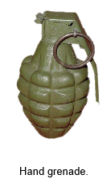
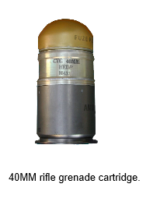
GRENADES
Method of Projection
Grenades may be classified according to method of projection as hand or rifle. Hand grenades are designed to be thrown by hand, while rifle grenades are projected from a grenade launcher.
Hand grenade
40mm rifle grenade cartridge

Slide 13
GRENADES
Hand grenades are thrown by hand and are used to supplement small arms ammunition for effects against an enemy in close combat. They can also be used to provide signaling and screening smoke effects.
Hand grenades have a short employment range; therefore, their effective casualty-producing radius is relatively small. They are configured with a delay element which provides for a safe throwing distance.
There are six types of hand grenades which are listed below.
Fragmentation
Illuminating
Chemical
Offensive
Practice/Training
Non-lethal

Slide 14
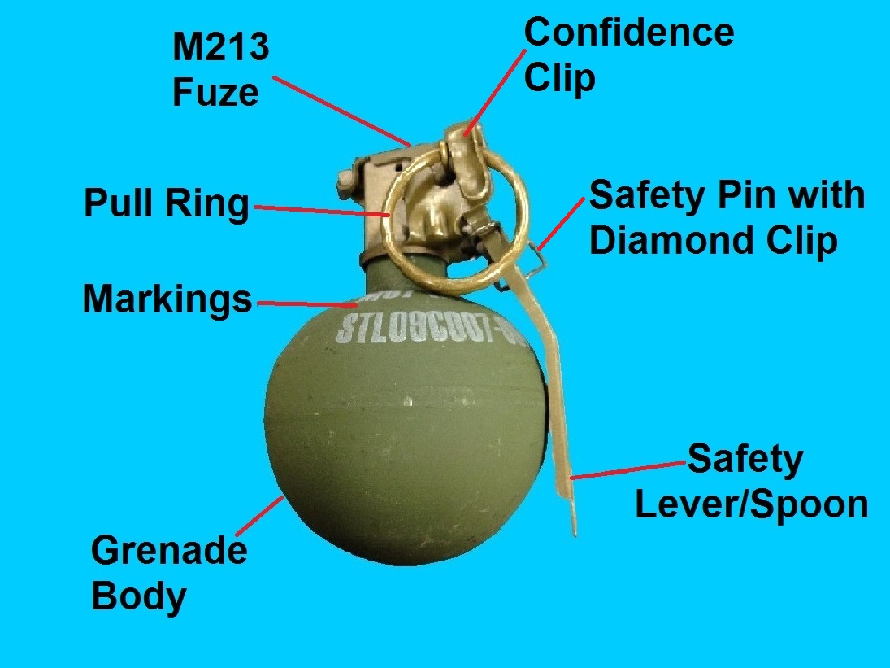
GRENADES
Fragmentation
Fragmentation hand grenades produce casualty by the high velocity projection of fragments. They have a thin metal body about the size and shape of a lemon and contain Composition B filler.
Removal of a safety pin is required immediately prior to use of this grenade.
WARNING-Never carry or handle a grenade by its safety pull ring. The safety pin might separate from the fuze.

Slide 15
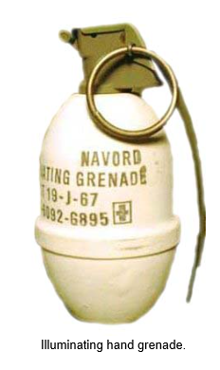
GRENADES
Illuminating
Illuminating grenades provide illumination of terrain and targets. Because their illuminant compound burns with a very hot flame, these grenades can also be used for incendiary (fire-causing) purposes against flammable targets.
These type grenades usually burn for approximately 25 seconds and illuminate an area approximately 200-meters in diameter.

Slide 16
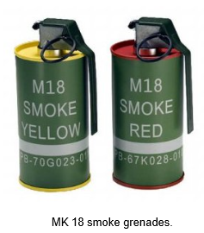
GRENADES
Chemical/Smoke
Chemical grenades are used for incendiary (fire-causing), screening, signaling, training, and riot control purposes. A typical chemical grenade has a cylindrical body with the top and bottom crimped in place.
Chemical grenades may contain a variety of irritating chemical agents used to impair an enemy such as tear gas and colored smokes.

Slide 17
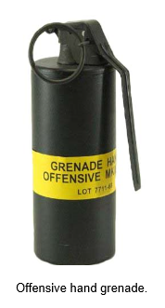
GRENADES
Offensive
Offensive hand grenades provide blast effects. They are of cylindrical shape and are loaded with approximately one-half pound of flaked TNT.
Offensive hand grenades are predominantly designed for demolition, final assault, and use in rooms, caves, and other enclosed areas.
Since the body of the offensive hand grenade is cardboard, the main effect of the grenade is blast; however, some metal fragments from the fuze may be projected.

Slide 18
GRENADES
Practice/Training
Practice hand grenades are used for training personnel in the use, care, and handling of service grenades. A typical practice hand grenade contains a small spotting charge of black powder and is fuzed with a 4- to 5-second delay igniting fuze.
Training hand grenades, on the other hand, are unfuzed and completely inert. They resemble service rounds in size and shape, but are only used for training in handling and throwing.

Slide 19
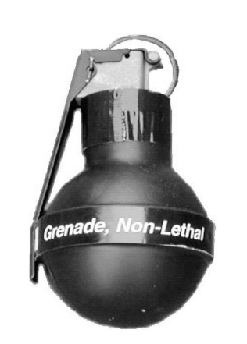
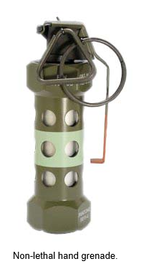
GRENADES
Non-lethal
Non-lethal grenades are used for diversion, stun and riot control
Diversionary
Rubber Ball

Slide 20
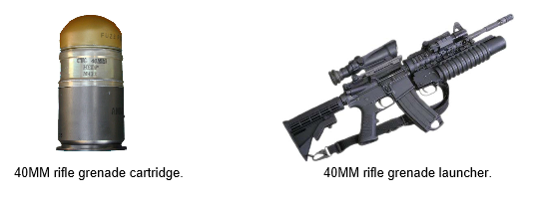
GRENADES
Rifle Grenades
Rifle grenades are fin-stabilized projectiles launched from rifles equipped with grenade launchers. The propelling force for this type of grenade is provided by a special gas-producing grenade cartridge.
Rifle grenades may be used against armored targets and personnel as well as for screening, signaling, and incendiary effects.

Slide 21
GRENADES
Types of Rifle Grenades
Anti-Tank
Chemical
Practice

Slide 22
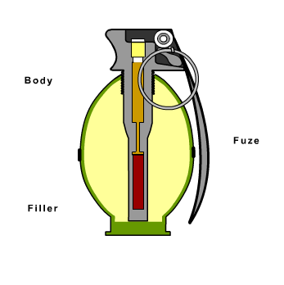
GRENADES
Major Components
A typical grenade consists of a body, filler, and fuze

Slide 23
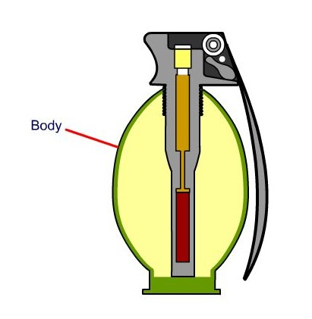
GRENADES
Body
The grenade body contains an explosive or chemical filler. It emits fragmentation upon combustion as well as provides a means of assembly for the fuze.
Grenade bodies may be made of metal, fiberglass, cardboard, or other suitable material and consist of a variety of shapes (e.g. round or lemon-shaped).

Slide 24
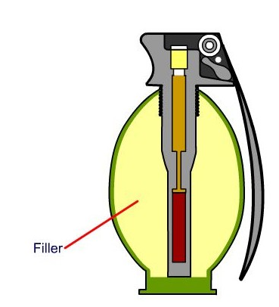
GRENADES
Filler
The filler is the material inside the grenade body that produces the desired effect (e.g. explosion or smoke).
Grenade fillers may be high explosive, producing blast and/or fragmentation, or chemical.

Slide 25
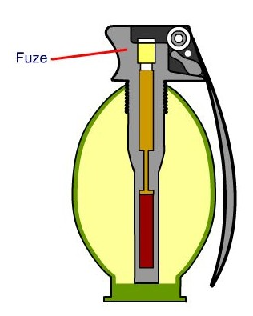
GRENADES
Fuze
The fuze of a grenade is the initiating device that causes the grenade to function.

Slide 26
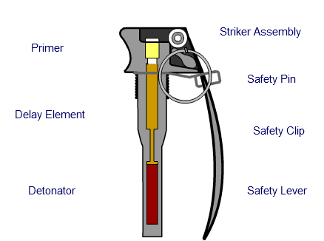
GRENADES
Fuze Subcomponents
A grenade fuze consists of the subcomponents illustrated in the animation at right. Roll your mouse over each text area for a brief description.

Slide 27
GRENADES
Types of Fuzes
Grenade fuzes may be classified as detonating or igniting.
Detonating fuzes explode within the grenade body and initiate the filler. Theses fuzes are used with high-explosive and chemical-type grenades.
Igniting fuzes burn at high temperatures to ignite the filler. These fuzes are used with all burning type chemical grenades and with practice grenades

Slide 28
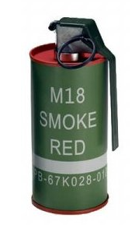
GRENADES
Markings
Grenades are stenciled with markings that include all information required for complete identification of its contents as well as for handling, storage, and use. This information might include the nomenclature of the grenade (e.g. model number, explosive filler) and lot number.
In the image of the grenade at right, its stenciled markings visually identify it as a model M18 smoke grenade that emits red smoke. The item lot number is stenciled on the bottom portion of the grenade body.

Slide 29
GRENADES
Color Coding
Color coding specification for grenades are primarily used to visually distinguish grenades by type. For example, practice grenades should be visually distinguishable from high explosive-filled fragmentation grenades. Table 1-1 of TM 9-1300-200 (illustrated below) provides general color coding specifications for grenades.
Color | Primary Use
Yellow | High explosive
Brown | Low explosive
Gray | Chemical
Light green | Smoke Light
Red | Incendiary
White | Illuminating/Pyrotechnic
Black | Armor Defeating
Aluminum/Silver | Countermeasure
Light blue | Noncombat (practice)
Bronze | Noncombat (training)

Slide 30
GRENADES
Grenade Packaging
Fiber Container
Grenades are packaged inside fiber containers with spacers enclosed to prevent any movement. The fuze is installed in the grenade as packaged so that it is ready for use upon issue.
WARNING-If a grenade is packed upside down (fuze down), do not attempt to remove it from its container. Notify the OIC/NCOIC immediately.

Slide 31
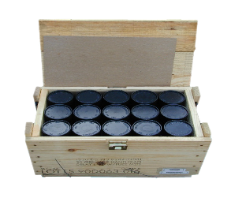
GRENADES
Wooden Boxes
Multiple grenades packaged in fiber containers are packaged inside wooden boxes.

Slide 33
Propellant

Slide 34
PROPELLANT
Learning Objectives
Describe the classifications of propellant.
Explain how grain configuration affects the burn rate of propellant.
Describe authorized packaging methods for bulk propellants.
Define propellant stability.
Describe the programs used by the Army to monitor propellant stability as defined in SB 742-1 and the Propellant Management Guide.
Describe how the Army uses the Propellant Stability Database to safely manage Army propellant.
Explain stability requirements for the receipt, issue, and shipment of Army propellant.
Explain the requirements for the loading and authorization of propellant.
Discuss the purpose and use of APE 1995.
Describe the programs used by the Navy to monitor and safely manage Navy gun propellant.

Slide 35
PROPELLANT
Introduction
Propellant Classification
Military propellants are typically used to propel ammunition items (e.g. projectiles and rockets). Propellants can be liquid or solid, but current Army applications use only solid propellants. The four classes of solid propellants are:
Double-Base
Single-Base
Triple-Base
Composite

Slide 36
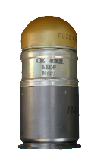
PROPELLANT
Single-Base Propellants
Single-base propellants contain a primary explosive ingredient of nitrocellulose. Single-base propellants are used in cannons, small arms, and grenades, such as the 40MM grenade cartridge illustrated at right.

Slide 37
PROPELLANT
Single-Base Propellants
Single-base propellants contain a primary explosive ingredient of nitrocellulose. Single-base propellants are used in cannons, small arms, and grenades, such as the 40MM grenade cartridge illustrated at right.

Slide 38
PROPELLANT
Double-Base Propellants
The term double-base propellant applies to compositions containing both nitrocellulose and nitroglycerine.
Double-base propellants are used in cannons, small arms, mortars, rockets, and jet propulsion units.

Slide 39
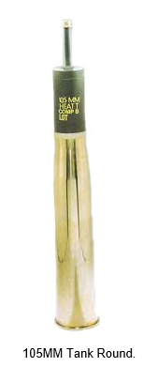
PROPELLANT
Triple-Base Propellants
Triple-base propellants contain three explosive ingredients, primarily nitroguanadine. The other two ingredients are nitrocellulose and nitroglycerine.
Nitroguanadine produces a larger amount of gas which propels projectiles towards the target with a greater force. It also generates lower flame temperatures which reduces wear on gun barrels.
Triple-base propellants are used in ammunition for cannon units.

Slide 40
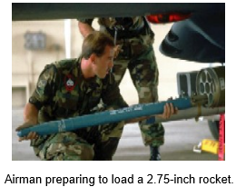
PROPELLANT
Composite Propellants
Composite propellants are composed of an organic fuel, an inorganic oxidizing agent, and an organic binding agent. They contain no nitrocellulose or nitroglycerine.
Composite propellants are generally large, single grains of solid propellant designed to provide a controlled burn in items such as rocket motors.
Composite propellants were developed because of the undesirable ballistic characteristics of double-base rocket propellants.

Slide 41
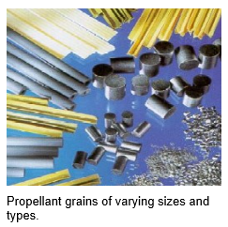
PROPELLANT
Propellant Grains Configuration
Military propellant is commonly used in forms called grains, which can be of varying sizes and shapes.
The size and configuration of a propellant grain influences the speed at which gases are produced. These factors influence the speed and range of the ammunition item being propelled.

Slide 42
PROPELLANT
Burn Rate Characteristics
The size and configuration of propellant determines the relative burn rate. The more surface exposed to burning, the faster the burn rate. Burn rates can be described as degressive, neutral, and progressive.
Non-perforated grains produce a degressive burn. As non-perforated grains burn, the burning surface area decreases continuously until the grain is consumed. the burn rate is initially quite rapid, but then steadily declines.
Single-perforated grains produce a neutral burn. A single-perforated grain burns in opposite directions (i.e. from the outside in, and from the inside out). By controlling the initial diameter of the perforation, the total burning surface hardly changes during burning.
Multi-perforated grains produce a progressive burn. A grain can be designed so that the burning surface actually increases until the burn is nearly complete. This burn is progressive in nature. This characteristic can be more pronounced if more perforations exist in the grain.

Slide 43
PROPELLANT
Bulk Propellant
Bulk propellant consists of all types and models of propellant packaged in bulk storage containers and is stored separate from the ammunition to which it belongs. For example, the M67 propelling charge consists of seven increment bag charges shipped and stored assembled to a 105MM artillery round. If the M67 is stored in its own container (without the 105MM projectile and cartridge case), then it is considered bulk packed propellant.
Bulk propellant is typically used in the manufacture of ammunition cartridges, the production of propelling charges, or for any other application where nitrocellulose-based propellant is required. They may include smokeless powder and solid propellants.
Bulk propellant is designated by FSC 1376.

Slide 44
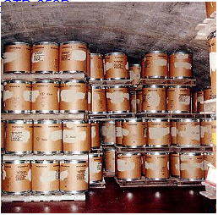
PROPELLANT
Packaging Methods
Bulk propellant is usually packaged in metal-lined wooden boxes. Bulk propellant may be temporarily packaged in fiber drums for shipment and storage for a period not to exceed six months. The maximum weight for each package is 150 pounds.
For more information on drawing numbers and specific packaging requirements inherent to bulk propellant, refer to MIL-STD-652D.

Slide 45
PROPELLANT
Propellant Stability
Propellant is not as sensitive to impact or shock as some high explosives; however, it can be easily ignited in the presence of heat or sparks.
Another potential hazard associated with nitrocellulose-based propellant is that over time, nitrocellulose tends to decompose, releasing heat. This decomposition process can cause the propellant temperature to rise to the point where it ignites - a phenomenon called autoignition.
To prevent autoignition, chemical stabilizers are added to nitrocellulose-based propellant compositions at the time of manufacture.
Examples of autoignition incidents are provided in paragraph 1-4c of the Propellant Management Guide.

Slide 46
PROPELLANT
Autoignition Concerns
Some propellant types are more likely than others to become unstable during their expected normal storage life. The following are some propellant types and their respective propensity to autoignite:
Single base propellants M10, CBI (Clean Burning Igniter), and IMR (Improved Military Rifle) exhibit the greatest likelihood of autoignition.
Note: Expulsion charges are frequently loaded with M10. CBI is found in igniter pads.
Double-base propellants are considered to be of less concern with the exception of M9.
Triple-base propellants pose a very low risk of autoignition.

Slide 47
PROPELLANT
Stabilizers
Stabilizers are chemical ingredients added to nitrocellulose-based propellant at the time of manufacture to decrease the rate of propellant degradation and reduce the probability of autoignition. Stabilizers react and combine with heat-producing nitrous oxides of decomposing nitrocellulose-base propellants in order to slow the decomposition process.
Because propellants continuously decompose, stabilizers are eventually consumed. The stabilizer content in propellant must be periodically tested to verify that the remaining effective stabilizer (RES) is not at dangerously low levels.
Commonly used stabilizers include:
Diphenylamine (DPA)
2-Nitrodiphenylamine (2-NDPA)
Ethyl Centralite (EC)
Akardite (AK)

Slide 48
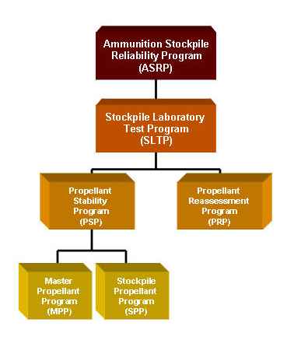
PROPELLANT
Ammunition Stockpile Reliability Program
Periodic testing of the RES in propellant is managed by the Ammunition Stockpile Reliability Program (ASRP). The SB 742-1 states:
"The Propellant Management Guide should be utilized at all installations to aid in the management of propellant stocks."
You will be provided applicable reading assignments from the Propellant Management Guide throughout this section.
One proponent of the ASRP is the Stockpile Laboratory Test Program (SLTP). The SLTP consists of the Propellant Stability Program (PSP) and the Propellant Reassessment Program (PRP). Both subprograms of the SLTP will be explained on the following pages.

Slide 49
PROPELLANT
Propellant Reassessment Program
The Propellant Reassessment Program (PRP) involves the test and evaluation of stored propellants to determine their functional serviceability prior to assembly into a major end item (i.e. during a maintenance operation).
The PRP does not apply to items intended exclusively for Research, Development, Test & Evaluation (RDTE).
Note: The propellant stability tests and propellant reassessment tests are conducted for two different purposes. Propellant stability tests are conducted for safety while propellant reassessment tests are conducted for performance. Each program operates independently of the other.

Slide 50
PROPELLANT
Loading Authorization
The results of the Propellant Reassessment test and other tests (i.e. ballistic testing), as required by higher headquarters, are used to approve loading authorization for the propellant lot. Loading authorization is required prior to assembly of the propellant into a major end item.
Loading authorization is only valid for a specific time period, normally two to five years. Loading authorizations are initially identified by a Notice of Ammunition Reclassification (NAR). All propellant lots with a current loading authorization will be listed in Appendix I of TB 9-1300-385.

Slide 51
PROPELLANT
Propellant Stability Program
The purpose of the Propellant Stability Program (PSP) is to provide propellant stability through continuous laboratory surveillance and periodic chemical analysis of stabilizer content.
The PSP is responsible for monitoring and analyzing stabilizer levels and stability trends of Army-managed nitrocellulose-based propellant lots. The PSP establishes guidelines to identify potentially unstable propellant lots in sufficient time to safely remove them from stockpiles.
The PSP is centrally managed by the surveillance office at the Joint Munitions Command in Rock Island, Illinois, and consists of the following two subprograms:
•Master Propellant Program
•Stockpile Propellant Program

Slide 52
PROPELLANT
Master Propellant Program
The Master Propellant Program requires that within six months of government acceptance, a sample of each newly produced bulk propellant lot be sent to the Propellant Surveillance Laboratory at ARDEC. This becomes the master sample and is monitored throughout the lifecycle of the propellant lot.
The stabilizer trends of the master sample are compared with samples of the same lot stored in other locations to determine potential differences in the rate of deterioration. This information is used to enhance safety and prevent the future loss of usable assets.
Master Sample
A safe interval prediction (SIP) test is performed on the master sample of each lot. The SIP test is designed to provide safe storage retest intervals for the stockpile propellant program.
Retest intervals range from 1 to 15 years based on the predicted aging behavior of the lot as determined by results of the SIP and field test samples. The safe storage and retest interval decreases over the life of the propellant, so the test frequency increases as the propellant approaches instability.

Slide 53
PROPELLANT
Test Sample Failure
If a master sample fails stability test, ARDEC notifies JMC who then decides upon either of the following actions:
•Suspend the lot and require immediate demilitarization.
Or
•Require samples of the same lot from a storage installation be tested and disposition determined based upon the test results.

Slide 54
PROPELLANT
Stockpile Propellant Program
The Stockpile Propellant Program (SPP) monitors bulk propellant, bulk-packed components, and separate loading charges.
The SPP directs the selection and testing of samples from lots in worldwide storage locations to assure that environmental effects are accounted for in determining their safe storage condition.
Not all Army propellant lots require testing under the SPP. Read the Five-Inch Rule and Items Particular to the Stockpile Propellant Program handout for more information.
The Propellant Surveillance Laboratory at ARDEC compares the test results of the SPP with the master sample and the safe interval prediction (SIP test to establish stafe storage and retest intervals for the lot. Retest intervals can range from 1 to 15 years based on the predicted aging behavior of the lot. Retest intervals tend to decrease over the life of the propellant resulting in an increase in the frequency of tests performed as the propellant nears the end of its useful life.

Slide 55
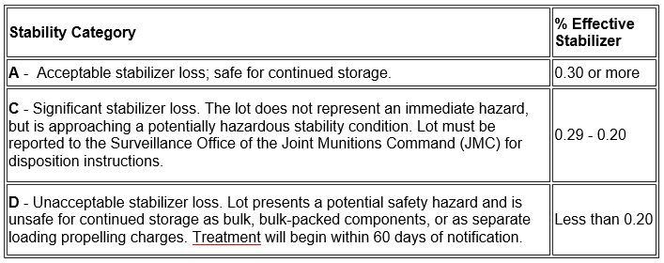
PROPELLANT
Propellant Stability Categories
Ammunition Stockpile Reliability Program
The percentage of RES determined during testing is used to assign a stability category to a propellant lot. Lot disposition is determined by the stability category assigned to that lot. The following table depicts stability categories based upon the percentage of effective stabilizer per propellant sample.

Slide 56
PROPELLANT
Propellant Stability Database
Results for all propellant lots tested under the SPP are documented in the Propellant Stability Database. The Propellant Stability Database may be accessed by visiting the following web site (password required):
https://aeps.ria.army.mil/aepspublic.cfm
Access to the Propellant Stability Database is not a requirement for completion of this course.
In various ammunition publications, the Propellant Stability Database may also be referred to as the Propellant Database or the Stability List.

Slide 57
PROPELLANT
APE 1995 (NIR Propellant Analyzer)
The Ammunition Peculiar Equipment (APE) 1995 Near Infrared (NIR) Propellant Analyzer is a portable propellant stability test set that yields immediate, on-site determination of stability levels for various propellants.
The APE 1995 gives individual installations the in-house means to immediately screen propellant for stability whenever they choose. A positive feature of the APE 1995 is that it performs non-destructive testing. No propellant is consumed as a result of this stability testing.
Formal training of operators is available through the APE Program and is arranged at the time of equipment issue.

Slide 58
PROPELLANT
Receipt and Issue
Upon receipt of propellant, verification of its stability category should be made against the Propellant Stability Database whether or not a receipt inspection is performed.
When clearing lots of propellant for shipment or issue, an annotation on the shipment planning worksheet (SPW) with the current stability category and minimum RES is required. The availability of this information on the Depot Surveillance Record (DSR) card should then be verified.
Shipment of stability category D propellant is authorized within 60 days of Category D assignment. Propellant shipped once the 60 day period expires must be carefully coordinated with the Surveillance Office of JMC. Each container shippped will require a visual inspection and the shipment must be tracked.
Propellant with unknown stabilizer levels cannot be shipped unless written approval from JMC is received.

Slide 59
PROPELLANT
Navy Gun Propellant
The history of the Navy propellant surveillance program is very similar to that of the Army. Autoignition of propellant in powder magazines aboard ships has caused the loss of several warships from the navies of various nations.
Propellants in many configurations that would be considered safe for use by the Army (such as propellant loaded in fixed rounds) have been and continue to be regularly condemned and destroyed by the Navy. Such ammunition is considered to be too hazardous for shipboard stowage.

Slide 60
PROPELLANT
Navy Gun Propellant Safety Surveillance Program
Information necessary to assure the safety of Navy propellant stocks (and the vessels upon which they are stowed) is provided to the fleet and storage installations through the monitoring and testing of all Navy propellants.
The Navy Gun Propellant Safety Surveillance Program (Indian Head, MD) produces this information through its two programs, the Master Sample Program and the Fleet Return Program.

Slide 61
PROPELLANT
Master Sample Program
The Navy maintains detailed records for each lot or index of their propellant. These records identify the final end item into which the propellant has been loaded.
The Master Sample Program of the Navy is similar to the Army program. Significant ways in which the Navy program differs from its Army counterpart are described on the following pages.
Propellant Index
The term propellant index is used by the Navy instead of propellant lot. Each index is a unique number that applies to only one lot of propellant. A propellant index is used in the same manner as a lot number.

Slide 62
PROPELLANT
Accelerated Aging Test
The Navy maintains Master Sample laboratory surveillance for many propellants that the Army Master Propellant Program ignores.
They Navy conducts the Accelerated Aging Test (AAT, "fume test") for most Navy propellants (bulk, separated, separate loading, components charge, and fixed round).
Triple-base propellants are tested for Remaining Effective Stabilizer (RES) in lieu of the AAT because of its ineffectiveness for such propellants.
Other propellants that are not constantly or routinely included in the AAT are those propellants used for any calibers below 20MM, as well as some 20MM, 25MM, 30MM, and some Navy-owned ammunition that is designed and used by the Army.

Slide 63
PROPELLANT
Low Stabilizer Propellant
The Navy takes action against major caliber ammunition that is loaded with low stability propellant. If a lot of propellant fails the fume test and that lot is loaded into an Army-owned round up to 127MM, the Army will take no immediate action against these fixed round assets (see note below). If the propellant is loaded in the same or similar Navy rounds, the fixed round lots into which that propellant is loaded will either be ordered destroyed by the Navy or a retest from fleet stocks may be ordered.
This Army policy is best explained in Paragraph 13-9a (Note) of SB 742-1:
Note: Immediate treatment directives disseminated by the Navy on Navy-specific bulk propellants or bulk-packed component charges will not apply when loaded into weapons systems smaller than five inch (127MM) that are currently in an Army ownership account, or after the items have been transferred to an Army demilitarization account. Army experience has demonstrated that uploaded propellants in such rounds have never autoignited.
.

Slide 64
PROPELLANT
Fleet Return Program
Through the Fleet Return Program, fielded stocks are tested in addition to the continuous tests of the Master Samples similar to the Army's Stockpile Propellant Program.
Like the SPP, individual samples are tested for RES. An increasing number of stabilizer tests for the Fleet Return Program have been conducted using a mobile laboratory facility in conjunction with the Mobile Ammunition Evaluation and Reconditioning Unit (MAERU) team. The mobile lab (a modified 8' X 8' X 20' ISO container) produces valid results quickly on-site, reducing the time from initial sampling to test result from several weeks to just a few days
.

Slide 65
PROPELLANT
Navy Propellant Management
The requirement for installations to maintain known stability information does not apply to Navy-tested propellants. The Navy does not routinely assign Stability Categories to its propellants. However, be assured that the Navy, through its Navy Gun Propellant Safety Surveillance Program, continues to apply effective safety surveillance to its propellant assets.
When a Navy propellant index is found to be unstable or nearing the end of its storage life, the Navy, through its chain of command, prompts a recommendation for reclassification which results in the issuance of a Notice of Ammunition Reclassification (NAR).
.

Slide 66
PROPELLANT
Notice of Ammunition Reclassification
Notice of Ammunition Reclassification (NAR) information is included in the latest version of NAVSUP P-801/TW024-AA-ORD-010, Ammunition Unserviceable, Suspended and Limited Use, which is the Navy's suspension and restriction manual. Propellant suspension information will remain a part of the publication for several years or until the Navy is confident that no traces of the propellant remain.
NAVSUP P-801/TW024-AA-ORD-010 can be found on the web by visiting the NOLSC website.
Navy propellant is considered to be hazardous waste immediately upon issuance of a NAR in which disposition instructions must be requested. Read more detailed information about NARs in Appendix E of the Propellant Management Guide.

Slide 67
PROPELLANT
Documentation
Individual storing installations are not required to post, nor do they have access to, stability levels of individual Navy propellant lots. The Navy system tells the storing installations to assume that, unless notice to the contrary is received, the propellant lot or index is stable.
When shipping Navy propellants, it is very important to check the TW0/suspense manual since this is the only source to guard against shipping unstable propellant. An annual review of all Navy propellant stocks on hand should be conducted against the TW0 and NARS as a reverse means of assuring the stability of Navy propellants.
The review of Navy-owned/Navy-tested stocks should be documented by listing each lot reviewed. Also, any lot listed not found in the TW0 or in NARs should be attested. The review should be dated and signed by the QASAS conducting the review and by the QASAS in charge.

Slide 68
Questions

