Slide 1
Fuzes

Slide 2
Learning Objectives
Identify fuzes based on ordnance and use
Identify unique hazards associated with storage and handling fuzes/fuzed ammunition
Describe packaging configurations for various fuzes/fuzed items
Identify the importance of inspection & packaging fuzes/fuzed items

Slide 3
References
TM 9-1300-200 (Ammunition General)
NAVSEA OP5 Vol 1 Rev 7
USMC Field Return and Inspection Guide
MIL-STD-1316 (Safety Criteria for Fuze Design)
TM-43-0001-28 (Artillery Data Sheets)

Slide 4
Defined
Device that detonates a munition's explosive material under specified conditions.
Typically contains a safety & arming mechanism to protect users from premature/accidental detonation.
May contain only the electronic/mechanical elements necessary to signal or actuate a detonator.
Some contain a small amount of primary explosive to initiate detonation.
Fuzes for large explosive charges may include an explosive booster.

Slide 5
Clarification
FUSE: Cord or tube for the transmission of flame or explosion usually consisting of cord or rope with gunpowder or high explosive spun into it.
FUZE: A device with explosive components designed to initiate a main charge.
Interchangeable terms; above versions are preferred.
FUZE is used to denote a sophisticated ignition device incorporating mechanical and/or electronic components
  for example a proximity fuze for an artillery shell, magnetic/acoustic fuze on a sea mine, spring-loaded grenade fuze, pencil detonator or anti-handling device
  as opposed to a simple burning fuse

Slide 6
Categorization by Munition Type
Artillery Fuze
  Tailored to function in artillery projectiles
  Projectile's initial rapid acceleration, high velocity and usually rapid rotation, affect both safety/arming requirements and options
  Target may be moving or stationary.
  May be initiated by a timer mechanism, impact or detection of proximity to the target, or a combination of these.
Hand Grenade Fuze
  Defined by the projectile's small size and slow delivery over a short distance.
  Necessitates manual arming before throwing as the grenade has insufficient initial acceleration for arming to be driven by "setback" and no rotation to drive arming by centrifugal force.
  Pyrotechnic delay detonating (HE-type)
  Pyrotechnic delay igniting (Smoke-type)

Slide 7
Categorization by Munition Type
Aerial Bomb Fuze
  Also referred to as "pistols".
  Main design consideration is the projectile is large and accelerating vertically downwards and may or may not be rotating relatively slowly.
Landmine Fuze
  Main design consideration is the device the fuze is intended to actuate is stationary, and the target itself is moving in making contact.
Naval Mine Fuze
  Design factors in naval mine fuzes are that the mine may be static or moving downward through the water, and the target is typically moving on or below the water surface, usually above the mine.

Slide 8
Categorization by Activation
Time Fuze
  Detonate after a set period of time by using one or more combinations of mechanical, electronic, pyrotechnic or even chemical timers.
  Depending on main device, fuzes may self-destruct or render itself safe without detonation, some seconds, minutes, hours, days, or months after deployed.

Slide 9
Chronology
Early fuzes were gunpowder-filled holes leading from surface to center. Burning gunpowder propellant flames ignited on firing, and burned to center during flight, then igniting/exploding filler material.
19th century devices more recognizable as modern fuzes were made of wood & trimmed to burn a predictable time after firing. Typically fired from smoothbore muzzle-loaders with large gaps between shell & barrel; relied on propellant gunpowder flame charge escaping past the shell on firing to ignite the wood fuze and initiate the timer.
Mid-to-late 19th century adjustable metal time fuzes became common, containing burning gunpowder as the delay mechanism, in conjunction with the introduction of rifled artillery. Rifled guns introduced a tight fit between shell & barrel, so could no longer rely on propellant flame to initiate the timer. The new metal fuzes typically use shock of firing ("setback") and/or projectile rotation to arm the fuze and initiate the timer; introducing a safety factor previously absent.
During World War I, mechanical, or clockwork, time fuzes were introduced for artillery by Germany.
Black match fuses like modern fireworks (infantrymen lit before throwing and hoped the fuse burned for the several seconds intended) were superseded in 1915 by the Mills bomb, the first modern hand grenade with a relatively safe and reliable time fuze initiated by pulling out a safety pin and releasing an arming handle on throwing.
Modern time fuzes often use an electronic delay system.

Slide 10
Characterization by Activation
Impact Fuze
  Impact, percussion or contact fuzes detonate when their forward motion rapidly decreases, typically on physically striking an object such as the target.
  Detonation may be instantaneous or deliberately delayed to occur a preset fraction-of-a-second after penetration of the target.
  "Superquick" (instantaneous) fuzes detonate instantly on the slightest physical contact with the target.
    Graze action fuzes will also detonate on change of direction caused by a slight glancing blow on a physical obstruction such as the ground.
  May be mounted in the shell nose ("point detonating") or shell base ("base detonating").

Slide 11
Characterization by Activation
Proximity Fuze
  Cause a warhead/projectile or other munition (e.g. air-dropped bomb or sea mine) to detonate when it comes within a certain pre-set distance of the target, or vice versa.
  Utilize sensors incorporating one or more combinations of: radar, active sonar, passive acoustic, infrared, magnetic, photoelectric, seismic or even television cameras.
    Sensors may take the form of an anti-handling device designed specifically to kill or severely injure anyone who tampers with the munition in some way (e.g. lifting or tilting).
    Regardless of the sensor used, the pre-set triggering distance is calculated such that the explosion will occur sufficiently close to the target that it is either destroyed or severely damaged.

Slide 12
Characterization by Activation
Remote detonators
  Use wires or radio waves to remotely command the device to detonate.
Barometric fuze
  Cause a bomb to detonate at a certain pre-set altitude above sea level by means of a radar, barometric altimeter or an infrared rangefinder.
[Uncommon to conventional ground ordnance]

Slide 13
Characterization by Activation
Combination Fuze
  A fuze assembly may include more than one fuze in series or parallel arrangements.
  The RPG-7 usually has an impact (PIBD) fuze in parallel with a 4.5 second time fuze; so detonation occurs on impact, but not later than after 4.5 seconds.
  Military weapons containing explosives have fuzing systems including a series time fuze to ensure that they do not initiate (explode) prematurely within a danger distance of the munition launch platform.
  The munition has to travel a certain distance, wait for a period of time (via clockwork, electronic or even a chemical delay), or have some form of arming pin/plug removed.
  Only when these processes have occurred will the arming process of the series time fuze be complete.
  Mines often have a parallel time fuze to detonate and destroy the mine after a pre-determined period to minimize casualties after the anticipated duration of hostilities.
  Detonation of modern naval mines may require simultaneous detection of a series arrangement of acoustic, magnetic, and/or pressure sensors to complicate mine-sweeping efforts.

Slide 14
Safety/Arming Mechanisms
Can be as simple as spring-loaded safety lever (M67 fragmentation grenade), which will not initiate the explosive train so long as the pin is kept in the grenade, or the safety lever is held down on a pin-less grenade.
Can be as complex as electronic timer-countdown on an influence sea mine, which gives the vessel laying it sufficient time to move out of the blast zone before the magnetic or acoustic sensors are fully activated.

Slide 15
Safety/Arming Mechanisms
Most artillery fuzes incorporate several safety features to prevent arming before leaving a gun barrel.
May include arming on "setback" or by centrifugal force, and often both operating together.
  Set-back arming uses inertia of accelerating shells to remove a safety feature as projectile accelerates from rest to in-flight speed.
  Rotational arming requires the shell reach a certain rpm before centrifugal forces cause a safety feature to disengage or move an arming mechanism to its armed position.

Slide 16
Safety/Arming Mechanisms
Aerial bombs & depth charges can be nose and tail fuzed using different detonator/initiator characteristics so crews can choose which effect will suit target conditions unknown before flight.
  Arming switch is set to one of safe, nose, or tail at the crew's choice.
Bombs, mines & projectiles may have fuzes that prevent accidental initiation (e.g. stopping rotation of a small propeller unless a lanyard pulls out a pin).
  Striker-pin cannot hit detonator even if the weapon is dropped on the ground.
  These types of fuzes operate with aircraft weapons, where the weapon may have to be jettisoned over friendly territory to allow a damaged aircraft to continue to fly.
  Crew can choose to jettison the weapons safe by dropping the devices with safety pins still attached, or drop them live by removing the safety pins as the weapons leave the aircraft.
Base fuzes are also used by artillery and tanks for shells of the 'squash head' type. Some types of armor piercing shells have also used base fuzes, as have nuclear artillery shells.

Slide 17
Safety/Arming Mechanisms
The multiple safety/arming features in the M734 mortar fuze are representative of the sophistication of modern electronic fuzes.
M734 Multi-Option Fuze shown in next slide is a rangefinder & collision detection system used on 60mm, 81mm, and 120mm mortars as a trigger to detonate at the most damaging heights of burst when combating four types of battlefield threats:
  Rangefinder electronics is a Doppler radar emitting a signal. Can be set to trigger two types of air-bursts:
    Near-surface burst to combat standing targets (NSB)
    Proximity burst downward onto prone or entrenched targets. (PRX)
  Collision detection portion consists of two mechanical devices
    Quick response electric inertial switch for a burst upon impact with a target, such as a vehicle. (IMP or PD)
    Slow response mechanical detonator that allows shell penetration, such as through a forest canopy, before detonating. (DLY)
This integration of four functions into a single fuze reduces the logistics and cost to support mortar crews on the battlefield.

Slide 18
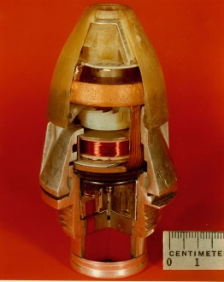
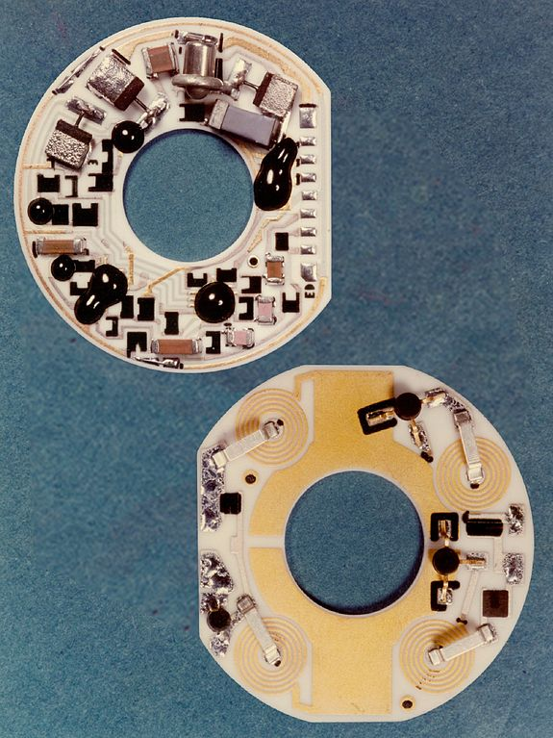
M734 Cross Section
Amplifier (top) and Oscillator

Slide 19
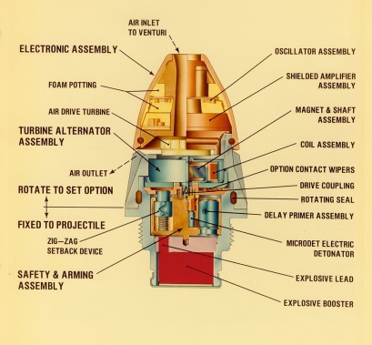

Slide 20
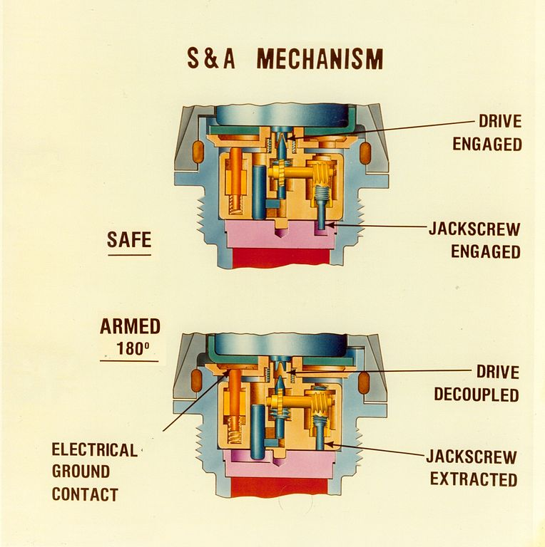

Slide 21
Firefighting
H/C-D and compatibility vary among separate-loaded & fixed-item fuzes.
  Commonly 1.1D / 1.2D / 1.4S
  Fight fires IAW standards for individual DODIC
1.1
  Do not fight unless attempting rescue
  If approved, attempt to extinguish
1.2
  Give the alarm; attempt to extinguish in early stages
  Prevent spreading of fire
  Provide protection from fragments
1.3
  Fight if explosives not directly involved
  Follow individual procedures for specific items (WP/HC/Pyro/Incend)
1.4
  Fight these fires
  Expect minor explosions & fragments

Slide 22
Storage of Fuzes
May require more quantity-distance in storage
Fuzed items likely more hazardous due to possible damage to fuze safety devices by heat & impact
Segregate individual fuzes from separate-loading projectiles
Protect fuzes from high temperatures and direct sunlight
Removal of fuze-hole plugs by hand is permitted for visual inspection of fuze cavities & liners
No distinction shall be made between loaded & fuzed projectiles, and loaded & unfuzed projectiles that have been fitted with approved plugs, provided the compatibility group requirements of OP5 or table 2-7 of NAVSEA SW020-AC-SAF-010 are met

Slide 23
Storage of Fuzes
Fuze holes shall be closed by approved fuzes or by the fuze hole plugs specified in ordnance drawings.
Compatibility group B detonators not assembled or sealed within a fuze as an integral part of the fuze shall not be stored in a magazine that contains explosive-loaded fuzes, except IAW compatibility requirements of OP5 or NAVSEA SW020-AC-SAF-010.
Storage of fuzes, primers, and similar devices should be divided among the magazines to preserve assets.
Unassembled fuzes should be stored as specified in OP5 (11-8.8):

Slide 24
Storage of Fuzes
OP5 (11-8.8)
  Store in original packing ctrs
  Shall be stored in std packing or storage ctr, or in specially designed storage blocks providing fixed-wall thickness between fuzes.
  Never store in close proximity to HE; keep away from fires, steam piping, electric apparatus, and locations susceptible to heavy shocks.
  Fuzes packed in the same container with bomb-type ammo may be stored with the bomb-type ammo that belongs to the fuzes (e.g. land mines).
  Fuzes that do not contain detonators, are integral parts of warheads, or are designed for storage in warheads may be stored in the warheads or in the magazine with the warheads.

Slide 25
Storage of Fuzes
OP5 (11-8.8 con’t)
  Fuzes assembled w/ detonators may be stored in the same magazine w/ detonators in accordance with compatibility stds.
  All ctrs shall be stacked with the tops of the boxes up; segregated by lot number & type.
  Stacks shall not exceed a height that would deform/crush ctrs on bottom layer.
  Bottom layer of ctrs shall be supported on a pallet or dunnage.
  In no case shall the base fuze be removed from a rocket warhead during magazine inspection.

Slide 26
Handling of Fuzes
Wrenches for fuzes shall not be air operated and shall not be reversible
Fuze threads may be cleaned with non-metallic brushes or alcohol
Do not rework, recondition, overhaul or modify any fuzes except by specific direction of the program manager
Projectiles shall be kept under hand control at all times so they do not bump into each other causing arming, damage, or loosening of fuzes
Loaded projectiles, whether unpacked, crated, palletized, or packed, shall be handled, transported, and sorted in a manner so as to avoid damage to fuzes
Fuzes from dropped (+5’) fixed ammunition items shall be reported to PM for disposition instructions
No attempt shall be made to disassemble any fuze unless specifically authorized by publication or PM

Slide 27
Handling of Fuzes
Fuzes are loaded with explosives sensitive to shock and friction. They are supported in trays or racks to protect them against shock.
Component ctrs should be kept in same airtight, sealed condition in which packed; expose to atmosphere for minimum periods.
Whenever a fuze or box containing fuzes is dropped from a height of 5 feet or more, the item dropped shall not be used or issued for use; segregate and report circumstances to PM with disposition instructions requested.
Mortar ammunition is considered an unusual hazard since rough handling can arm or break the fuze and explode the bursting charge.
Safety wire shall only be withdrawn from a fuze just before firing and at no other time.
Fuzes, in general, should not be dropped or rolled

Slide 28
Handling of Fuzes
Fuze hole threads shall be protected against damage.
All fuze holes shall be closed with approved plugs or closures to protect the fuze-hole threads and cavities unless the ammunition or components are boxed, palletized, or specifically exempted by NOSSA.
Precautions shall be taken to avoid defacing or marring of identification markings.
Any attempt to burn high explosives with ignition sources such as fuzes will almost certainly result in an explosion.
Treatment/disposal:
  Fuzes should be treated by detonation.
  Fuzed items, which may have internally damaged components, should not be moved but destroyed in place.

Slide 29
Additional Safety Precautions
Do not open factory-sealed and undamaged containers, unless unsafe conditions are readily noticeable.
  Sealed and undamaged inner containers can be repacked for storage.
Prior to repackaging and returning to storage, ensure that the DODIC, lot number, NSN, and quantity on the inner containers match the markings on the outer container.

Slide 30
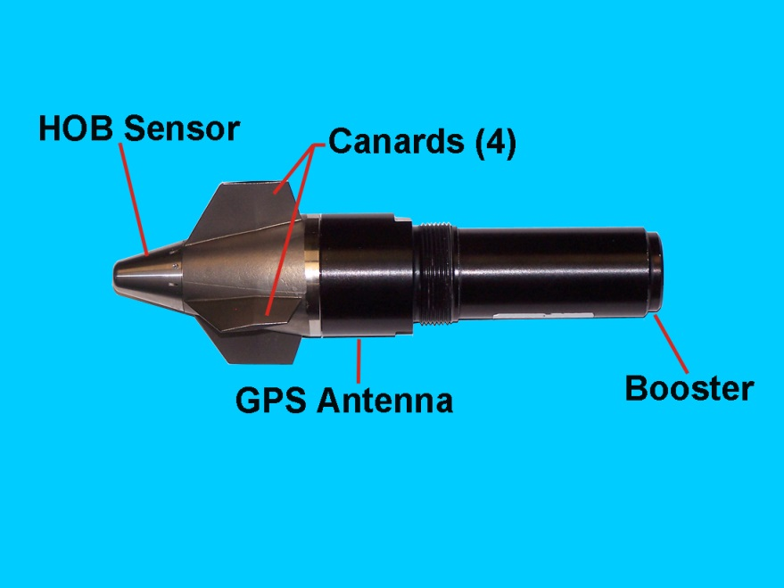
Additional Safety Precautions
(NA28)
To avoid injury to personnel, do not fire any unpackaged PGK Fuzes that are dropped more than five feet from ground height, with or without canard cover.
Containerized PGK Fuzes that are dropped more than seven feet are unserviceable and must be segregated for inspection/disposition.
Palletized PGK Fuzes that are dropped more than 40 feet are unserviceable and must be segregated for inspection/disposition.

Slide 31
Additional Safety Precautions
Practice/Training Fuzes
  N205/N209: Ensure that no “LIVE” fuzes are returned w/ the ammo. Segregate live fuzes and place in a holding area.
PD Fuzes
  N335/N340: Ensure that the fuze is set on "SQ" prior to handling. If not, place the fuze in a holding area and have the returning unit reset the fuze.
  N659: Ensure that the fuze is set on "delay" prior to handling. If not, place the fuze in a holding area and have the returning unit reset the fuze.

Slide 32
Additional Safety Precautions
Time
  N289/N290/NA15/NA17: Should be not be activated (illuminated LCD).
  NA15: Notify OIC/SNCOIC/QASO immediately if a fuze is received armed.
Proximity
  N291: Ensure that the fuze is set on "PD" prior to handling. If not, place the fuze in a holding area and have the returning unit reset the fuze.

Slide 33
Additional Safety Precautions
(120mm Mortars)
CA03/CA04: Ensure fuze is set on "120 PRX" prior to handling. If not, place in a holding area and have returning unit reset fuze.
CA45/CA46/CA49: If the fuze has been set, ensure it is set to 88.8 prior to shipping and storage. Fuze has approx 15-days service life, after 15 days fuze is deemed unserviceable.
C625/CA07: Ensure fuze is set on "S" prior to handling. If not, place in a holding area and have returning unit render ammunition safe.

Slide 34
Additional Safety Precautions
(60mm/81mm Mortars)
B642/C868: Ensure fuze is set on "PRX" prior to handling. If not, place in a holding area and have returning unit reset fuze.
B630/B643: Ensure fuze is set on "SQ" prior to handling. If not, place in a holding area and have returning unit reset fuze.
BA16: Ensure fuze is set to “60 81 PRX” prior to handling. If not, place in a holding area and have returning unit reset fuze.
B647/C484/C870/C871: Ensure fuze is set on "S" prior to handling. If not, place in a holding area and have returning unit reset fuze.
BA15/C875: Notify OIC/SNCOIC/QASO immediately if received with an armed fuze. The fuze is armed when the RED color indicator on the striker is visible.

Slide 35
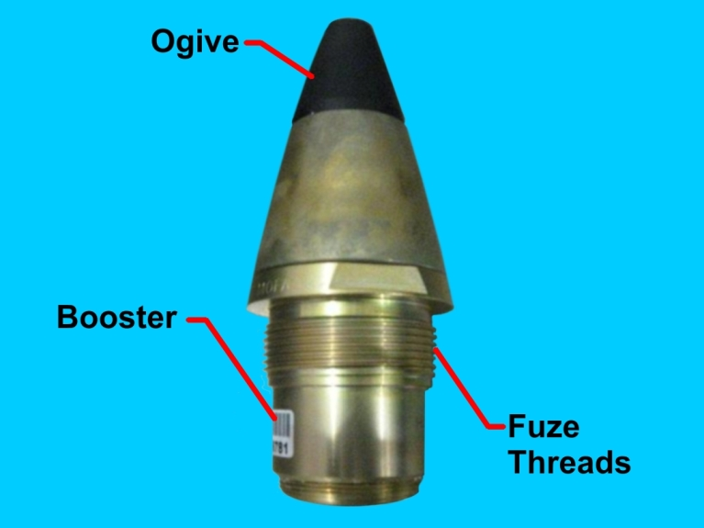
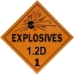
DODIC NA09
The Multi-Option Artillery Fuze (MOFA) M782A1
Compatible with all current 155 bursting-type artillery projectiles
Inductively (electronically) settable; provides electronic talkback to inductive fuze setter, so setter can verify fuze received correct mission data (mode & set time).
Four functional modes:
  Proximity mode, w/PD backup if PRX fails.
  Electronic time, settable from 0.5 to 199.9 sec in increments of 0.1 sec. Functions within 0.1 sec of set time. Provides PD backup if ET mode fails.
  Point detonation, in which fuze functions upon target impact.
  Delay, in which fuze functions approx 5-10 milliseconds after target impact.

Slide 36

DODIC NA28
Fuze, Multi-Option: Precision Guidance Kit (PGK), XM1156
Deep intrusion precision guided fuze, designed for use w/ M795 High Explosive (HE) & M549A1 High Explosive Rocket Assisted (HERA) projectiles in M777A2 155mm Howitzer.
Intended use against normal HE target sets.
Will only be set with the M1155A1 Enhanced Portable Inductive Artillery Fuze Setter (EPIAFS).
Modes include Point Detonating (PD) and Proximity (VT).

Slide 37
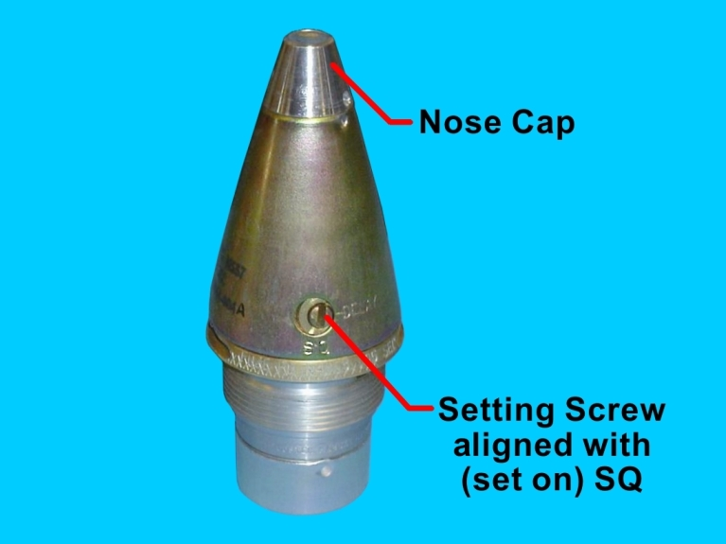
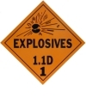
DODIC N335
Fuze, Point Detonating M557
Comprised of M48A3 fuze assembled w/ M125A1 booster.
Fuze contains M24 detonator, M54 primer, delay assembly, & intermediate charge.
Fired from 155mm M198 Medium Towed & M777 lt-wt Howitzers.
For use w/ bulk loaded HE projectiles to either detonate on impact or function after brief delay to allow a small degree of target penetration.
Mild steel ogive housing steel base & flash tube w/ aluminum head containing the detonator.

Slide 38
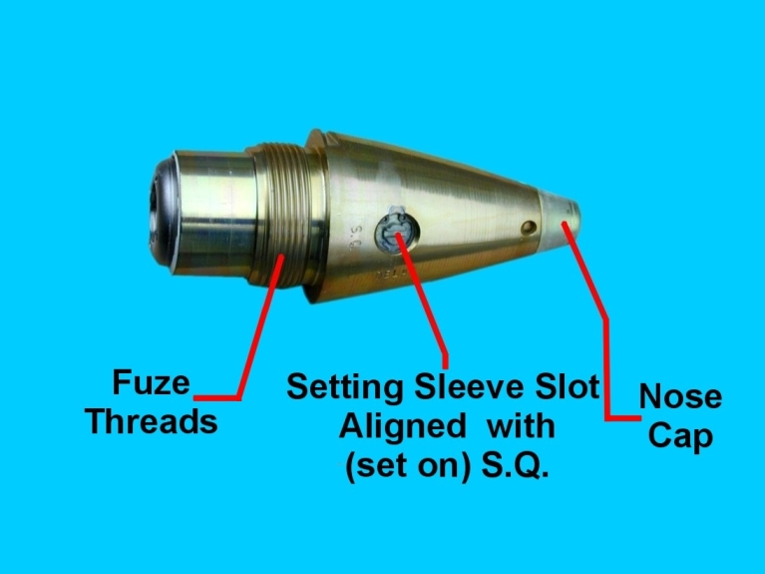
DODIC N340
Fuze, Point Detonating M739/M739A1
Latest improved version of selective impact fuzes for bulk loaded HE or burster type projectiles. Replaced DODIC N335.
Detonates on impact or functions after brief delay to allow a small degree of target penetration.
1-piece design of solid aluminum w/ 2” base matching cavity of std arty projos.
Visually consists of:
  Rain insensitive sleeve under nose cap; allows firing in heavy rain w/ reduced functioning.
  Interrupter in the side of fuze body through flash port of Detonator. Provides either SQ or DLY modes.
  M739 is bright gold anodized; M739A1 is flat olive drab.

Slide 39
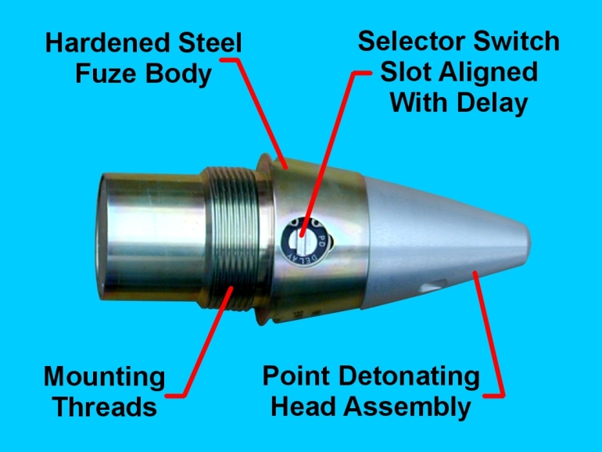
DODIC N659
Fuze, Point Detonating MK399 Mod 1
Latest selectable PD/DLY, concrete piercing, fuze for HE projos.
Supersedes N331.
PD explosive train in nose w/ hardened steel body housing a pyro delay assy & MK49 Mod 2 delay arming safety device.
Standard 2-inch threaded base.
Visually consists of:
  Hardened steel fuze body & PD head assembly
  Selector switch on the side, normally set for delay

Slide 40
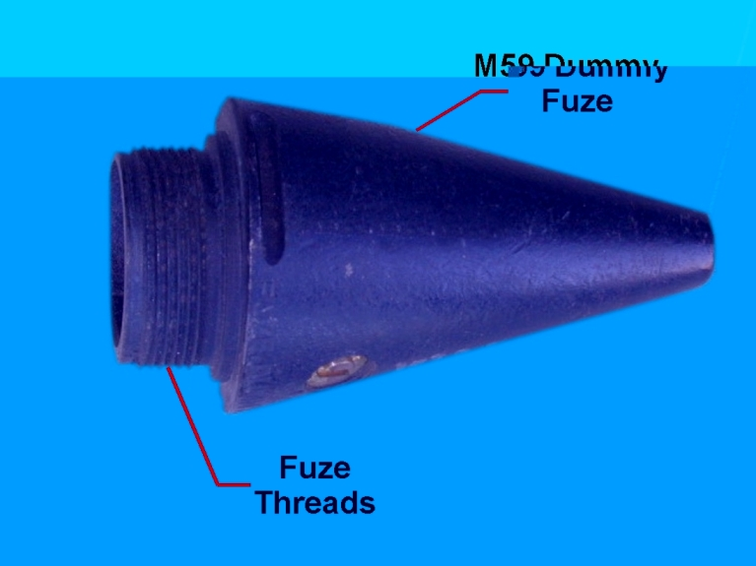
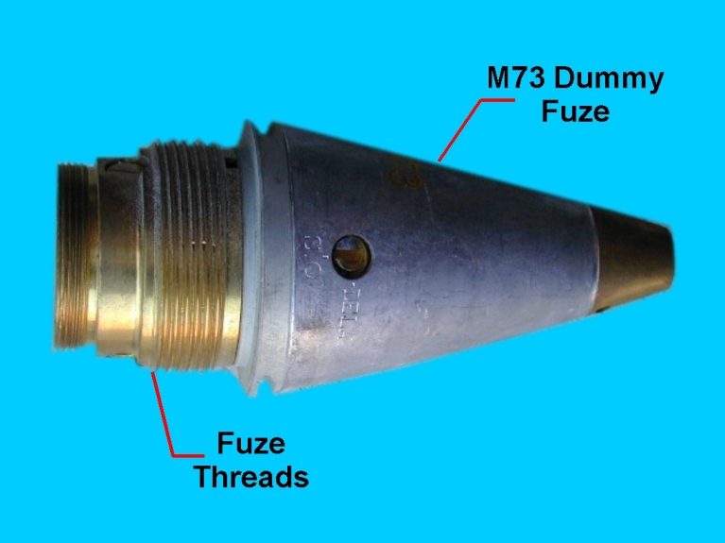
DODIC N205
Fuze, Point Detonating Dummy M59
DODIC N209
Fuze, Point Detonating Dummy M73
Dummy for M48 Series, M51 Series, M535, M557, and M572 Service Fuzes
Used on M19 series 75mm dummy cartridge.
Simulates contour/weight of M51 Series Fuzes & can be used to simulate M557/M572 Service Fuzes.
Dummy fuzes are for use with such ammunition as drill type rounds, not requiring normal, full functioning fuzes.
These fuzes are not suitable for firing.

Slide 41
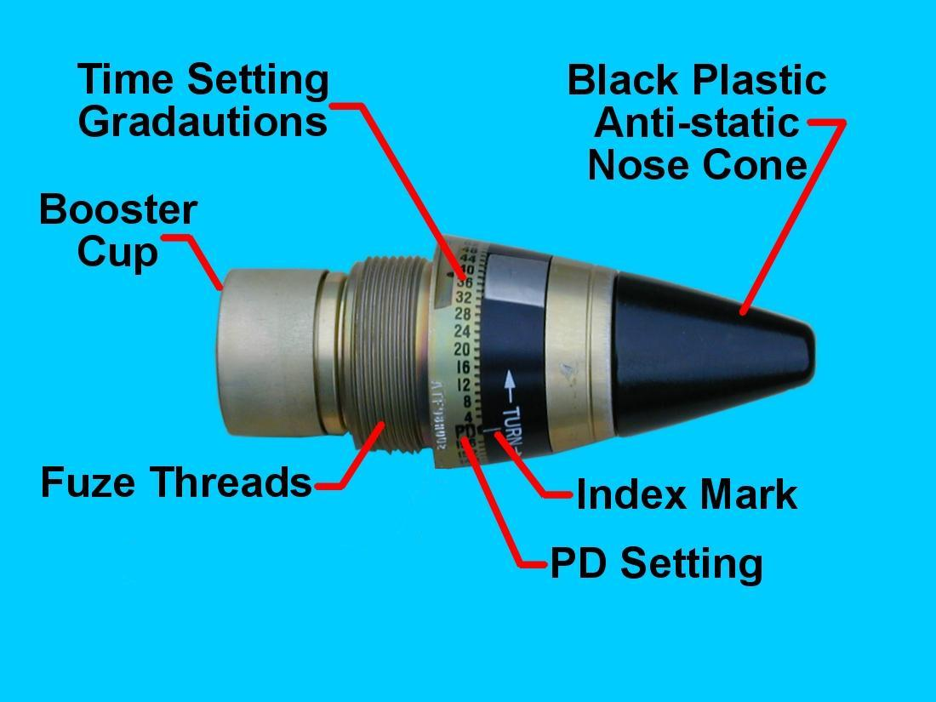
DODIC N291
Fuze, Proximity M732A2
Latest proximity fuze
Supersedes N463/N464
N463/N464 still available substitutes
  N463 preferred substitute for PWR
  N464 preferred substitute for trng
Standard 2-inch threaded base
Visually consists of:
  Time setting graduations w/ PD position on base & corresponding index mark on setting ring
  Black plastic anti-static nose cone

Slide 42
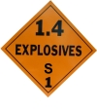
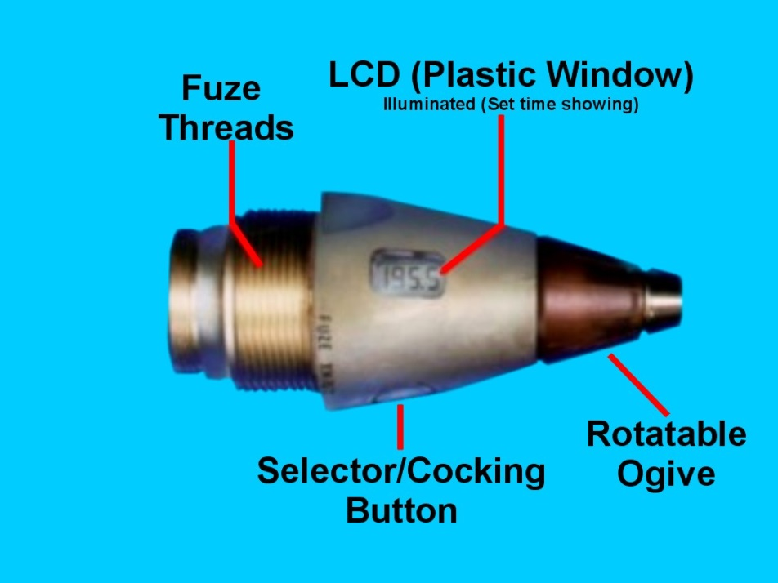
DODIC N289
Fuze, Electronic Time M762
Used w/ projos carrying payloads expelled during flight (airburst).
Fired from 155mm M198 Medium Towed & M777 lt-wt Howitzers.
Supersedes N285/N248 Mechanical Time Fuzes.
  N248 is obsolete; N285 can be substituted for N289.
Contains an electronic timing system that may be set from 0.5 to 199.9 sec in increments of tenths of a second.
When used w/ wpns equipped w/ auto-setters, fuze will be automatically remote set prior to launch via inductive comm link between fuzed ammo & wpn fire ctrl sys.
Can be hand set (w/o tool) by rotating ogive while depressing thumb-operated selector/cocking button until desired time appears in LCD window.
Reserve lithium battery powers the fuze
In time mode, safe/arming device arms at 50 milliseconds prior to set time, providings overhead safety.
When set to point detonating fuze is armed at 0.5 seconds in flight.

Slide 43
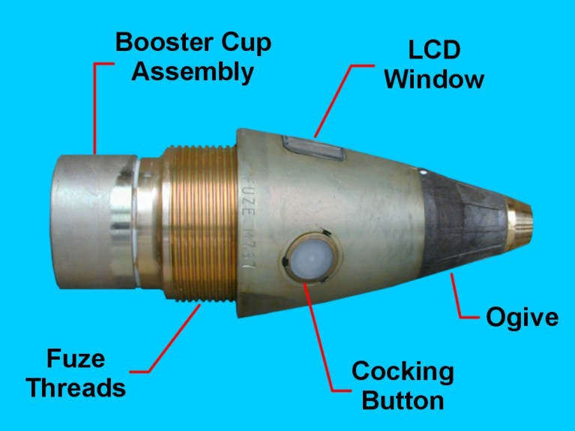
DODIC N290
Fuze, Artillery Electronic Time M767
Latest version of time fuze for bulk loaded or burster charge type projectiles.
Fired from 155mm M198 Medium Towed & M777 lt-wt Howitzers.
Supersedes N286/N278 MTSQ Fuzes, which may still be used as substitutes.
Contains electronic timing system that may be set from 0.5 to 199.9 seconds in increments of tenths of a second.
When used w/ wpns equipped w/ auto-setters, fuze will be automatically remote set prior to launch via inductive comm link between fuzed ammo & wpn fire ctrl sys.
Can be hand set (w/o tool) by rotating ogive while depressing thumb-operated selector/cocking button until desired time appears in LCD window.
Reserve lithium battery powers the fuze
In time mode, safe/arming device arms at 50 milliseconds prior to set time, providing overhead safety.
When set to PD fuze is armed at 0.5 seconds in flight.

Slide 44
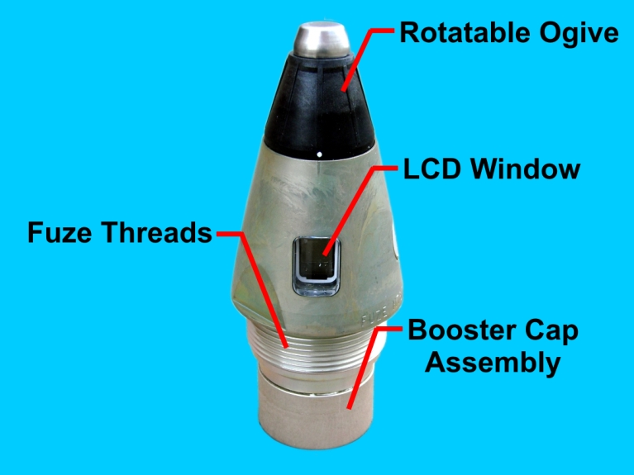
DODIC NA15
Fuze, Artillery Electronic Time M767A1
Latest version of time fuze for fragmentation (HE Loaded) and burster charge type projectiles.
Fired from 155mm M198 Medium Towed & M777 lt-wt Howitzers.
Contains electronic timing system that may be set from 0.5 to 199.9 seconds in increments of tenths of a second.
Supersedes N290.
In time mode, safe/arming device arms at 50 milliseconds prior to set time, providing overhead safety.
When set to PD fuze is armed at 0.5 seconds in flight.

Slide 45
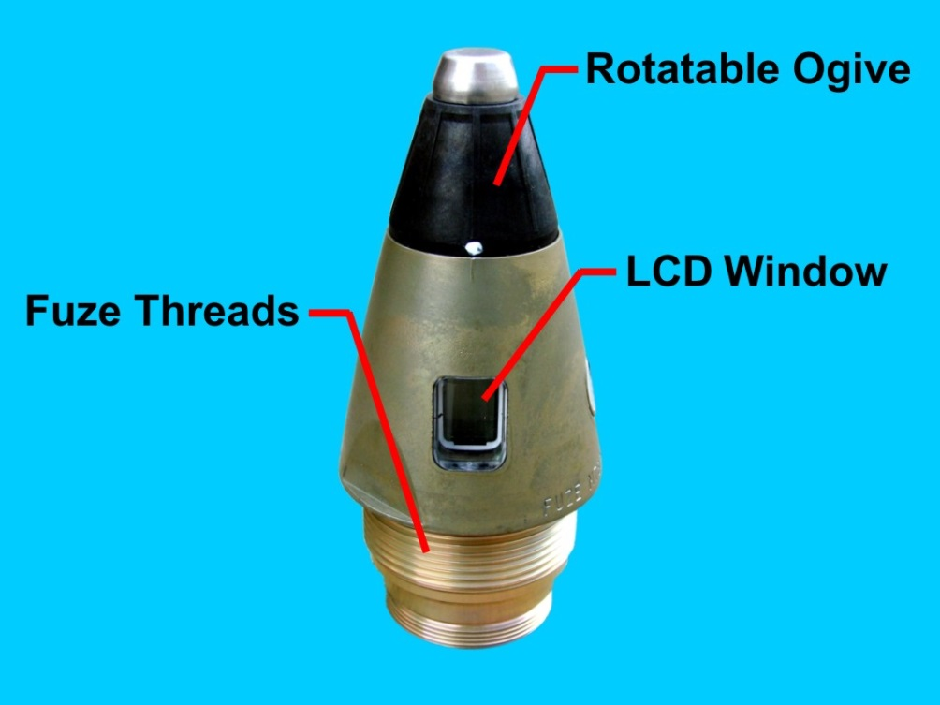
DODIC NA17
Fuze, Electronic Time M762A1
Used w/ projos carrying payloads expelled during flight (airburst).
Fired from 155mm M198 Medium Towed & M777 lt-wt Howitzers.
Contains electronic timing system that may be set from 0.5 to 199.9 seconds in increments of tenths of a second.
In time mode, safe/arming device arms at 50 milliseconds prior to set time, providing overhead safety.
When set to PD fuze is armed at 0.5 seconds in flight.
Supersedes N289.

Slide 46
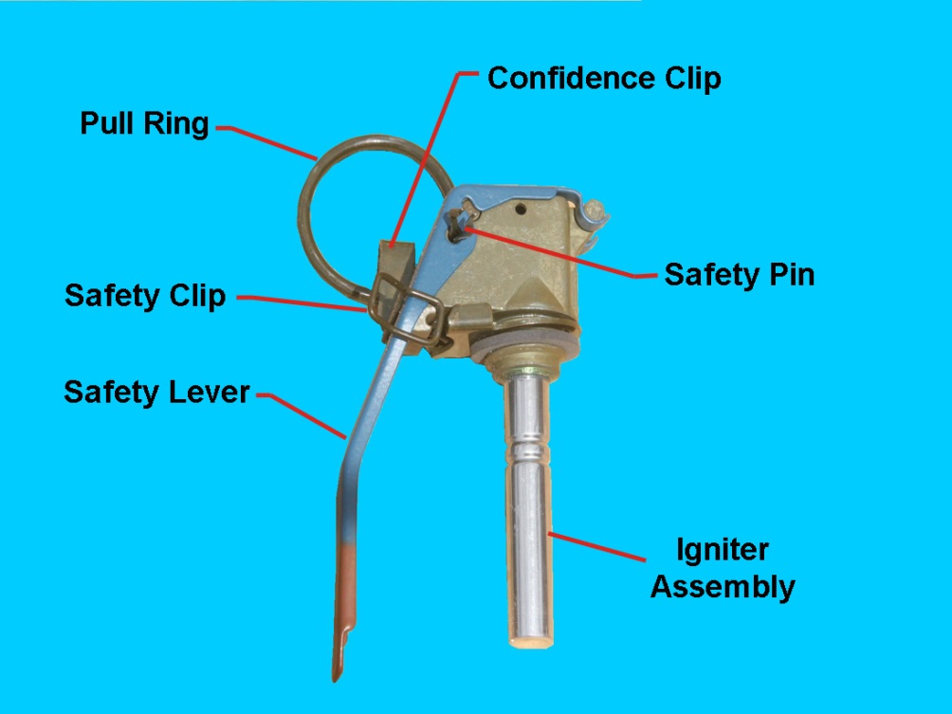
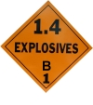
DODIC G878
Fuze, Hand Grenade Practice
M228
Pyrotechnic delay-igniting fuze,
Used w/ Grenade, Hand Practice M69 (G811).
Body contains a primer & a pyrotechnic delay column.
Assembled to the body:
  Striker
  Striker Spring
  Safety Lever
  Safety Pin w/ pull ring
  Safety Clip
  Confidence Clip
  Igniter Assembly
Split end of safety pin has angular spread or diamond crimp.
Each weighs approximately 2.5 ounces.
Later production M228 Fuzes are equipped w/a confidence clip which retains pull ring until grenade is deployed.

Slide 47
Summary
Identify fuzes based on ordnance and use
Identify unique hazards associated with storage and handling fuzes/fuzed ammunition
Describe packaging configurations for various fuzes/fuzed items
Identify the importance of inspection & packaging fuzes/fuzed items

Slide 48

QUESTIONS?

