Slide 1
DEMOLITION MATERIALS

Slide 2
DEMOLITION MATERIALS
Learning Objectives
Define and describe demolition materials used in military applications.
Determine the applications for use of demolition materials.
Recall general identification specifications for demolition materials.
Describe packaging configurations applicable to demolition materials.

Slide 3
DEMOLITION MATERIALS
Demolition materials consist of items used by the U.S. military in the destruction of earthworks, fortifications, railroads, dams, bridges, and buildings.
Demolition materials are designated by FSC 1375.

Slide 4
DEMOLITION MATERIALS
Classifications
Demolition materials may be classified by composition as explosive or non-explosive or by use as service (combat) or training.
More specifically, demolition materials may be classified according to the following types, each of which is defined on the following page.
Demolition charges
Priming and initiating materials
Demolition equipment kits
Mine clearing devices

Slide 5
DEMOLITION MATERIALS
Classifications
Demolition materials may be classified by composition as explosive or non-explosive or by use as service (combat) or training.
More specifically, demolition materials may be classified according to the following types, each of which is defined on the following page.
Demolition charges
Priming and initiating materials
Demolition equipment kits
Mine clearing devices

Slide 6
DEMOLITION MATERIALS
Demolition Charges
Demolition charges are high explosives of various sizes and shapes used as the main charge with certain detonating devices (e.g. demolition blocks used in general demolition).
These types of demolition materials may also be used in the form of charges for special mechanical apparatus such as mine clearing devices.

Slide 7
DEMOLITION MATERIALS
Priming and Initiating Materials
Priming and initiating materials consist of explosive and non-explosive, electric and mechanical equipment and accessories used to initiate demolition charges.

Slide 8
DEMOLITION MATERIALS
Demolition Equipment Kits
Demolition equipment kits are made up of selected explosive and non-explosive items, containers, and carrying attachments. They are intended for special demolition tasks.
Demolition training kits are designed for such demolition operations and mine field clearing or preparation of excavations.

Slide 9
DEMOLITION MATERIALS
Mine Clearing Devices
Mine clearing devices consist of long, slender, explosive charges and are projected into mine fields then detonated in order to clear a path through the field.

Slide 10
DEMOLITION MATERIALS
Mine Clearing Devices
Mine clearing devices consist of long, slender, explosive charges and are projected into mine fields then detonated in order to clear a path through the field.

Slide 11
DEMOLITION MATERIALS
Demolition charges are used in general demolition operations, such as cutting, breaching, and cratering. They are composed of high-velocity explosives such as RDX, PETN, Amatol, Composition B, Composition C series, TNT, and the low-velocity explosive Ammonium Nitrate. Most demolition charges are made in the form of rectangular blocks, but some are of cylindrical form (e.g. 1/4-pound TNT charge).
Recent studies show that a thin layer of explosives spread over a larger area is more efficient than a thick block of the same weight. Newer demolition charges are thinner than the older charges as well as fitted with pressure-sensitive adhesive for quick placement on practically any surface.
Demolition charges may be further classified by type as cutting and breaching, cratering, shaped charges, and dynamite.

Slide 12
DEMOLITION MATERIALS
Cutting and Breaching
Cutting and breaching type demolition charges include:
Tetrytol blocks
Compostion C2 and C3 blocks
Composition C4 blocks
TNT blocks

Slide 13
DEMOLITION MATERIALS
Tetrytol
Composed of 75% Tetryl and 25% TNT, Tetrytol blocks have a threaded cap well in each end. The threaded cap well is designed to receive a detonator, a primed firing device, or a priming adapter with an electric or non-electric blasting cap.
This type of demolition charge is brittle and is only slightly soluble in water. Each block is wrapped in olive-drab, asphalt-impregnated paper.

Slide 14
DEMOLITION MATERIALS
Composition C2 and Composition C3
Composition C2 and Composition C3 demolition block charges are plastic explosives. Plasticity of the this material permits it to be molded by hand, like putty. Confinement of it, in the case of packing it into irregular-shaped objects, gives it high demolition efficiency.
Insoluble in water, Composition C2 and C3 block demolition charges are suitable for underwater demolition. Initiation may be by detonating cord tied in a double knot, with the plastic explosive molded into a ball around the knot, or by a special blasting cap inserted into the explosive.

Slide 15
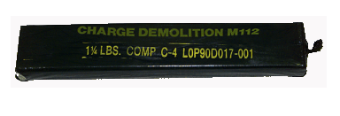
DEMOLITION MATERIALS
Composition C4
Composition C4 demolition block charges have many advantages over those made of Composition C2 of C3. Not only are they more powerful, but they may also be molded over a broader range of temperatures. They are more stable, less sticky, and less subject to water erosion when used for underwater demolition operations.
Composition C4 demolition block charges are issued in thin blocks or packed in white plastic containers with a threaded cap well in each end.

Slide 16
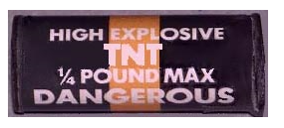
DEMOLITION MATERIALS
TNT
TNT is one of the most powerful military explosives. It has a high detonating velocity and is used in general demolitions for cutting and breaching. It can also be burned in the open in small quantities without exploding.
TNT is the benchmark for all other military explosives. Other military explosives are rated by comparing them to TNT and expressing the statistic in percent of TNT.
TNT is insoluble in water and can be used in underwater demolition operations. Unlike Composition C2, C3 and C4 block charges however, TNT blocks are unable to be molded.
TNT blocks are available in three sizes (1/4-pound, 1/2-pound, and 1-pound blocks).

Slide 17
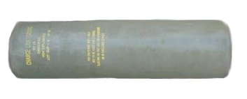
DEMOLITION MATERIALS
Cratering
Ammonium Nitrate or H-6 blocks are used in cratering-type demolition charges.
Ammonium Nitrate is the least sensitive of military explosives having a low detonating velocity unsuitable for cutting and breaching. Its low detonating velocity, however, produces a pushing or heavy effect making it well suited for cratering and ditching operations.
Illustrated in the image below is a 40-pound cratering demolition charge.

Slide 18
DEMOLITION MATERIALS
Shaped Charges
Shaped charges consist of cylindrical blocks of high explosives having a conical, metal-lined cavity at one end and a conical shape with blasting cap well at the other end.
Detonation of a shaped charge begins at the cap well and travels to the cavity. There, the detonation wave is focused to produce a narrow concentrated jet resulting in a penetration greater than that produced without the cavity.
Maximum penetration of a shaped charge is obtained when it is exploded at a certain characteristic distance, called standoff, from its target. Standoff is provided for by a fiber sleeve or metal legs supporting the charge at the time of firing.
Shaped charges are available in 15- and 40-pounds.

Slide 19
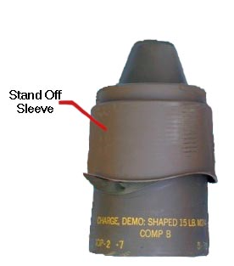
DEMOLITION MATERIALS
15-Pound Shaped Charge
The 15-pound shaped demolition charge consists of an explosive charge of Composition B and a 50/50 Pentolite booster in a moisture-resistant fiber container. This type of charge has a threaded cap well for receiving a blasting cap and adapter or any standard firing device.
A cylindrical fiber base slips on the end of the charge to hold the charge at the proper standoff distance. The cavity liner is a cone of high-density glass. This charge will pierce 36-inches of reinforced concrete. In a wall of greater thickness, it will produce a hole 30-inches deep and 2- to 3 1/2-inches in diameter.

Slide 20
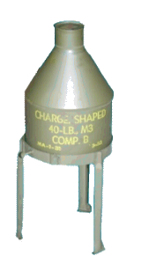
DEMOLITION MATERIALS
40-Pound Shaped Charge
The 40-pound shaped demolition charge consists of a larger quantity of Composition B than the 15-pound charge. The cavity liner is made of metal and a threaded cap well is provided for receiving a blasting cap and adapter or any standard firing device.
A metal tripod for gaging correct standoff distance is shipped unassembled, nested with the charge in the same container. This charge will penetrate 60-inches of reinforced concrete, producing a hole tapering from 5-inches to 2 1/2-inches in diameter.

Slide 21
DEMOLITION MATERIALS
Military Dynamite
Dynamite consists of cylindrical paper charges containing an RDX mixture used in construction, quarrying, and demilitarization operations. Dynamite is initiated by a blasting cap or detonating cord.
The standard size of one stick of dynamite is 1 1/4-inches in diameter by 8-inches long.

Slide 22
DEMOLITION MATERIALS
Priming and Initiating Materials
Priming and initiating materials comprise the initiating and priming components, accessories, and tools used in conjunction with demolition charges. The variety of initiating and priming components and accessories available permits considerable flexibility in the design of demolition rounds. Thus, specific demolition projects may be accomplished with the efficiency and safety appropriate to a given tactical situation. Click each term below for a definition.
Initiating Component - Initiating components receive the initiating action, such as a pull on a fuse igniter. Initiating components include time blasting fuse and igniters, firing devices, and blasting machines.
Detonators are used to combine the functions of initiating and priming components.
Priming Component - Priming components receive the action initiated by the initiating component. The action may be a flame or an electrical impulse.
Priming components include destructors, detonating cord, and blasting caps.

Slide 23
DEMOLITION MATERIALS
Types
There are a variety of priming and initiating materials, most of which will be covered in detail on the following pages. You will first learn the general category of each type of priming and initiating material, then you will learn the subcategories that follow.
Priming and initiating materials consist of:
Blasting caps Time blasting fuse Igniters Firing devices
Blasting machines Detonating cord Accessories

Slide 24
DEMOLITION MATERIALS
Detonators
Detonators are explosive devices sensitive to mechanical initiation. They are used to detonate explosive charges and combine the functions of firing devices and blasting caps in a single unit.
Detonators may or may not incorporate a time-delay mechanism.

Slide 25
DEMOLITION MATERIALS
Explosive Destructor
Explosive destructors are used to adapt ammunition and other explosive material which cannot be reliably detonated by special blasting caps. Explosive destructors are used in demolition work, booby-traps, and improvised mines. Explosive destructors are also used to destroy deteriorated or abandoned ammunition.

Slide 26
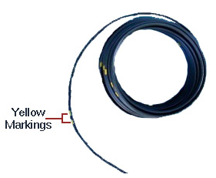
DEMOLITION MATERIALS
Time Blasting Fuse
Time blasting fuse is used to transmit a flame from an igniter to a non-electric blasting cap or other explosive charge.
One end of a strand of time blasting fuse is crimped to the flared end of a blasting cap while the other end is assembled to an igniter. The burn rate of a strand of time fuse depends upon the length of the fuse. The longer the fuse, the longer the time delay before initiation of the the blasting cap. The time delay is necessary to allow personnel to initiate the firing system and retire to a safe distance before detonation.
The most common type of time blasting fuse is the M700, illustrated in the image at right.

Slide 27
DEMOLITION MATERIALS
M700 Time Blasting Fuse
The M700 time blasting fuse is approximately .20-inches in diameter and consists of a black powder core wrapped in several layers of fiber. It has a dark green, smooth plastic outer covering for waterproofing purposes. The outer covering of this type time fuse has a single yellow band at 1-foot or 18-inch intervals and double yellow bands at 5-foot or 90-inch intervals, depending upon the time of manufacture.
The burn rate for the M700 time fuse will vary by each roll of issue. In order to determine the exact burn rate for a particular roll of M700 time blasting fuse, a test burn must be performed.

Slide 28
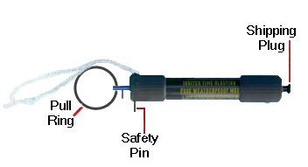
DEMOLITION MATERIALS
Time Blasting Fuse Igniter
Time blasting fuse igniters are initiating components used to light time blasting fuse.
Time blasting fuse igniters may be of either friction or weatherproof type. Those of friction type consist of a paper tube containing friction powder. Weatherproof type igniters, such as the M60 illustrated below, consist of a barrel holding a firing mechanism and a coupling base that contains a percussion cap primer. Plastic sealing material is used to waterproof the joint of the time blasting fuse and fuse igniter. This type igniter will ignite the smooth surface fuse under any weather condition, even under water.

Slide 29
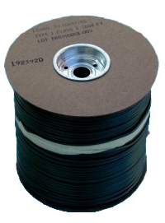
DEMOLITION MATERIALS
Detonating Cord
Detonating cord is used to prime and detonate other explosive charges. It will transmit a detonating wave at a rate of at least 5,900 meters-per-second.
Detonating cord has a core of PETN, which is a boostering explosive with a high rate of detonation. This core of white PETN is encased in a seamless textile tube that is covered with a thin layer of asphalt and sheathed in an outer covering of plastic coated textile. This outer surface is smooth and is olive-drab in color.
Detonating cord is initiated by a blasting cap. When initiated, it will explode over an entire length and detonate any properly connected demolition material.

Slide 30
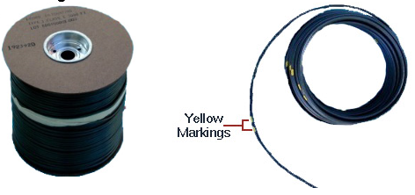
DEMOLITION MATERIALS
Comparing Time Blasting Fuse and Detonating Cord
WARNING: Never confuse detonating cord with time blasting fuse. Detonating cord will ignite instantaneously upon impact of a blasting cap.
Both detonating cord and time fuse are olive drab in color, but time fuse has a black core (black powder) and detonating cord has a white core (PETN). Also, time fuse has single and double yellow markings on the outer surface while detonating cord does not.
CAUTION: To avoid problems with moisture infiltration, never use the first or last six inches of detonating cord.

Slide 31
DEMOLITION MATERIALS
Firing Devices
A firing device is designed to initiate a train of fire or detonation of demolition charges, booby-traps, or mines principally by initiation of a non-electric blasting cap or a mine activator. A common type of firing device is the detonating cord firing device.
More information on this type of demolition item may be found in paragraph 2-47 of FM 3-34.214, although it is beyond the scope of this course.

Slide 32
DEMOLITION MATERIALS
Blasting Caps
Blasting caps are used to initiate explosives. Blasting caps are composed of a thin, tubular metallic shell and are about 2 1/2-inches long and 1/4-inch in diameter. They are filled with small charges of sensitive high explosives.
The two types of blasting caps are the M7 nonelectric (illustrated at bottom left) and the M6 electric (illustrated at bottom right).

Slide 33
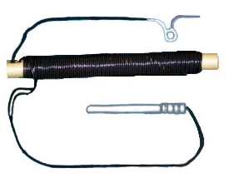
DEMOLITION MATERIALS
M6 Electric Blasting Cap
The M6 electric blasting cap contains an electric bridge wire with two 12-foot lead wires embedded in the ignition charge. The lead wires extend through a rubber plug in the open end of the cup assembly.
To function this type of blasting cap, an electric current flows through the bridge wire creating sufficient heat to ignite an ignition charge. The M6 electric blasting cap would be used in conjunction with a blasting machine.

Slide 34
DEMOLITION MATERIALS
M7 Nonelectric Blasting Cap
The M7 non-electric blasting cap is usually crimped to time blasting fuse. In order for the M7 non-electric blasting cap to function, a length of time fuse is inserted into the open end of the cap in such a manner that the cut end seats firmly against the ignition charge.
The cap is crimped to prevent movement of the time fuse while the other end is ignited by use of an igniter.

Slide 35
DEMOLITION MATERIALS
Modernized Demolition Initiators
MDI is the project name given to a new family of non-electric blasting caps, non-electric boosters, and associated items. MDIs supplement and partially replace the M7 non-electric blasting cap, the M6 electric blasting cap, and the M700 time fuse. The snap together MDI components simplify initiation systems and some types of explosive priming.
MDIs also improve reliability and safety.

Slide 36
DEMOLITION MATERIALS
Accessories/Tools
Accessories/tools used in accordance with priming and initiating materials include:
Priming Adapter
Detonating cord clip
Waterproof blasting cap sealing compound
Electric wire and cable
Blasting galvonometer
Blasting machine
Cap crimper
On the following page, you will be provided with a brief definition of each. Information beyond the scope of this course may be found in both the TM 9-1300-200 and FM 3-34.214.

Slide 37
DEMOLITION MATERIALS
Demolition Kits
Demolition kits contain explosive and non-explosive items used in performing various demolition tasks. Some kits are designed for general demolition, while others are designed for specific demolition tasks.
Demolition kits include accessories, tools, and other specialized components in specially designed containers. A common type of demolition kit is the Bangalore Torpedo Kit, discussed in more detail on the following page.

Slide 38
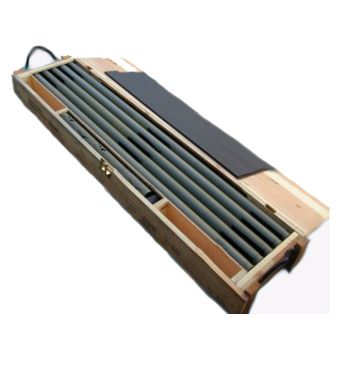
DEMOLITION MATERIALS
Bangalore Torpedo Kit
The Bangalore torpedo demolition kit is composed of single, high-explosive filled steel tubes of multiple lengths with connecting sleeves. It is used for blasting a path through wire entanglements or other obstructions.
This particular kit consists of 10 loading assemblies (each is a five-foot long steel tube filled with explosives), ten connecting sleeves, and one nose sleeve.

Slide 39
DEMOLITION MATERIALS
Mine Clearing Devices
Mine clearing devices (sometimes referred to as projected charges) are used to clear paths for maneuvering forces through minefields, wire entanglements, and various other types of obstacles or obstructions.
Mine clearing devices consist of line charges ranging in length of up to 400-feet. They are capable of clearing paths large enough to accommodate foot troops, military vehicles, and tanks.
A common mine clearing device is the Mine Clearing Line Charge (MICLIC). The MICLIC is a 5-inch rocket motor that projects an explosive line charge across the target. The line charge is 350-feet long and is filled with Composition C-4.

Slide 40
DEMOLITION MATERIALS
Demolition Materials Identification
Demolition materials and associated accessories are marked in accordance with specifications outlined in appropriate military publications. Detailed marking information may be found in the respective page of a demolition material item in the TM 43-0001-38, Datasheets for Demolition Materials.
On the following page, you will be introduced to some of the general marking specifications for demolition material items.

Slide 41
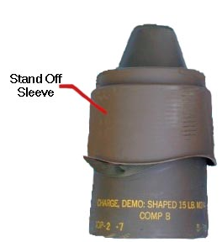
DEMOLITION MATERIALS
Marking
Demolition material containers and packaging are stenciled with markings that include all information required for complete identification of its contents as well as for handling, storage, and use. This information might include the nomenclature of the item (e.g. model number, explosive filler) as well as lot number.
In the image of the shaped demolition charge at right, it is visually identifiable that this type charge is a 15-pound shaped charge filled with Composition B filler.

Slide 42
DEMOLITION MATERIALS
Demolition Materials Packaging
Packaging configurations for demolition material items and associated accessories vary by the respective items specifications and requirements for packaging and storage, handling, and transportation. Specific packaging requirements for demolition materials may be found in the TM 43-0001-38, Datasheets for Demolition Materials.
On the following pages, you will be introduced to a variety of packaging specifications for types of demolition materials.

Slide 43
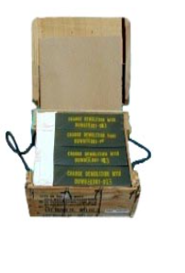
DEMOLITION MATERIALS
Composition C4 Demolition Block Charges
Composition C4 demolition charges are packaged and enclosed in a plastic envelope which is then enclosed in a wooden box.

Slide 44
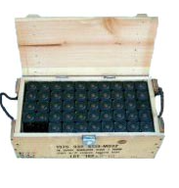
DEMOLITION MATERIALS
TNT Demolition Block Charges
TNT demolition block charges are packaging inside wooden boxes.

Slide 45
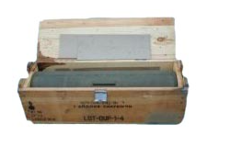
DEMOLITION MATERIALS
Cratering Charge
Cratering demolition charges are packaged in wooden boxes.

Slide 46
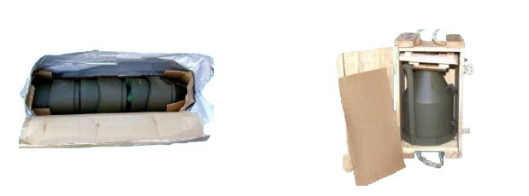
DEMOLITION MATERIALS
Shaped Charge
15-pound shaped demolition charges are packaged inside a cardboard box, which is then housed in a barrier bag as illustrated in the image at the bottom left. 40-pound shaped demolition charges are packaged in a wooden box as illustrated in the image at the bottom right.

Slide 47
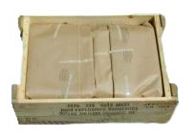
DEMOLITION MATERIALS
Dynamite
Sticks of dynamite are packaged inside waterproof bags then placed in wooden boxes.

Slide 48
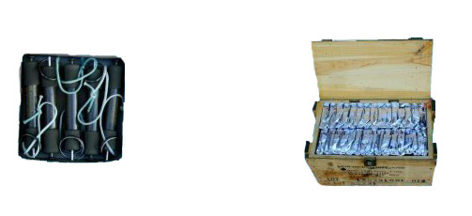
DEMOLITION MATERIALS
Igniter
Five igniters are packaged inside a cardboard carton (illustrated at bottom left), then sealed in a barrier bag. A series of barrier bags are then enclosed in a wooden box (illustrated at bottom right).

Slide 49
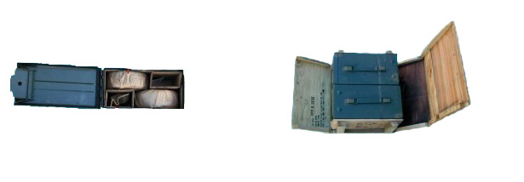
DEMOLITION MATERIALS
Time Fuse
Time blasting fuse, particularly of model M700, is enclosed in a paper wrapping which is then housed inside a metal can (illustrated at bottom left). Two metal cans are then packaged per wooden box (illustrated at bottom right).

Slide 50
DEMOLITION MATERIALS
Detonating Cord
Detonating cord is packaged wrapped around a spool and then enclosed in a cardboard box (illustrated at bottom left). The cardboard box is then sealed in a barrier bag which is packaged in a wooden box (illustrated at bottom right).

Slide 51
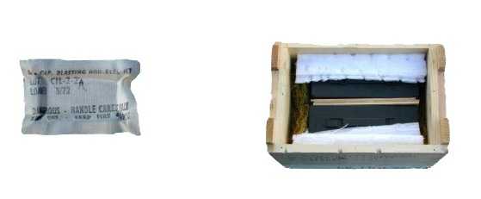
DEMOLITION MATERIALS
Non-electric Blasting Cap
The M7 non-electric blasting cap is packaged inside a cardboard carton which is enclosed in a barrier bag. A series of barrier bags are then packaged into a metal can and then a wooden box.

Slide 52
DEMOLITION MATERIALS
Electric Blasting Cap
The M6 electric blasting cap is wound around a cardboard tube which is housed in a metal can. A series of metal cans is then enclosed in a wooden box.
There are ten M6 electric blasting caps per metal can and four metal cans per wooden box.

Slide 53
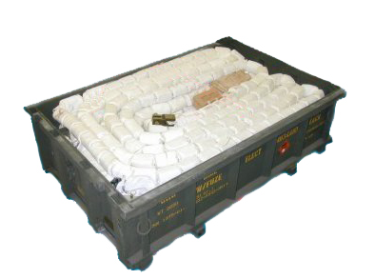
DEMOLITION MATERIALS
Mine Clearing Line Charge
The Mine Clearing Line Charge (MICLIC) is stored in a pallet which can be transported on a trailer.

Slide 54
Questions

