Slide 1
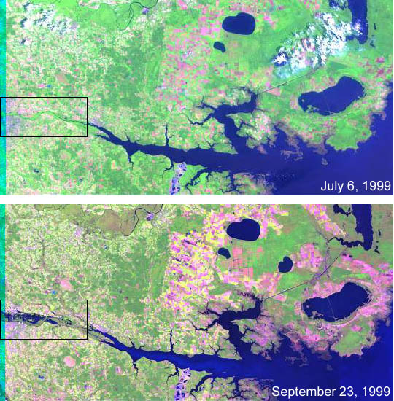
Stormwater pollution Prevention Plan
Stormwater Pollution Prevention Plan 2018

Slide 2
Over View
SWPPP
A stormwater pollution prevention plan (SWPPP) is a fundamental requirement of stormwater permits.
  Identifies all potential sources of pollution which may reasonably be expected to affect the quality of stormwater discharges to the environment.
  Describes practices to be used to reduce pollutants in stormwater discharges.
  Helps assure compliance with the terms and conditions of the permit (when the plan is designated for the individual site, and is fully implemented)
  Updated annually

Slide 3
Your responsibility
RESPONSIBILITES
Inspect:
  Barracks
  Parking lots/garages
  Work spaces
  Report
  Document

Slide 4
What’s inspected
Area’s Inspected
Above Ground Storage Tanks (AST)
Oil and Waste Separators (OWS)
Exterior Vehicles/Equipment Storage Areas
Stormwater inlets
HM Storage areas
Solid Waste storage areas
Parking Lots
Barracks Lots
Common Areas

Slide 5
What’s inspected
ESWPPP Maps
Will be given to all ECO’s to help facilitate inspections.
Shows areas that could impact the environment
Visually shows all assets and media within each area.

Slide 6
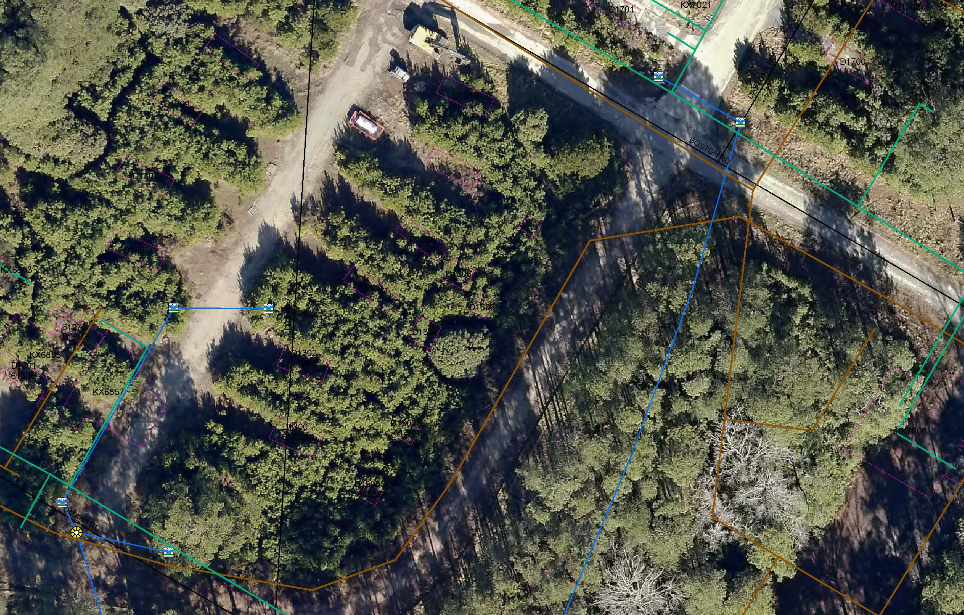
What’s inspected
Maps

Slide 7
The Summary page
Areas Identified on the ESWPPP

Slide 8
Spill response
Spill Readiness
Mapping provides information for where the spill occurred and what impact it could have on the environment.
Gives street names and locations in order for First Responders to locate the area. Also provides what types of additional media is in the area.
Shows streams, rivers and any type of waterway a spill could affect.

Slide 9
Spill response
Summary
The ESWPPP will provide EMD and the ECO’s the opportunity to track and verify all media located within their areas.
If you have questions or concern contact EMD at 910-451-9657.

