Slide 1
Storage of a&e

Slide 2
STORAGE OF A&E
There are 3 common forms of storage of A&E.
1. Permanent Storage (ASP)
2. Range Storage (is the staging of A&E on a specific range or training area in support of the weapons being used on that range or a training area)
3. Field Storage (intended for temporary storage of A&E for training and contingency operations)

Slide 3
FIELD STORAGE
MCIEAST-MCB CAMLEJO 8020.1
Field Storage exceeding 5 days requires approval from the Base Commanding Officer.
Submit request NLT 15 Days prior to exercise.
2-5 days prior to the exercise, confirm with the ESO that the events of the exercise are still happening.

Slide 4
FIELD STORAGE
Area map. Location(s) must meet explosives safety quantity distance requirements (i.e. inhabited building, public traffic routes)
An SOP must be established, tailored for the A&E operations being conducted. Containing, Security plan, communication plan, transportation and safety measures.
A storage plan: including Site diagram, DODIC, Qty, Hazard Cass/Division, compatibility group, and N.E.W. of each A&E item to be stored..

Slide 5
FIELD STORAGE
Inventory Control procedures must be implemented.
Adequate Firefighting equipment must be readily available.
Appropriate Qualification/Certification levels to support the field storage operation.

Slide 6
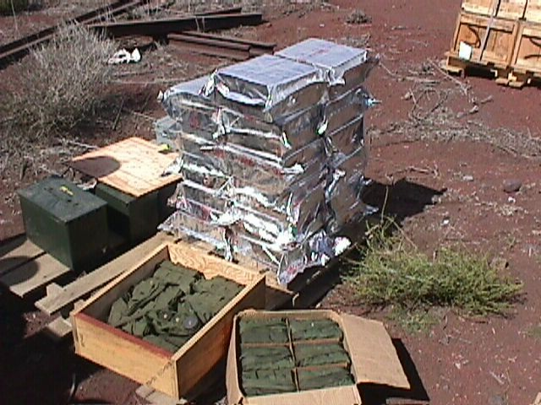
Excessive Breakouts
Officers in Charge must ensure that only the A&E that will be expended is unpackaged .
Excessive A&E breakout is not authorized!
Only open the items you intend to fire at that particular time.

Slide 7
Questions

