Slide 1
MCB Camp Lejeune RANGE CONTROL BRIEF

Slide 2
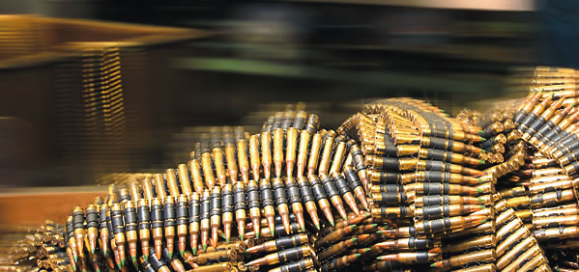
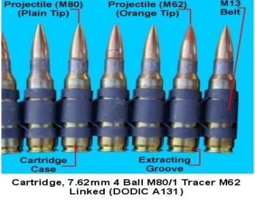
range control
Situation
The importance of attention to detail and avoidance of complacency when using weapons/ammunition and pyrotechnics in garrison /training areas/live fire ranges as part of tactical environments is paramount.
You will be held Accountable!
You are Responsible!
It is a Command Responsibility!
Notes:
APP D-3

Slide 3
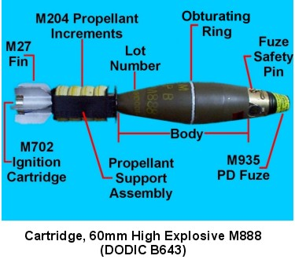
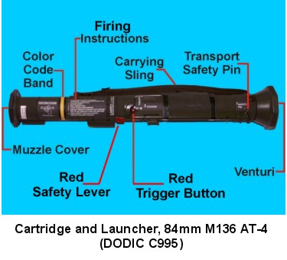
range control
Objective
Apply RISK MANAGEMENT (RM) to all Weapons, Ammunition, Pyrotechnics, and Range Operations at all times for ACCIDENT PREVENTION.
Know your Marines/Sailors, Watch after them.
If it can Happen, it will Happen, and most likely it has Happened Already Once Before!
Notes:
APP D-5

Slide 4
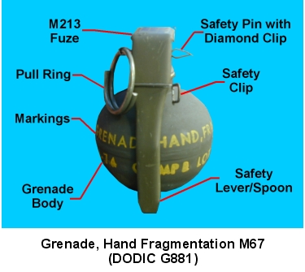
range control
Reasons for Error
The major underlying reasons for errors related to all accidents and injuries on live fire ranges are:
Lack of self-discipline.
Failure to enforce standards/polices.
Inadequate or lack of training.
Inadequate supervision.
Inadequate planning.
Common Sense/Leadership/Supervision is a must!!
Notes:
APP D-7

Slide 5
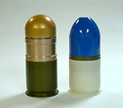
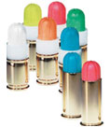
range control
Weapons
Most common injury-producing areas in handling of weapons/ammunitions.
Failure to follow proper procedures.
Improper or inadequate clearing.
Untimely loading/unloading.
Personnel in the path of the recoil or back blast.
Failure to enforce standards.
Handling weapon /ammunition improperly.
Notes:
APP D-7

Slide 6
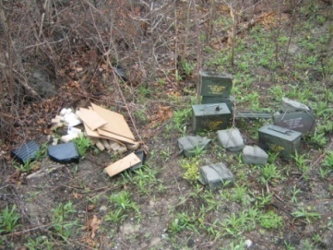
range control
Range Safety/Ammunition Safety
Blank Ammunition Safety (BFAs)
Camp Pendleton Situation (Twice) Live Ammunition on Blank Fire Event
Keep Blank Ammunition and Live Ammunition Separate
(Shake Down/Check/Recheck and Supervise!)
Training Devices/Pyrotechnics Safety
SESAMS/SIMUNITION Safety
Ammunition/Weapon Security at all times
Crew Served Weapons/Stock Weapons/LTIs/PFIs
Repacking Ammunition

Slide 7
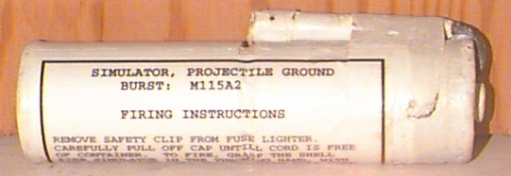
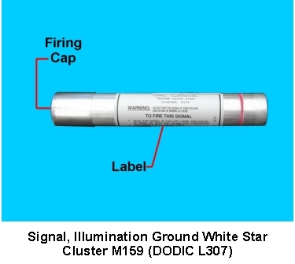
range control
Pyrotechnics
Most common injury-producing areas in the handling of ammunition & pyrotechnics is failure to properly observe safety features.
Improper safety procedures.
Improper attention to detail.
UXO/Simulators.
Hazards/Controls.
Double Check/Supervise

Slide 8
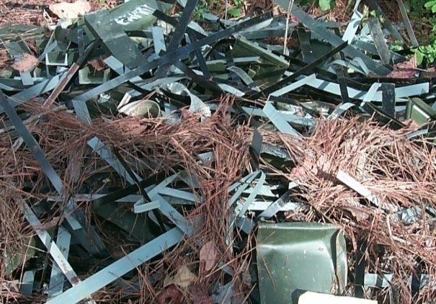
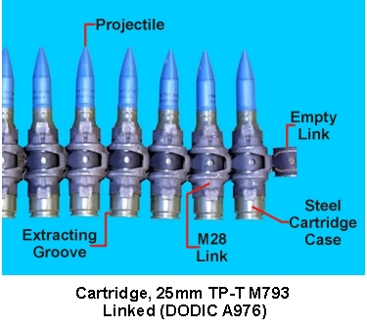
range control
Policy
The safe conduct of Marines training, firing, detonating explosives and live fire maneuvering on ranges and training areas is a command responsibility.
Surface Danger Zones (SDZs) (Ground Only)
Weapons Danger Zone (WDZs) (Air Only)

Slide 9
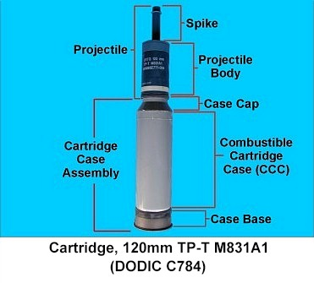
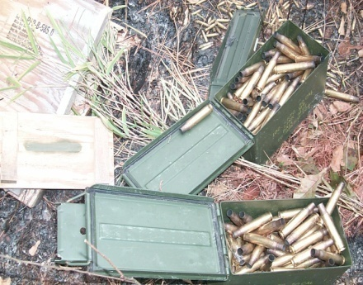
range control
References
MCO 3570.1C, DA PAM 385-63
MCIEAST-MCB CAMLEJO 3570.1A with Change 3 (Range Control SOP)
Laser Safety, MCO 5104.1C
ORM Order, MCO 3500.27C
RTAM Quantico Pocket Guide, Range Safety

Slide 10
range control
Requirements
MCO 3570.1C/DA PAM 385-63 and the MCIEAST-MCB CAMLEJO 3570.1A with Change 3 (Range Control SOP) prescribes the Marine Corps and Camp Lejeune Range Safety policies, procedures, responsibilities, and standards for firing all ammunition, lasers, guided missiles, rockets, and provides guidance for the application of risk management in range operations.
Notes:
APP D-7

Slide 11
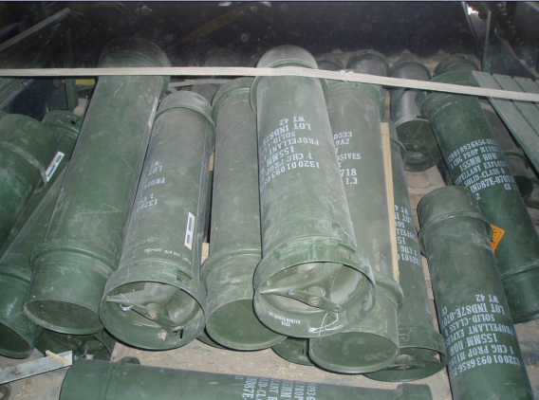
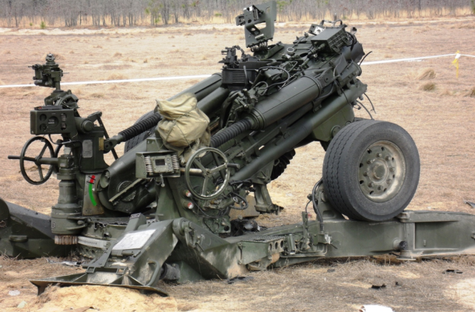
range control
Reporting
Accidents and Ammunition Malfunctions will be reported IAW
MCO 5102.1B with Change 2 (Mishap/Safety)
MCO 8020.10 (Ammo/Expl Safety)
NAVMC 10155 (Ammunition Malfunction Data Collection Guide)

Slide 12
range control
General Comments
POV’s in the Field/on the Ranges, it is not authorized.
Trash/Garbage/Ammunition Dunnage (Police it up).
Communications with Blackburn. 34.70, 451-3064/4449
Range Inspectors, Duties/Functions.
Port-A-Johns, Trash/Ammunition Dunnage.
Notes:
APP D-7

Slide 13
range control
Dummy/Inert Ammunitions (Demo).
Extra Ammunition/Mad Moments/Trash Shots
Impact Areas, Burying Ammunition .
Request for Base EOD Support.
Vehicle safety, speed limits, cargo/loads (Think Safety).
Live & Blank Ammo (Segregation) Must Check!

Slide 14
range control
Reporting ammunition expended To Blackburn/ Range Control.
Expenditures Reports (Must Complete).
Dumpsters (Ammunition Dunnage).
ROIC and RSO Functions

Slide 15
range control
Risk Management (RM)
Hazards | Causes | Controls | Risk Assessment
A Marine getting shot | Improper weapons employment | Proper training, knowledge of left and right lateral limits, safety brief, and supervision. Gunners will be told to keep weapons pointed down range. | Moderate
Personal Injury | Improper weapon function | Proper PFIs before firing and inspection of weapon by gunner prior to going down range each time | Moderate
Injury to others | Ammo in weapon when returning to start point | Proper brass check to ensure weapon is clear | Moderate
POVs entering range area while conducting training | Disregard for posted signs, gates, and road guards | Locked gates. Check for POVs every morning before going hot. | Low
Hearing damage | Decibels exceeding normal range | Hearing protection | Low
Sunburn/ Dehydration | Lack of water, improper rest, improper gear | Proper supervision, training, gear checks(full canteens, sunscreen, utilities, rest breaks | Low
Notes:
APP D-4

Slide 16
range control
DELINKING
MCIEAST-MCB CAMLEJO 3570.1A with Change 3 dated 29 Jan 18
(Range Control Order)
During fire conditions 5 and above units are restricted from delinking ammunition.

Slide 17
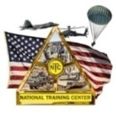
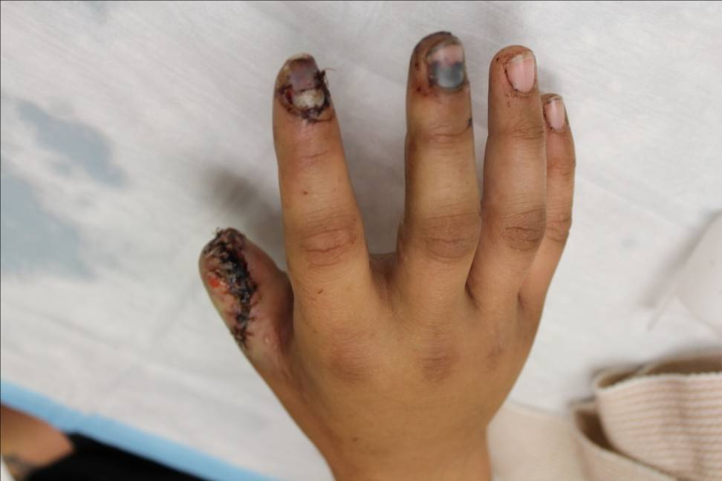
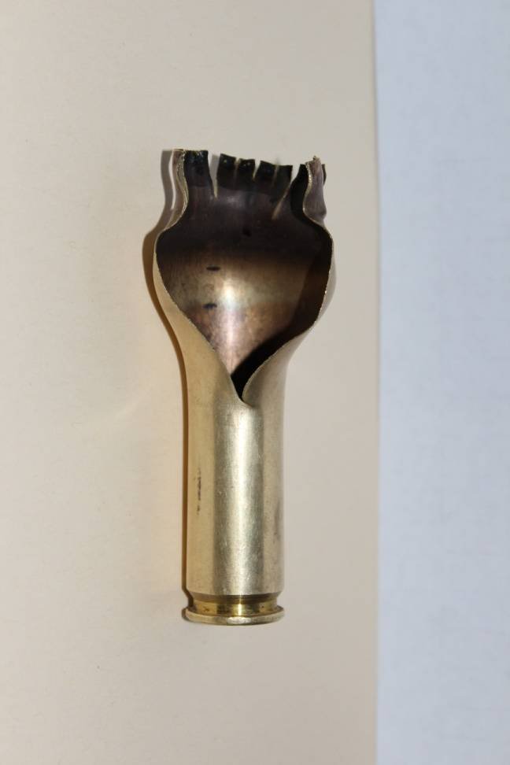
SAFETY ALERT
S
A
F
E
T
Y
A
L
E
R
T
S
A
F
E
T
Y
A
L
E
R
T
OUTLAW O1 SENDS
30 APRIL 2012
25 MAY 2012
ENSURE WIDEST DISSEMINATION
FILE PHOTO
14 MAY 2012: A Soldier struck an unexpended blank 50 cal round against the top right handle of a M2 Machine Gun. The round detonated resulting in the partial amputation of right distal thumb and injury to index and middle fingers.
LESSONS LEARNED:
Establish a command climate that does not allow for ammunition handling
complacency.
Blank ammunition contains enough gun powder to create substantial blast.
Use ammunition only as it is intended to be used.
AMMUNITION SAFETY
SAFETY ALERT

Slide 18
range control
Safety Violations
Importance of shakedowns
This ammo was found at our Jacksonville civilian airport.
Shakedown of personnel and their gear should be conducted prior to leaving the Range!!!!

Slide 19
range control
Think and Act Safety! Marines/Sailors you are a very valuable asset, please take care of yourself, and if you are in charge, take charge and take care of your Marines/Sailors. Train them right.

Slide 20
Questions

