Slide 1
Qualification and certification

Slide 2
MCO 8023.3C mandates that all personnel whose duties include the handling of A&E will participate in a personnel QUAL/CERT program. This includes but is not limited to personnel assigned to the MOS fields 2300 and 6500 unless exempted.
qualification and
Certification

Slide 3
qualification and
Certification
Documentation and Personnel Screening
Personnel that require screening:
All personnel involved in the custody, maintenance, disposal, distribution, or security of AA&E in the performance of their duties will be screened using the AA&E screening package in the MCO 5530.
The qualification certification program (MCO 8032.3c) is a further requirement of the A&E program, this does not replace the AA&E screening requirement.

Slide 4
qualification and
Certification
AA&E screening must be completed prior to QUAL/CERT and consists of:
AA&E screening form (NAVMC 11386)
Statement of Understanding
Local Records Check
Medical screening annual
Medical Examiners Certificate OPNAV 8020/6
Validate National Agency Check (NAC) or Entrance National Agency Check (ENTNAC)
Unit Diary entry (upon completion of screening)

Slide 5
qualification and
Certification
Records will be electronic and via EQual
eQual is mandated for all ground activities to document QUAL/CERT.
Paper records are not authorized without written approval from HQMC

Slide 6
qualification and
Certification
QUAL/CERT training and Documentation
Training module eQual
Formal/informal and OJT
Training scheduled in eQual will cover you for ESSA requirement.
Semi Annual Training Documentation eQual
Records latest training conducted by family group and work task code every 6 months
Qualification/Certification
Board Chairperson certifies via eQual
Tells you what you are authorized to handle
Form may be modified to allow for more family groups (only authorized family
groups from MCO 8023.3C)

Slide 7
qualification and
Certification
Qualification Categories
Team Member (TM) – Must be supervised by a TL or SO at all times.
Team Leader (TL) – The Rank of Corporal or above. Rank requirement may be waived by commander.
Individual (IND) – Applies to supported units any ranks, does not require supervision by a TL or SO
Quality Assurance (QA) – Must be a Corporal or above who has held the position of a TL.
Safety Observer (SO) - Must be a Corporal or above. Rank requirement may be waived by commander.

Slide 8
qualification and
Certification
Work Task Codes and Family Groups
Individuals will only be QUAL/CERT’d for the Family Groups and the Work Task Codes listed in the MCO 8023.3C. No other Family Groups can be added to eQual.
Board members and clerks can input training
Duration of Certification
Valid for the duration of assignment to the same command as long as it is reviewed annually.
Certification is transferable at the discretion of the receiving command.

Slide 9
qualification and
Certification
E-Qual Training
Create the training event
Enroll attendees
Conduct the training
Confirm attendees
Verify Training

Slide 10
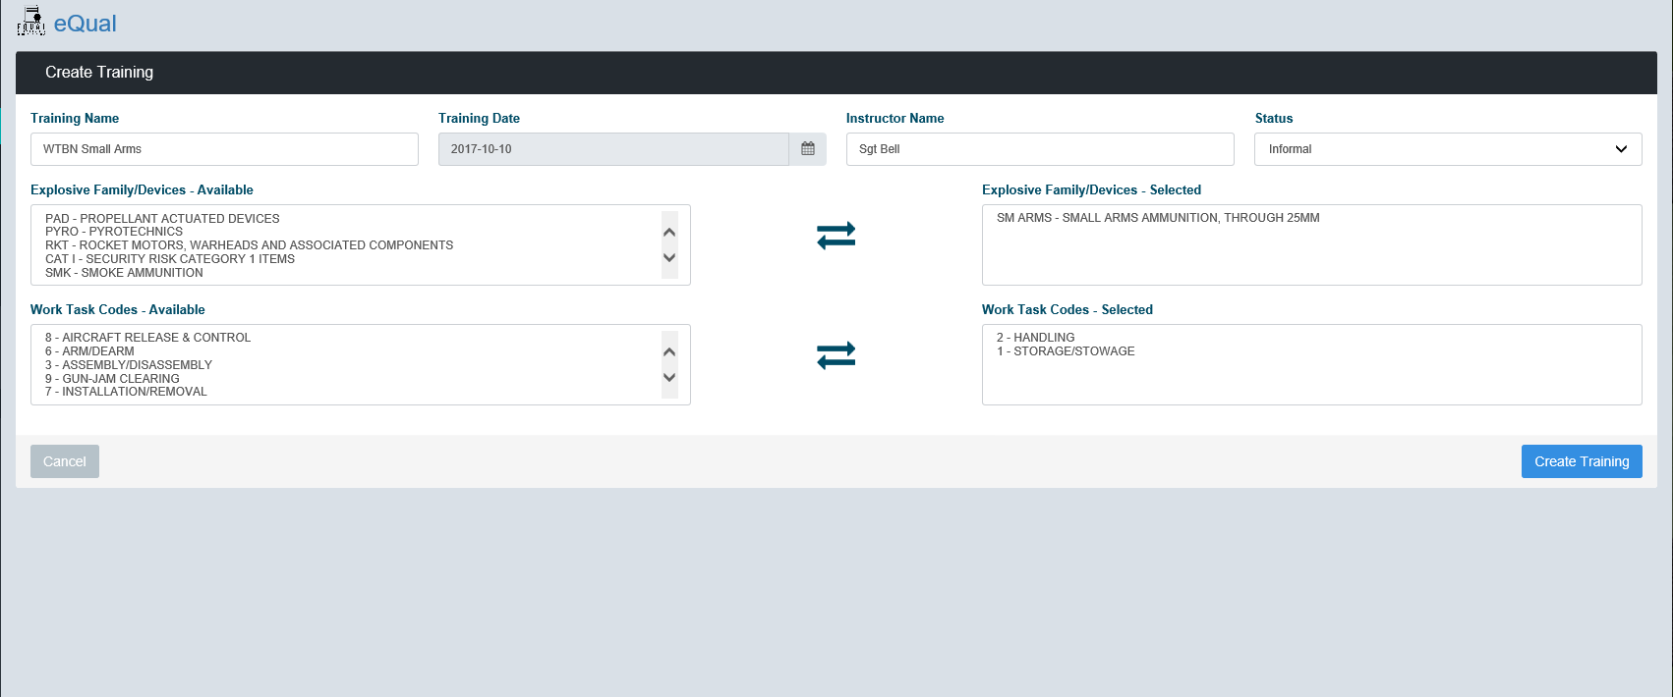
qualification and
Certification
Annual Training E-Qual

Slide 11
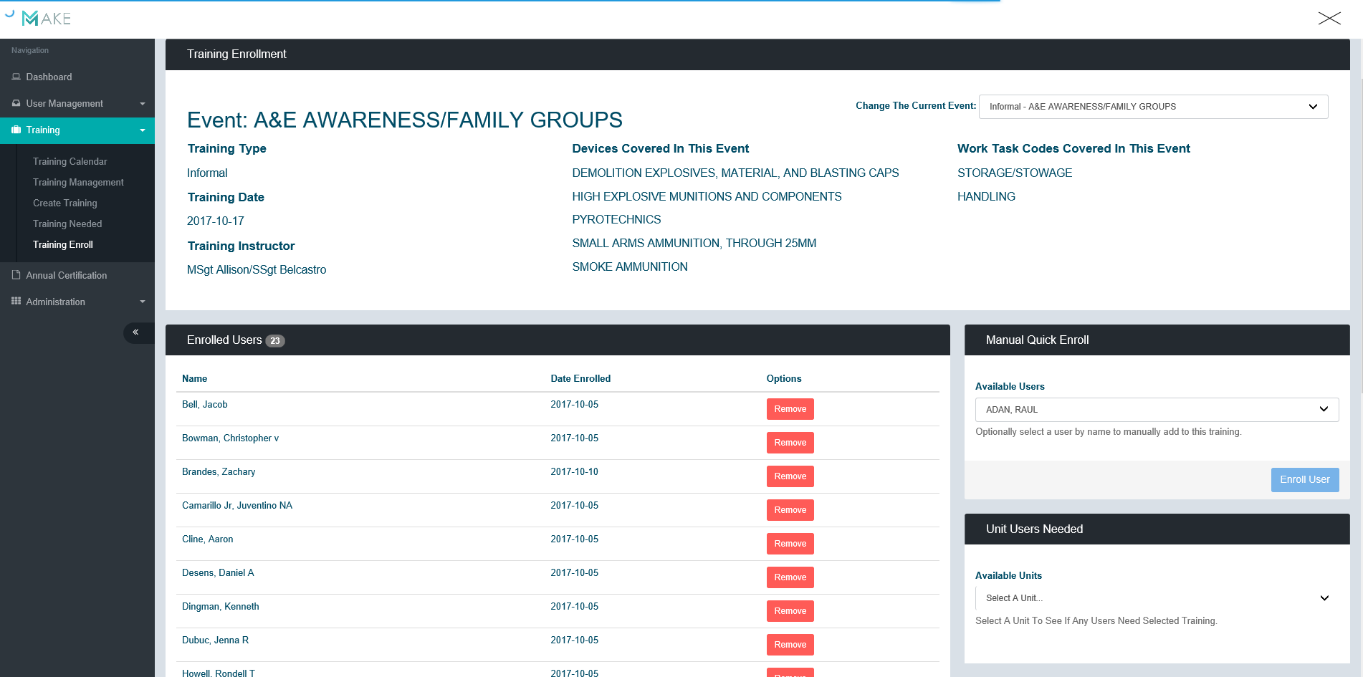
qualification and
Certification
Enroll attendees

Slide 12
qualification and
Certification
De-Certification/Suspension
Temporary administrative measure to allow for retraining and subsequent re-certification
Mandatory when an explosive mishap occurs and is caused due to negligence, carelessness, safety infractions or no longer meets AA&E screening.
Revocation
Action to permanently remove an individual from the QUAL/CERT program.
Administrative action must be taken to remove individual from MOS.

Slide 13
Questions?

