Slide 1
TRANSPORTATION

Slide 2
Transportation
Medical Examination
Training and Qualification
Off-Base Transportation Request
Route Plan
Vehicle Requirements
Driver Requirements
Combat Loaded
Restricted Loads
CLNC Intra-base Movements

Slide 3
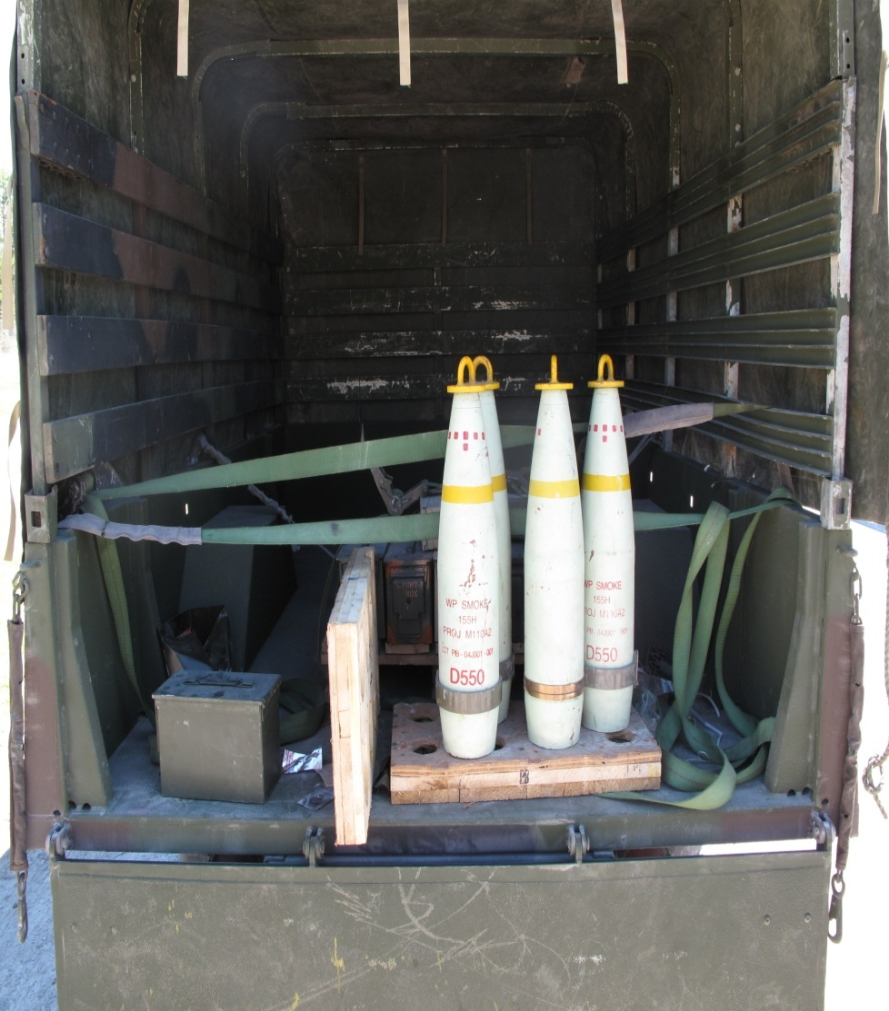
Transportation
Improper preparation of A&E turn in

Slide 4
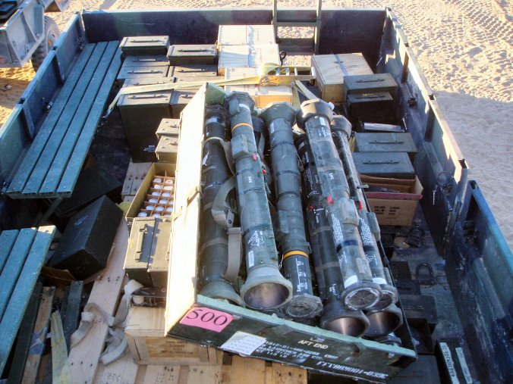
Transportation
Improper preparation of A&E turn in

Slide 5
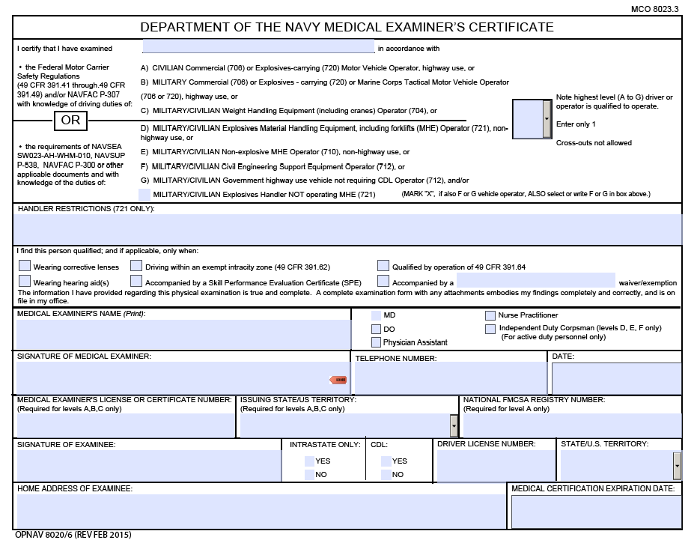
Transportation
Medical Examinations
Military (every 2 years until the age of 50) and Civilian (every 2 years until the age of 60) drivers must have a current Medical Examiners Certificate. (OPNAV 8020/6)

Slide 6
Transportation
Drivers (military and civilian) of government owned vehicles must have a valid OF-346. The OF-346 must be annotated with the following:
Explosives Driver Must hold a Current Medical Certificate

Slide 7
Transportation
Training and Qualification
Valid State Driver License and Valid Military Identification Card
Driver Improvement Card (Under 26)
Valid Medical examiners Certificate (OPNAV 8020/6)
Valid Government Motor Vehicle Operators Identification Card (OF-346)
Drivers must be 18 for on-base movements and 21 for off-base movements.
Civilian drivers must have a valid state license with a Commercial Driver’s License.

Slide 8
Transportation
Off-Base Transportation Request
Transportation to Camp Lejeune local ranges do not require off-base transportation requests.
Two explosive drivers are required for all A&E movements off-base outside 100 mile limit.
No one is allowed to ride in the cargo area while transporting A&E.
Explosive drivers shall not drive for more than 8 hours a day, unless in an emergency.
One driver shall always remain with vehicle during rest stops. (No further then 25 ft away)

Slide 9
Transportation
Route Plan
A written route plan required for off base movement of A&E
most direct and efficient route possible to avoid hazards.
Route plan must include:
unit name
POC
date of shipment
origin and destination
security plan
communication plan
A&E description
number and types of vehicles to be utilized to transport the A&E
recovery plan
number of explosive drivers per vehicle

Slide 10
Transportation
Vehicle Requirements
Vehicles shall be inspected prior to arriving at the ASP
Driver shall present a copy of DD Form 626 to the ASP Issues Section.
All drivers shall have a current copy of the Glove Box Edition (NAVSEA SW020-AF-HBK-010).
Sufficient quantities of tie-down straps.
Sufficient tarpaulins to cover ammunition issued.

Slide 11
Transportation
Correct and sufficient quantity of placards for the A&E issued. Units must bring their own duct tape to affix placards to subject vehicles.
One armed guard is required per vehicle at all times.
Units must provide a government chaser vehicle to stage/un-stage vehicles.

Slide 12
Transportation
Driver Requirements
Ensure that no other gear except required SL3 belonging to the vehicle is stowed in the cargo compartment.
Ensure no excess gear is located in the cab of the vehicle that would prevent safe driving.

Slide 13
Transportation
Results of exceeding the speed for the road conditions

Slide 14
Transportation
Load was properly secured preventing damage to the Driver, Vehicle or load

Slide 15
Transportation
Combat-Loaded
Restricted to live-fire training areas only.
Prohibited from travel on the following roads: Lyman Rd, NC 172 from Onslow Beach to Sneads Ferry Gate, Marine Rd, or any other part of Sneads Ferry Rd.
The area between the Triangle Outpost Gate and Onslow Beach may be used for transport when that portion of NC 172 is blocked from normal through-traffic.

Slide 16
Transportation
Restricted Roads
No A&E, except HC/D 1.3/1.4 will be transported on McHugh Blvd past Gonzales Rd, or from the intersection of Holcomb Blvd and Sneads Ferry Rd, or any road entering the Hadnot Point area (mainside).
A&E will not be transported into any housing, troop billeting, administrative, or industrial/maintenance areas for any reason except for security/reactionary force requirements.

Slide 17
Transportation
Camp Johnson:
No A&E will be transported into any housing, troop billeting, or industrial/maintenance areas at Camp Johnson. To transport A&E aboard Camp Johnson, drivers must utilize Harlem Dr.
Piney Green Rd and NC 24 may be used to transport A&E to Camp Johnson.

Slide 18
Transportation
CLNC Intra-base Movements
Primary traffic routes for on-base movement of A&E (HC/D 1.1&1.2) are: Piney Green Rd, Marines Rd, Sneads Ferry Rd, Lyman Rd and NC 172.
Maximum speed limit on base for tactical vehicles transporting A&E is 45 mph. Lower speed limits will be observed as posted.

Slide 19
Transportation
Approved Explosives routes for on-base movement

Slide 20
Questions

