Slide 1
HAZARDS OF ELECTROMAGNETIC RADIATION TO ORDNANCE (HERO)

Slide 2
HERO
HERO is the program concerned with prevention of accidental ignition of electrically initiated devices (EID’s) in ammunition and explosives due to radio frequency (RF) electromagnetic fields.
HERO order: NAVSEA OP 3565 Vol 2
Three classifications pertinent to HERO

Slide 3
HERO
Classifications
HERO Safe – Any Ordnance item that is proven by test or analysis to be sufficiently shielded, or otherwise so protected that all EID’s contained by the item are immune to adverse effects.
HERO Susceptible – Any Ordnance containing EID proven by test or analysis to be adversely affected by RF energy to the point that safety and/or reliability of the system is in jeopardy.
HERO Unsafe – Any Ordnance item, whose inadvertent initiation or detonation causes an immediate catastrophic event that has the potential to either destroy equipment or injure personnel..

Slide 4
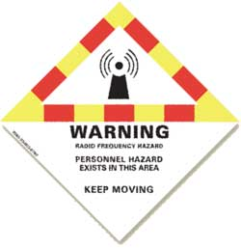
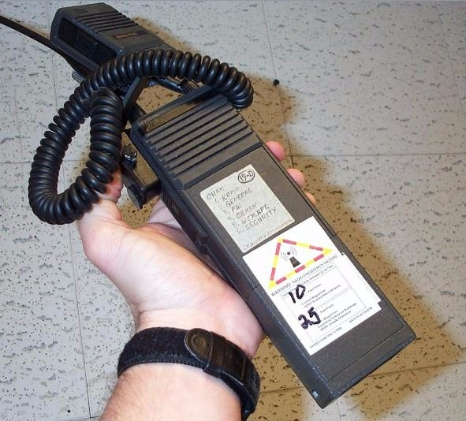
HERO
Symbols and Labels
HERO Warning Symbols and Labels alert the radio and portable emitter systems operators of the potential HERO hazards.
Low-power transceiver devices such as cell phones, active pagers, Computer Tablets, and some walkie-talkies automatically transmit RF energy without operator action.
i.e. 15’- closed / 25’ open magazine

Slide 5
Questions

