Slide 1
ASP OPERATIONS & PROCEDURES

Slide 2
ASP OPERATIONS &
PROCEDURES
Preparation
Units are expected to arrive at the ASP ready to conduct business. This includes: vehicle(s), load plan(s) appropriate amount of tie down straps, correct fire extinguishers, glove box edition, correct medical cert, OF 346, and all documentation.
Units MUST do their due diligence the day prior to arriving at the ASP!

Slide 3
ASP OPERATIONS &
PROCEDURES
Most recent DISREPS:
Supported Unit turn-in problems:
Units returning misfires without being cleared/documented by EOD.
Missing packaging/munition components. (Safe/Unsafe)
Munitions not strapped to the vehicle properly.
Excessive breakout.
Vehicles not passing inspection.
Strapping Ammunition loads. (Completely UNSAT)
Mixing ammunition and dunnage.
Incompatible loads\
Vehicles placarded incorrectly.

Slide 4
ASP OPERATIONS &
PROCEDURES
Supported Unit Issue DISREPS:
MEDCERTS
No Ammo endorsement
Incorrect fire extinguisher
Missing Chock Blocks
Missing placards
Vehicles not passing inspection
No load plan
Not enough bed space
Turn in followed by an Issue. Arriving too late.

Slide 6
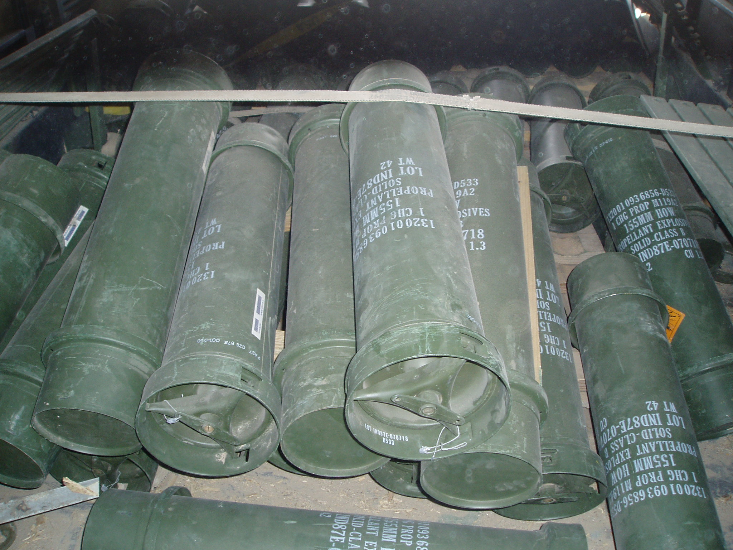

Slide 7
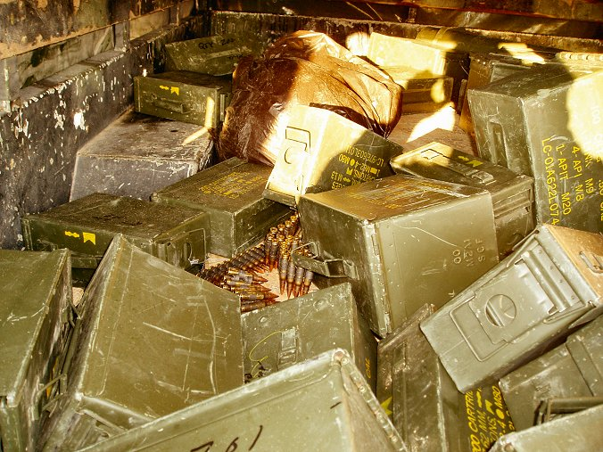
Mr. H verbiage here

Slide 8
Fuze igniter, time fuze, blasting cap, inserted into C-4 with det cord !!!

Slide 9
Loose blasting cap, C-4 in ammo can. (rode that way for approximately 10 miles!!!)

Slide 11
Recent DISREPS
The following pics were taken at the ASP recently…….
SAVE YOUR PACKING MATERIAL

Slide 12
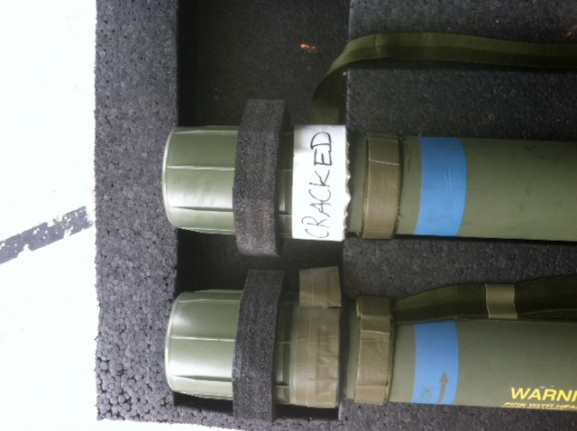
CC-A PACKAGED WITH CC-H MATERIAL NO EOD DOCUMENTATION

Slide 13
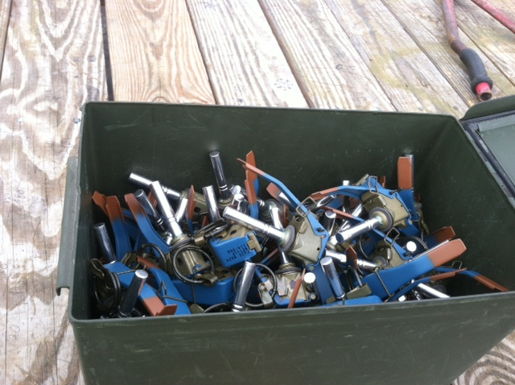
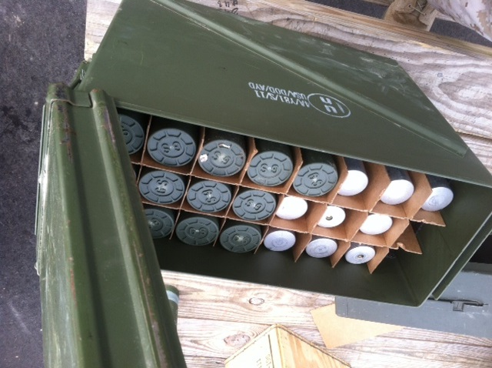
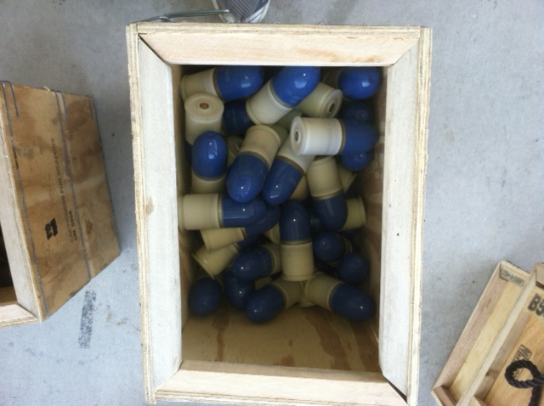
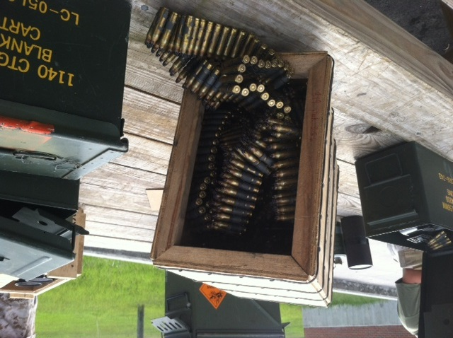
Missing Packaging

Slide 14
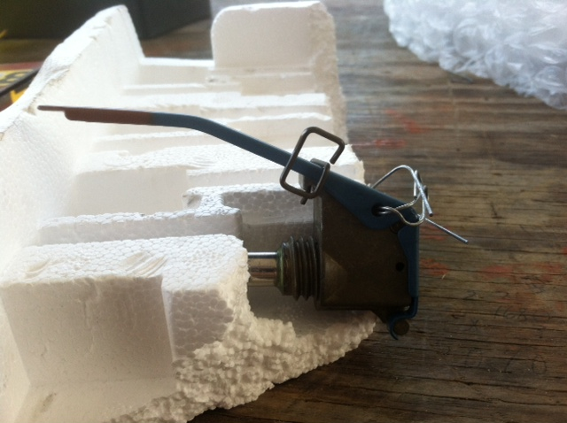
Missing Pull PIN (ASP Inserted wire)

Slide 15
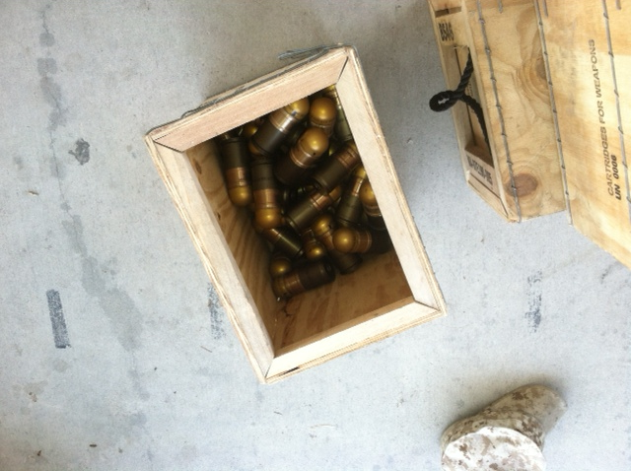
What’s the worst that could happen?
Ask yourself “How did we fail?”

Slide 16
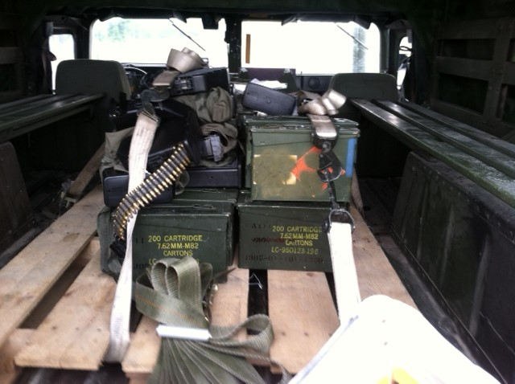

Slide 19
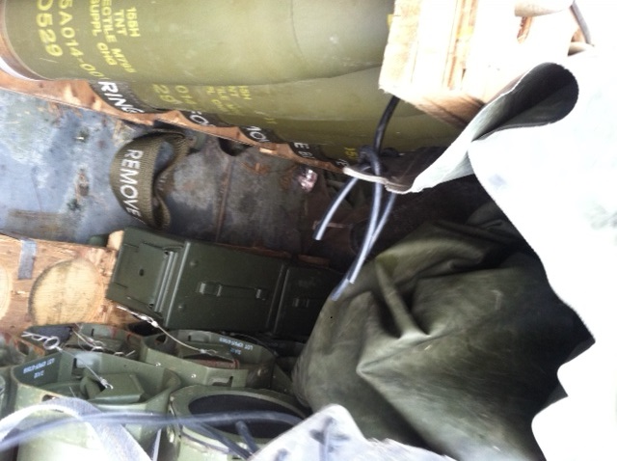

Slide 20
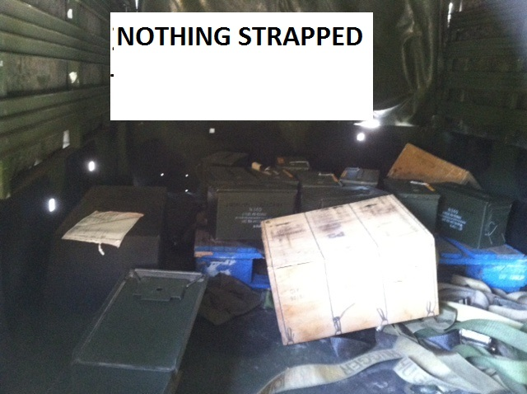

Slide 21
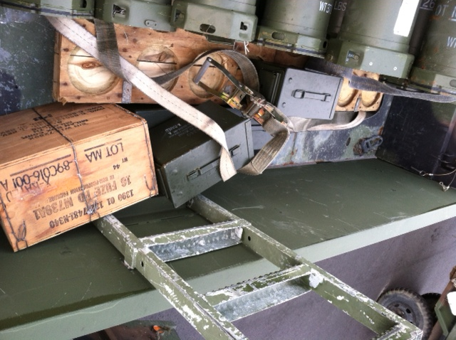

Slide 22
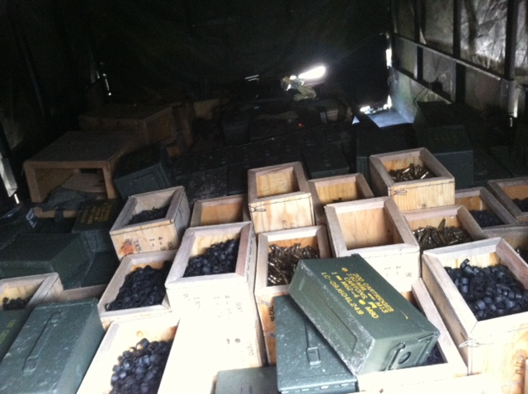

Slide 23
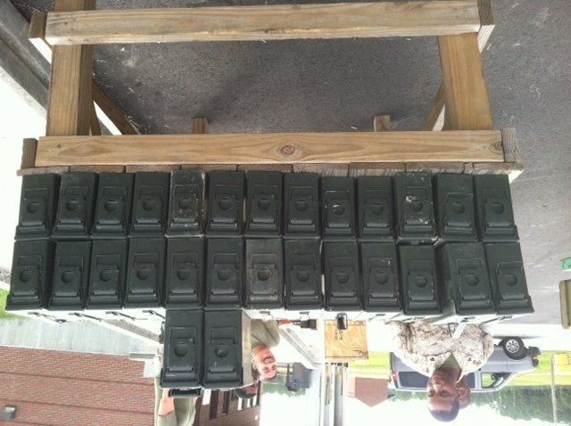

Slide 24
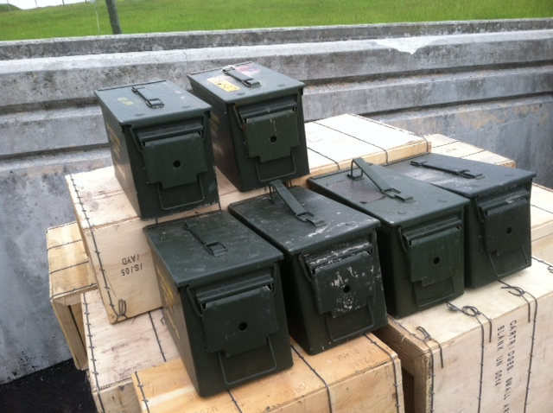
NOT What it looks like…

Slide 25
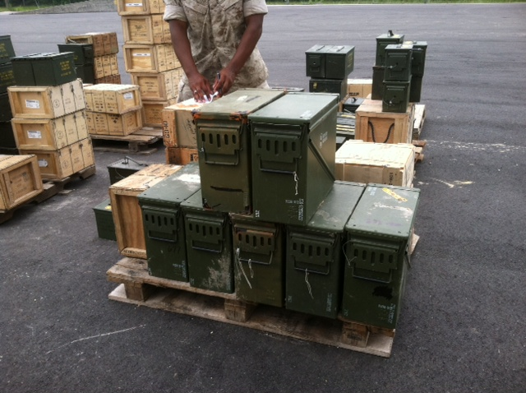

Slide 26
ASP OPERATIONS &
PROCEDURES
Common Questions:
Can I “Safe Haven”?
Can I do an extended pre-stage?
Do I need the same driver?
What time do you stop doing Turn-ins?
What happens if during my issue the ASP has lightning within 10 miles?

Slide 27
ASP OPERATIONS &
PROCEDURES
All steps are adjustable.
Most problems/discrepancies could be prevented with a phone call.
POC’s:
OIC CWO4 Henry
SNCOIC MGySgt Weiss 451-4723
AOIC Mr. Nyman
RSI GySgt Ososkie 451-4738

