Slide 1
MPPEH/MDAS

Slide 2
MPPEH/MDAS
Material Potentially Presenting an Explosives Hazard (MPPEH)
All A&E residue from ranges and training areas (i.e. brass, fiber containers, plastic containers)
Material Documented as Safe (MDAS)
MPPEH that has been screened and documented as not presenting an explosives hazard
Personnel authorized to screen MPPEH
Must be appointed in writing by the commander.
Should have approved training that allows for recognition and safe handling of used military munitions of the type being handled.
MPPEH class on Navy eLearning is recommended. (Completed Yearly)

Slide 3
MPPEH/MDAS
MDAS storage
All Material not small arms(.50 cal and below) must be certified and verified before being stored in a units retrograde lot.(All marking obliterated, MDAS paperwork complete)
Material must be certified and verified in an area site approved for required Hazard Class. (At the Range.)
Small arms ctgs (.50 cal and below) can be screened at Range by two individuals and brought back to storage location to complete MDAS certification.
Must be segregated and kept in an area with controlled access and covered.(out of the weather)
Minimize the time and quantity that MDAS is accumulated and retained.(Make appointments prior to range if possible)
Maintain MDAS paperwork for 10 years.

Slide 4
MPPEH/MDAS
MPPEH processing
Units must have written MPPEH/MDAS processing procedures.
Procedures should cover from the moment the MPPEH is verified and certified at the range until turned-in to DLA
Ensure all previous markings have been obliterated. Repurposed cans have to be marked with what is currently in the cans on two sides. (ie CFT, Cleaning gear, SL3)
Maintain chain of custody of MDAS certification.
If MDAS certification is lost or MPPEH is added to MDAS material it is now all considered MPPEH and must be treated as such.

Slide 5
MPPEH/MDAS
Packaging materials from small arms(50 cal and below) such as (cardboard, plastic, plywood containers and packaging materials) may be discarded as solid waste (that is, general trash) provided that the following criteria are met:
100 percent visually screened for the presence of munitions by two different individuals
All previous markings are removed or obliterated
The items are broken down or otherwise deformed
There are no environmental regulations precluding such disposal (recycle)

Slide 6
MPPEH/MDAS
Approved other than small arms materials (cardboard, plastic, plywood containers and packaging materials) may be discarded as solid waste (that is, general trash) provided that the following criteria are met:
Same criteria as small arms requirements shall be met
Certified as MDAS on a DD Form 1348-1 (series) or a local form
Chain of custody is maintained
Verify with QRP what they will take

Slide 7
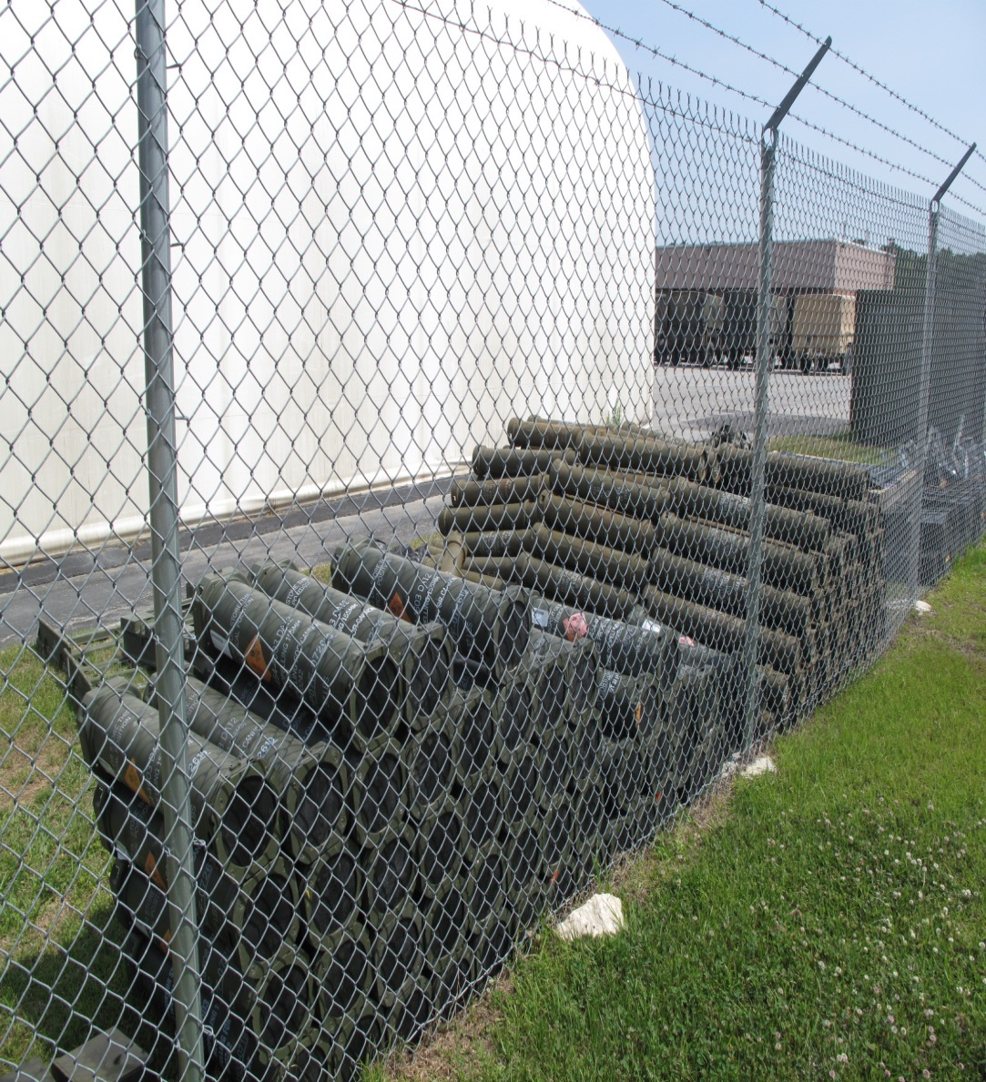
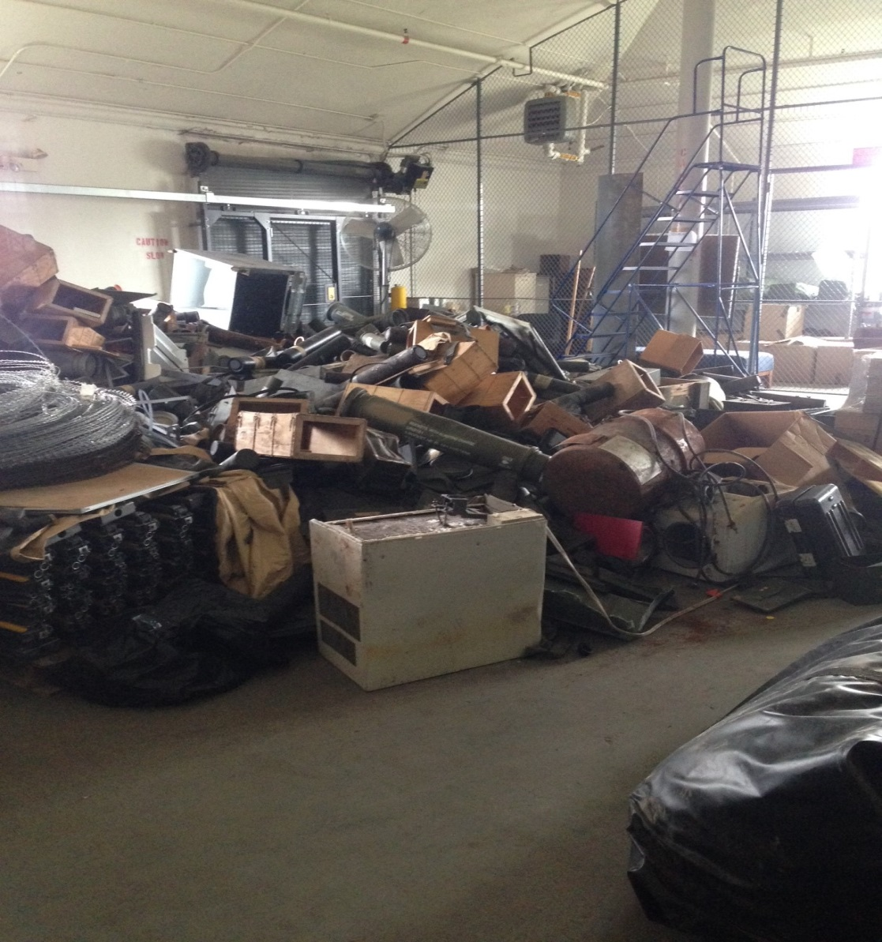
MPPEH/MDAS
Artillery and Infantry improper MPPEH Storage: Markings not obliterated

Slide 8
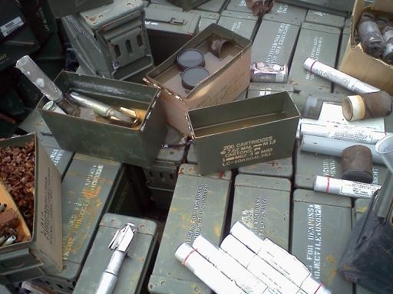
MPPEH/MDAS
Armored Unit MPPEH storage: Not Covered or Secured

Slide 9
MPPEH/MDAS
Missile Warheads found on range were placed in retrograde lot. Later determined to be LIVE ammo!!!
DO NOT take UXO from the Range.
Malfunctioned prac TOW rounds taken from the range and stored in a unit warehouse.
Prepped for T/I to DLA; still had unburned propellant in the missiles.

Slide 10
Questions

