Slide 1
W9-L WELCOME ABOARD SMART PACK
CHECK-OUT PROCEDURES
JOSEPH "RANDY" REICHLER RECEPTION CENTER (JRRRC)
Headquarters and Service Battalion (H&SBn)
Marine Corps Installations-East (MCI-EAST)
BL 59 Molly Pitcher Drive
Marine Corps Base (MCB), Camp Lejeune, NC

Slide 2
Transportation to and from JRRRC Bldg. 59
Uber and Lyft can access base. Service member can use the online APP to request transportation.
Tarheel Taxi (910) 938-8989
Yellow Cab (910) 353-1111
The Airporter (910) 324-9990
Americab (910) 333-2427
King Cab (910) 577-5464

Slide 3
Required documents upon check-in
Orders
Flight Itinerary
Port call (if you have it) As well Delayed Flight Sheet from airline if applicable

Slide 4
Reporting / Check-in to JRRRC Bldg. 59
Upon check-in you'll be handed five forms to fill out: Unit Diary Package, Check in Form, RPAC CamLej Seps, Checkout Sheet (you keep this one), Reporting Endorsement, and W9L Acknowledgement of Responsibility.
Please have your documents on hand (orders, fight itinerary, port call if you have it) and or statement from airline for flight delays.
When filling out the forms please specify your separation type (EAS, ADSEP, Terminal Leave, or Skill Bridge). You will fill out three logbooks: W9L Logbook, Linen Logbook, and New Join Logbook.
If you are staying in the Squad Bay you will be issued two sheets, one blanket, a pillow and pillowcase.
If you are a Medical Separation (MEDSEP) you report to HP55 Duty Hut, this for all medical separation personnel which is across the street from Bldg. 59. If you need help finding HP55 the duty will help you find it.
If you are checking in after hours (1800-0700) please call the Duty cell phone (910) 554-9126 or ring the Buzzer at the RPAC entrance bldg. 59.

Slide 5
Documents required to check-out
Career planner / CO EAS interview (enlisted only)
TFRS msg (over six years active service or involuntary separations-enlisted only)
RPAC check-out with S-1 Signature only
NAVMAC2648 / Capstone (TRS)
Final physical DD2807 / 2808 / 2637
STR: Medical and Dental With DD2963 (DD2963 completed at local BAS)
DD2656 retired pay data form- at least 30 days prior to EAS (Retirees / TDRL / PDRL only)
SBP Marine Net course completion certificate (Retirees/TDRL/PDRL only)

Slide 6
Hotels on/off Base
Inns of the Corps (910) 451-3041. $80-90 / night (non-availability letter will be provided if lodging is not provided
Red Roof Inn $80-90 / night (910) 353-3336. 1723 Lejeune Blvd, Jacksonville, NC 28546
Suburban Extended Stay $65-75 / night (910) 346-7759. 1323 Lejeune Blvd, Jacksonville, NC 28540
Extended Stay America $70-85 / night (910) 347-7684. 20 McDaniel Drive, Jacksonville, NC 28546
Days Inn by Wyndham $65-75 / night (910) 467-8271. 505 Marine Blvd, Jacksonville, NC 28540
Candlewood Suites $100-115 / night (910) 333-0494. 119 Penney Ln, Jacksonville, NC 28546
Baymont by Wyndham $65-75 / night (910) 347-6500. 474 Western Blvd, Jacksonville, NC 28546

Slide 7
Command POC Information
Troop Handler: cell (910) 554-9126 desk (910) 451-2123
Separations Branch: OIC (910) 451-5615
AOIC: (910) 451-2161
Clerks: (910) 451-2016
Retirements: OIC (910) 450-9540
Clerks: (910) 451-7308
SNCOIC: (910) 451-2058
SNCOIC: (910) 450-7307
ADSEPS: OIC (910) 451-5963
Clerks: (910) 451-0115 / 0119

Slide 8
Accountability Times
Squad Bay Marines 0800 every day.
On/off base Marines 0800 everyday (phone call check-in).
If you are in the Squad Bay and are going to miss a formation, please call the Duty desk or the Duty cell phone.
Following morning accountability morning clean-up will be conducted.
Field day is on Thursdays @ 1300.

Slide 9
Squad Bay Rules
Alcohol is not authorized in the Squad Bay.
Make your rack if you're not using it daily.
Utilize wall lockers. Please do not leave anything you are not using in the aisles.
No food in the Squad Bay, all food must be consumed in the lounge or in the outside pavilion.
Overall keep the Squad Bay clean and clean up after yourself.
If something is broken, please inform the Troop Handlers so they can get the issue resolved.

Slide 10
Checking out of JRRRC
Wash, dry, and fold linen neatly and place on the laundry room counter or where the duty has specified.
Show the Duty a copy of your DD-214.
Good luck in your future, Farewell and following seas.

Slide 11
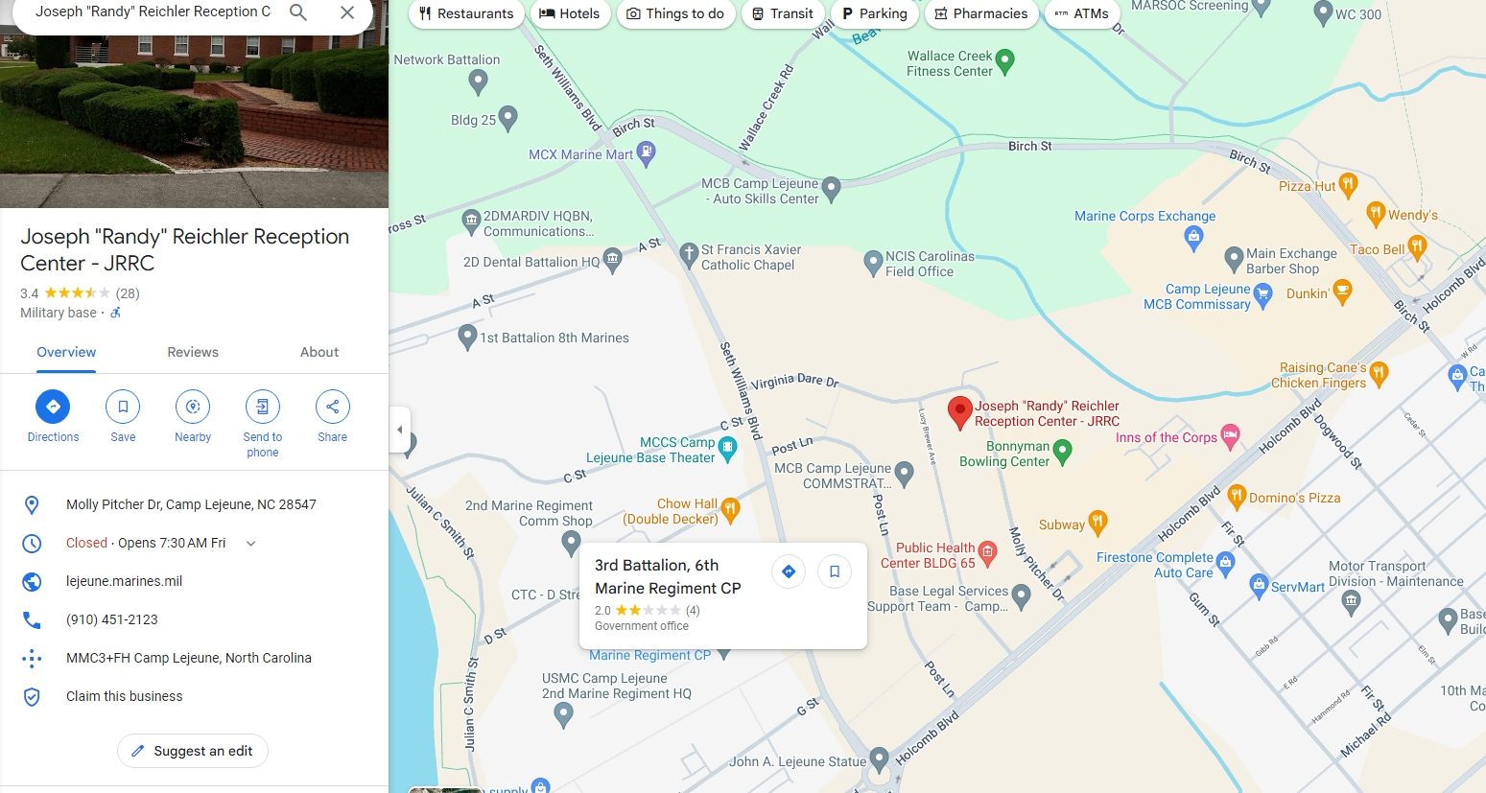
JRRRC Bldg. 59 Location
Mon-Fri hours: 0600-1800
Sat-Sun: closed
Front hatch buzzer during non-working hours for check-ins

Slide 12
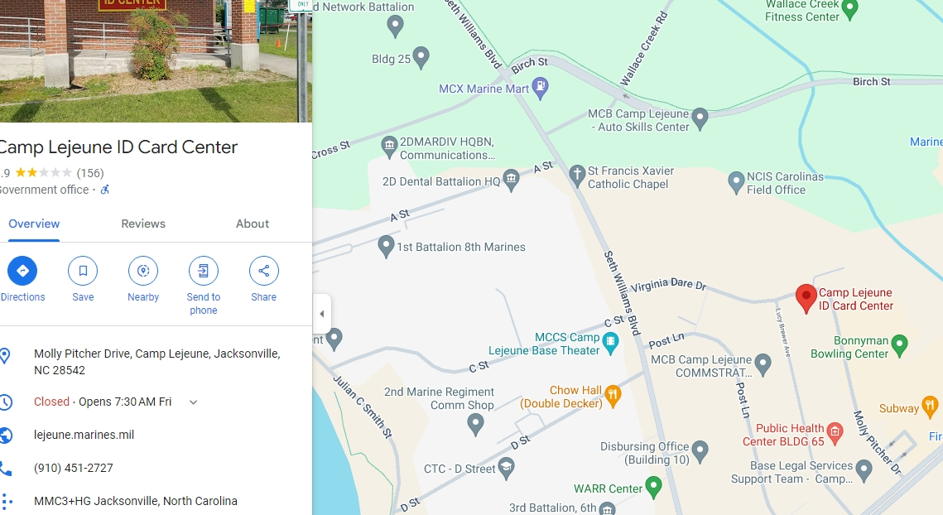
Identification Card Center (IDCC)
Mon-Thur hours: 0730-1515 / Fri hours: 0730-1415
Sat-Sun: closed

Slide 13
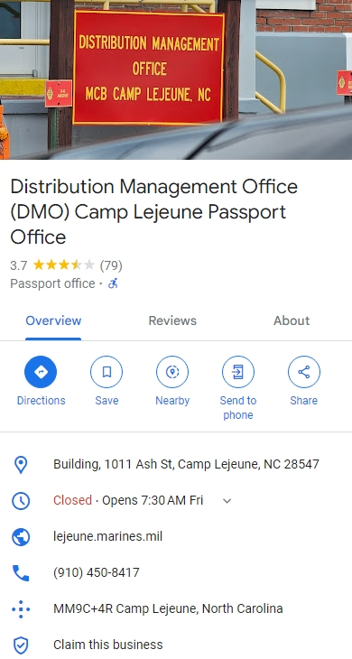
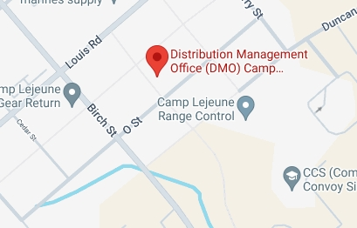
DMO Location
Mon-Fri hours: 0730-1630
Sat-Sun: closed

Slide 14
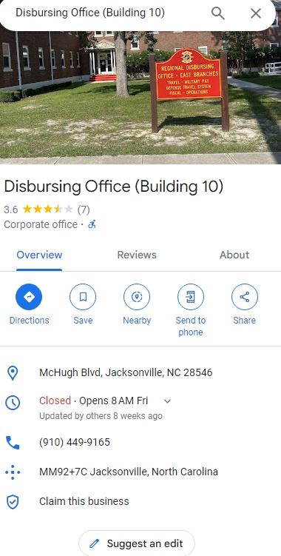
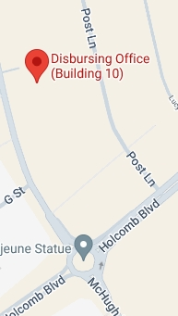
Disbursing Travel
h
Mon-Fri hours: 0800-1100
Sat-Sun: closed

Slide 15
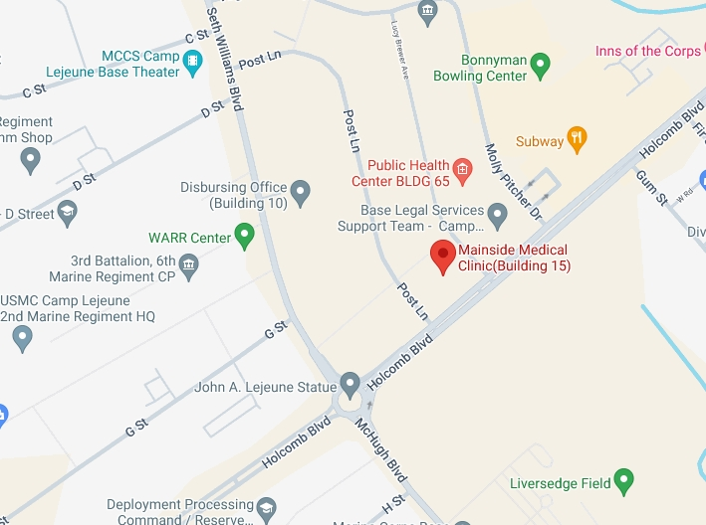
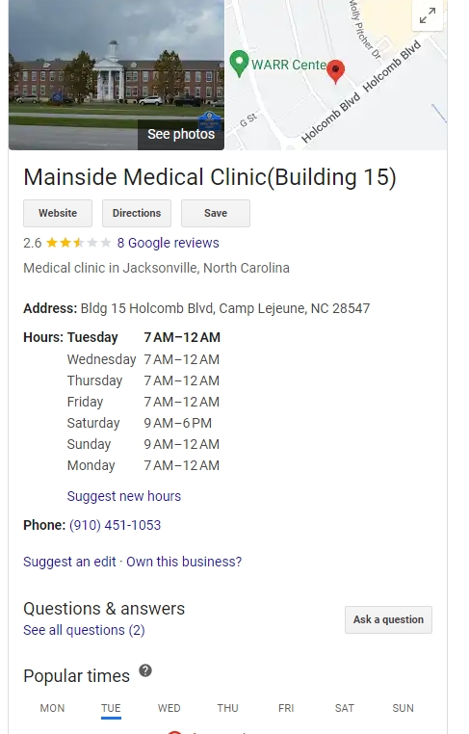
Medical and Dental Locations

Slide 16
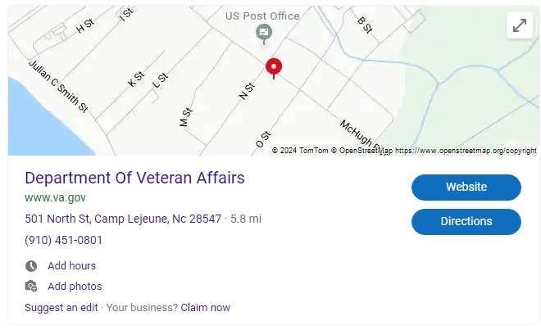
Veterans Affairs (VA) Office
Mon-Fri hours: 0730-1600
Sat-Sun: closed
Require medical documents/records.
This is if you need to make any claims, this is not a requirement.

