Slide 1
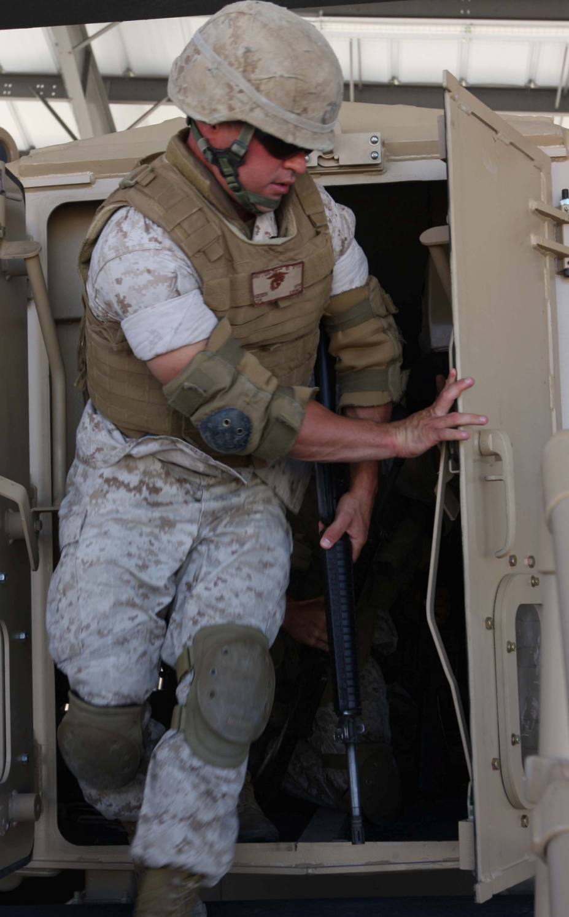
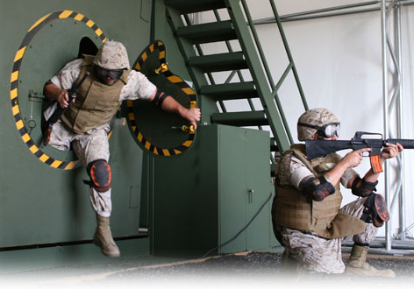
Dry Rollover and Egress Training (DRET)
USMC Student Course
November 2010

Slide 2
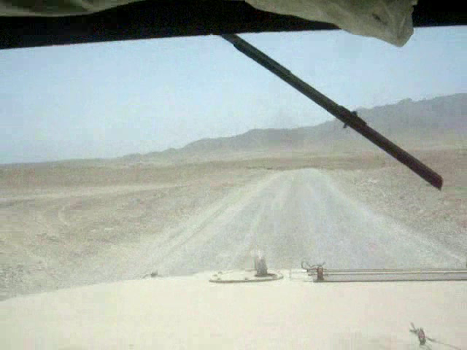
Why DRET Training?
¹Army tactical vehicle rollovers, FY01 - 05/09
  1219 rollovers
  809 injuries
  225 fatalities
²80% reduction in Gunner fatalities if egress trained
³250% greater change of survival if egress trained
Notes:
INSTRUCTOR NOTE
Ensure that the video clips in the PowerPoint presentation are linked and play correctly before presenting to the class. See Lesson Plan or Linking Video Clips in PowerPoint.docx for instructions.
GAIN ATTENTION.
INSTRUCTOR NOTE
Begin this slide by clicking the video in the presentation for an attention gaining example of a HMMWV rollover caused by excessive speed for the road conditions (i.e., speeding, turning, gravel).
Good morning/afternoon Marines! We’re here today because the number of preventable rollover accidents, and personnel injured or killed in them, continues to be a serious issue.
INSTRUCTOR NOTE
Click anywhere on the screen to display statistics.
Footnotes:
¹ Army Safety Program, Risk Management Information System
²Combat Readiness Safety Center data cited in 071-MET-CREW / MRAP Egress Trainer (MET), Training Support Package (TSP), v1.0, 20 Apr 09.
³A study reported by Helicopter World (now Defense Helicopter) magazine in September 2000 cited in 071-MET-CREW / MRAP Egress Trainer (MET), Training Support Package (TSP), v1.0, 20 Apr 09.
OVERVIEW.
The purpose of this class is to teach you how to avoid a vehicle rollover, and quickly and safely egress with and without injured personnel if you are involved in a rollover.
You will be introduced to rollover-relevant, wheeled vehicle characteristics, components, and considerations and how to avoid a rollover to begin with, before taking a detailed look at the procedures you will perform before, during, and after a rollover. Lastly, you will learn about motion sickness and heat exhaustion before visiting the dry rollover egress trainers (e.g., HMMWV Egress Assistance Trainer (HEAT) and MRAP Egress Trainer (MET)) to conduct your training exercises.

Slide 3
Terminal Learning Objective (TLO)
Perform dry rollover and egress procedures within two minutes.
Notes:
INSTRUCTOR NOTE
Introduce learning objectives. Read aloud and probe for questions.
Complete Terminal Learning Objective
⁴Given classroom training, access to fully functional dry rollover training devices (e.g., HEAT and MET), requisite support personnel and equipment, scripted rollover scenarios, crew positions, combat load, with and without injuries, debris, and visibility, perform dry rollover and egress procedures, in accordance with the procedural steps, safety guidelines, and sequence described in the references⁵, within two minutes of being given the signal to egress, without inflicting injury to self or crew or damaging equipment or property, remediated to 100%.
Footnotes:
⁴ The conditions and standards for this TLO have been modified because it is unsafe and impractical to conduct a real vehicle rollover to train egress. Thus, dry rollover training devices (e.g., HEAT and MET) will be used to simulate dry rollovers. Note that although learning rollover avoidance guidelines is a critical objective for this training, the terminal objective is rollover and egress training, not driver’s training. Vehicle driver training is conducted by motor transport prior to this training, thus additional driver training here is unnecessary. This rollover and egress training reiterates and expands on rollover-relevant characteristics, components, and considerations of wheeled vehicles, as well as, general rollover avoidance guidelines for wheeled vehicles to specifically call attention to, and associate this knowledge with, this egress training.
⁵ The references cited in this TLO standard statement are the SME validated HEAT student and train-the-trainer lesson plans and the Army-developed MET Training Support Package (20 April 2009) until the technical references can be updated and validated.

Slide 4
Enabling Learning Objectives (ELOs)
Classroom:
  Recognize rollover-relevant characteristics, components, and considerations of tactical wheeled vehicles.
  Recall the guidelines for avoiding a wheeled vehicle rollover accident.
  Recall the emergency procedures performed to react to an imminent rollover.
  Recall the emergency procedures performed after a dry rollover accident.
  Recall the characteristics and prevention of motion sickness and heat exhaustion.
Training Devices:
Egress from dry vehicle.
Account for crewmembers.
Establish security.
Notes:
Complete Enabling Learning Objectives
Knowledge-Based
Conditions: Given classroom instruction and a written exam.
Knowledge Tasks:
Recognize rollover-relevant characteristics, components, and considerations of tactical wheeled vehicles.
Recall the guidelines for avoiding a wheeled vehicle rollover accident.
Recall the emergency procedures performed to react to an imminent rollover.
Recall the emergency procedures performed after a dry rollover accident.
Recall the characteristics and prevention of motion sickness and heat exhaustion.
Standard: Perform the tasks at an accuracy rate of 80% or better, remediated to 100%.
Performance-Based
Conditions: Given classroom training, access to fully functional dry rollover training devices (e.g., HEAT and MET), requisite support personnel and equipment, scripted rollover scenarios, crew positions, combat load, with and without injuries, debris, and visibility.
⁶Performance Tasks:
Egress from dry vehicle.
Account for crewmembers.
Establish security.
Standard: In accordance with the procedural steps, safety guidelines, and sequence described in the references⁷, within two minutes of being given the signal to egress, without inflicting injury to self or crew or damaging equipment or property, remediated to 100%.
Footnotes:
⁶The conditions and standards for the lesson TLO and these performance-based ELOs have been modified because it is unsafe and impractical to conduct a real vehicle rollover to train egress.
⁷The references cited in the standard statement for these ELOs are the SME validated HEAT student and train-the-trainer lesson plans and the Army-developed MET Training Support Package (20 April 2009) until the technical references can be updated and validated.

Slide 5
Training Agenda
Lesson 1: Classroom
L1 - Academic materials
    Rollover-relevant characteristics
    Avoidance
    Emergency procedures
    Training safety
L1 - Written exam
Lessons 2-5: HEAT & MET Devices
L2 – MET demonstration
L3 – MET practical application
L4 – HEAT demonstration
L5 – HEAT practical application
Notes:
TRAINING AGENDA.
INSTRUCTOR NOTE
Explain the on-screen training agenda.
METHOD/MEDIA.
INSTRUCTOR NOTE
Inform students that this course will be taught using the informal lecture/video, demonstration/video, and practical application methods. The lecture/video (lesson 1) will be augmented by a PowerPoint presentation and student handout. After the lecture/video, students will observe (lessons 2) other teams of Marines undergoing training in the MET, before performing their own practical application exercises in each device (lesson 3). After completing the MET training, they will watch (lesson 4) and do (lesson 5) their training in the HEAT.
EVALUATION & REMEDIATION.
INSTRUCTOR NOTE
Explain the following evaluation and remediation procedures to the Marines:
They must complete a multiple-choice written exam after the classroom academic lesson with a score of 80% or better remediated to 100%.
After the written exam, the exam questions will be reviewed with the students to remediate them to 100%.
The instructors (i.e., you and the other instructor/assistants) will directly observe them during the practical application exercises for compliance with the references.
The instructors will assist and remediate them, as needed, during each scenario in the practical application, and after each scenario in an after action review, to remediate them to 100% mastery.

Slide 6

Safety/Cease Training (CT) Brief
Cease Training (CT):
In cases of tornado, fire, or earthquake
Immediately if anyone is injured or device is damaged
Power outages and other safety concerns –instructor decides
Notes:
TRANSITION: Are there any questions regarding the learning objectives, training agenda, evaluation and remediation procedures, or cease training guidelines?
We will begin this lesson by recognizing rollover-relevant characteristics, components, and considerations of tactical wheeled vehicles.

Slide 7
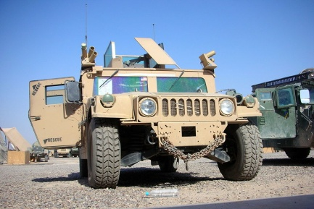
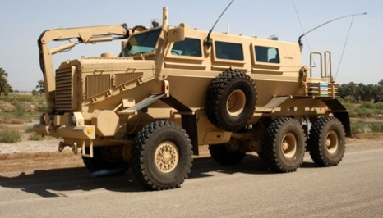
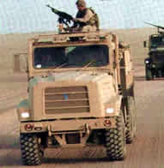
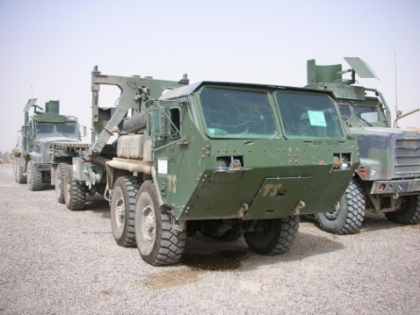
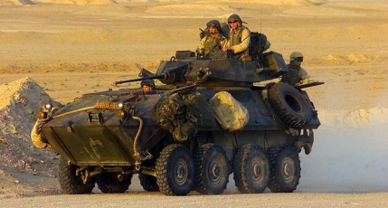
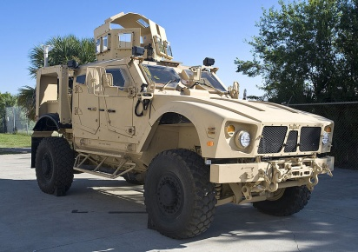
Rollover-Relevant
Characteristics, Components, & Considerations
USMC Wheeled Vehicles:
HMMWVs (most common in rollovers⁸)
MRAPs (most common in rollovers⁸)
MTVRs
LVSRs
LAVs
M-ATV
Know your vehicle’s:
Max. side slope operation
(i.e., rollover angle)
Restraint systems
Egress points
Egress considerations
Notes:
USMC Wheeled Vehicles:
The Marine Corps employs multiple families of tactical wheeled vehicles and their variants including HMMWVs, MRAPs, MTVRs, LVSRs, LAVs, M-ATVs, etc. Although, HMMWVs and MRAPs are the most common tactical vehicles involved in rollovers⁸, all vehicles can rollover.
Know Your Vehicle:
Before you travel in a vehicle, you should thoroughly familiarize yourself with the rollover-relevant characteristics, components, and considerations of your specific vehicle. These include the:
Vehicle’s maximum side slope operation (i.e., rollover angle)
Restraint systems in the vehicle and how they work
Location and operation of egress points in the vehicle
Egress considerations given these vehicle characteristics and components and the vehicle’s orientation after the roll over
Footnotes:
⁸The Safety Corner, MCCLL, 31 Oct 2008.

Slide 8
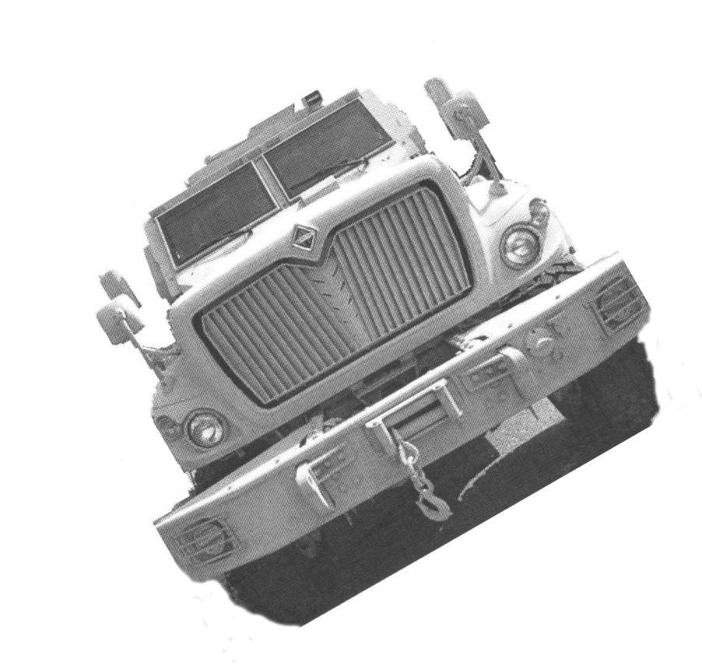
Rollover-Relevant
Characteristics, Components, & Considerations Cont.
Side Slope Rollover Angles:
Know your vehicle!
Side slope decreases as load/CG moves up or shifts from side-to-side.
You will learn what a 13 degrees side slope looks and feels like.
Vehicle | Percent Side Slope | Degrees Side Slope
ECV HMMWV⁹ | 30 | 13.5
MTVR¹⁰ | 30/40* | 13.5/18
LVSR¹¹ | 30/40* | 13.5/18
FPI Cat I¹² | 30 | 13.5
FPI Cat II¹³ | 30 | 13.5
MATV¹⁴ | 40 | 18
13.5º
*30 percent side slope @ 15 mph and 40 percent side slope @ 5 mph @ GVWR
Notes:
Side Slope Rollover Angles:
See Table.
INSTRUCTOR NOTE
Emphasize to the Marines that:
They should always know the maximum side slope operation of the vehicle they will be traveling in or operating before embarking. Whether they are driving or riding, they need to be able to recognize and alert others to a potential rollover.
Side slope decreases as load/CG moves up or shifts from side-to-side. Specifically, as a load moves up, so too does the Center of Gravity (CG), and consequently, the maximum side slope operation is reduced. The side slope can also be reduced when a load shifts sideways during operations.
During the practical application, they will learn what a 13 degrees side slope looks and feels like in the dry egress simulator(s).
Footnotes:
⁹TM 11033 ECV HMMWV Operator's Manual.
¹⁰TM 10629 MTVR Operator's Manual.
¹¹TM 11313 w ch 1 LVSR Operator's Manual.
¹²10016324 Cougar A2 Operators Manual 24 Sep 09.
¹³10016324 Cougar A2 Operators Manual 24 Sep 09.
¹⁴TM 11083A-OI MATV Operator's Manual.

Slide 9
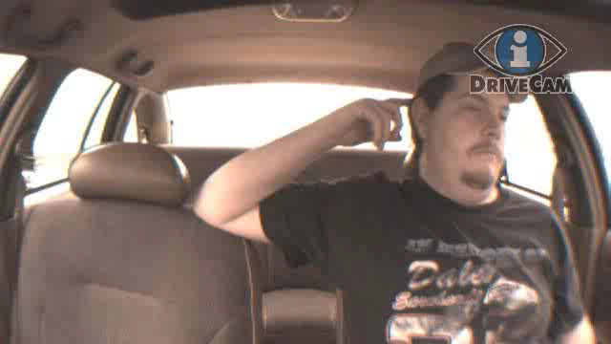
Rollover-Relevant
Characteristics, Components, & Considerations Cont.
Restraint Systems:
¹⁵Presented with permission from DriveCam Inc.
Notes:
Restraint Systems:
INSTRUCTOR NOTE
Click the video in the presentation for an illustration of what happens during a rollover accident when a seatbelt is not wore and why you should not drive when fatigued.
Footnote:
¹⁵Video presented with permission from DriveCam Inc. Contact Adam.Dupree@l-3com.com for copy of written permission.

Slide 10
Rollover-Relevant
Characteristics, Components, & Considerations Cont.
Restraint Systems Cont.:
Seatbelts are NOT a hazard; they will save your life!
440% greater chance of hospitalization when not worn¹⁶.
300% greater chance of fatality when not worn during tactical vehicle operations¹⁷.
94% greater chance of surviving a HMMWV rollover when worn¹⁸.
Know your restraint system. Operation and quick release.
Marines required to wear¹⁹.
Notes:
Restraint Systems Continued:
Seatbelts are NOT a hazard; they will save your life!
Soldiers not wearing a seatbelt were found to have a 440% greater chance of hospitalization compared to Soldiers wearing a seatbelt¹⁶.
The risk of fatality is 300% greater for Marines or Soldiers who do not wear a seatbelt during tactical vehicle operations¹⁷.
You have a 94% chance of surviving a HMMWV rollover when you wear your seatbelt¹⁸.
Always familiarize yourself with the operation of your restraint system upon entering a vehicle.
Restraint systems have quick release mechanisms for rapid egress.
All Marines are required to wear seatbelts (when available) in personal and U.S. Government vehicles on or off DoD installations¹⁹.
INSTRUCTOR NOTE
Specifically, MCO 5100.19E, SD, 29 Dec 00 states:
“Marine Corps tactical vehicles, designed to contract specifications, shall also be equipped with restraint systems and rollover protection when applicable unless the Commandant determines that such equipment will unacceptably degrade an essential military characteristic.”
“Restraint systems will be worn by all operators and passengers of U.S. Government vehicles on or off a DoD installation. The senior occupant is responsible for ensuring that this requirement is observed. If the senior occupant cannot be determined the driver is responsible for enforcement.”
“Restraint systems will be worn by all military service members and Reserve Component members on active Federal service, or Inactive Duty for training, while driving or riding in a PMV whether on or off duty, on or off a DoD installation.”
INSTRUCTOR NOTE
Emphasize the importance of seatbelt usage in theater. Use your own experience or knowledge to relate and communicate seatbelt usage to Marines.
Footnotes:
¹⁶Deployments and Operations Task Force (DSOC) Brief on Tactical Vehicle Restraint Effectiveness referencing U.S. Army Public Health Command & John Hopkins Center for Injury Research and Policy using Army Combat Readiness/Safety Center data from 1999 to 2006.
¹⁷Deployments and Operations Task Force (DSOC) Brief on Rollover Prevention & Survivability 06 Oct 2008 and The Safety Corner, MCCLL, 31 Oct 2008 referencing OIF/OEF CY03-04, USACHPPM study.
¹⁸The Safety Corner, MCCLL, 31 Oct 2008.
¹⁹MCO 5100.19E, SD, 29 Dec 00.

Slide 11
Rollover-Relevant
Characteristics, Components, & Considerations Cont.
Egress Points:
Variety
Side doors, roof hatches, Gunner’s turret, window exits, rear doors
Know your vehicle!
Practice immediate action egress drills.
Considerations:
On side
On roof
Egress plan
Small exits
Windows
Blocked exits
Combat locks
Notes:
Egress Points:
There is a variety of exit types, locations, and operational mechanisms within each family of wheeled vehicle. In general, these tactical vehicles can have side doors, roof hatches, Gunner’s turret openings, window exits, and/or rear doors/ramps. Exits may have reflective markings around them to help you locate them in low light conditions. Be sure to become thoroughly familiar with your vehicles’ egress points and how they work before each mission and practice immediate action egress drills as a team.
Considerations:
Consider how your vehicle’s characteristics and components will be affected, or will affect your egress, after a rollover. You should take the following issues into consideration when attempting to egress after a rollover:
Vehicle resting on one side: If your vehicle has side doors, the doors against the ground will obviously not be viable egress points after a vehicle rolls onto its side. More importantly though, is to recognize that the other side doors may be very difficult or impossible to open due to their weight. Most armored doors can weigh 200 to 600 pounds, or more, and it may not be possible to push these doors up and open against gravity when the vehicle is on its side. In such cases, you should attempt to exit through roof, and perhaps rear, exits as these exits will be much easier to open given this vehicle orientation.
Vehicle resting of the roof: If your vehicle has roof exits, again the exits against the ground will not be viable egress points. In this situation, the side and rear exits will be your most likely egress points.
Egress plan: Given these issues and the fact that your vehicle will come to a rest on either its side or roof in the overwhelming majority of rollovers, identify the closest roof and side exit, if applicable, when you establish your egress plan. In this way, you are likely to find a viable egress point after the majority of rollover accidents.
Small exits: Be sure to consider the size of potential egress points. Some escape exits may be small and require you to doff your gear before egress. Try getting out of small exits with your gear on to determine if you will need to remove the gear in an emergency situation.
Windows: Some windows that can be cracked opened, such as those in some HMMWVs, are too small to fit through regardless of whether you doff your gear or not. Make sure you know which windows you can get out of and which ones you cannot before you find yourself in an emergency. Also, most tactical vehicle windows cannot be kicked out, so do not waste valuable time trying to do this. Determine the characteristics of your specific vehicle’s windows ahead of time. Your best plan is to initially consider egress points that are specifically designed to allow you to escape.
Blocked exits: Egress points may become blocked by the installation of Government-Furnished Equipment (GFE). In many FPII Cat II MRAPs, the roof escape hatch is/was blocked by the installation of the radio rack. In many FPII Cat I MRAPs, the roof escape hatch could be blocked depending upon the location of the turret/MCTAGS. Know your vehicle!
Combat Door Locks: Combat door locks are designed to keep the enemy out. Locks make it difficult for rescuers to enter after an accident. Know the location of the combat door lock keys for each vehicle. Commanders will determine if doors should be unlocked when operating near bodies of water. Also recognize that the accident may damage or jam a door preventing it from being a viable egress point. Some vehicles, like certain HMMWVs, have combat-lock bypass mechanisms. Ensure that you determine if your vehicle is equipped with combat-lock bypasses and how to use them. Have a plan and the resources necessary to forcibly remove jammed doors from the outside in case of emergency.

Slide 12
Review
Review
Questions?
Comprehension Check (click)
The risk of fatality is _____ for Marines or Soldiers who do not wear a seatbelt during tactical vehicle operations?
What about your vehicle should you always know before you embark?
What obstacle may make egress from a side door very difficult or impossible after a rollover when the vehicle comes to a rest on its side?
Side slope decreases as load/CG _____.
True or false, wearing your seatbelt/restraint system is optional?
Side slope
Restraint system
Egress points
Egress considerations
Side doors may be very difficult or impossible to open due to their weight when a vehicle is resting on its side. Most armored doors can weigh 200 to 600 pounds, or more, and it may not be possible to push these doors up and open against gravity
Moves up or shifts from side-to-side
False. All Marines are required to wear seatbelts (when available) in personal and U.S. Government vehicles on or off DoD installations. (MCO 5100.19E, SD, 29 Dec 00)
300% greater
Review
General characteristics
Rollover angles
Seatbelts
Egress points
Egress considerations
Notes:
TRANSITION: This concludes the section on the rollover-relevant characteristics, components, and considerations of tactical wheeled vehicles. Do you have any questions?
INSTRUCTOR NOTE
After answering the Marines’ questions, ask the following suggested comprehension check questions, and/or your own questions, and remediate as needed before proceeding. Click on the PowerPoint screen to display each suggested question and answer in turn.
Question: What about your vehicle should you always know before you embark? Answer: Before you travel in a vehicle, you should thoroughly familiarize yourself with the rollover-relevant characteristics, components, and considerations of your specific vehicle. These include the:
Vehicle’s maximum side slope operation (i.e., rollover angle)
Restraint systems in the vehicle and how they work
Location and operation of egress points in the vehicle
Egress considerations given these vehicle characteristics and components and the vehicle’s orientation after the roll over
Question: Side slope decreases as load/CG _____ . Answer: Moves up or shifts from side-to-side.
Question: The risk of fatality is _____ for Marines or Soldiers who do not wear a seatbelt during tactical vehicle operations (Deployments and Operations Task Force (DSOC) Brief on Rollover Prevention & Survivability 06 Oct 2008 and The Safety Corner, MCCLL, 31 Oct 2008 referencing OIF/OEF CY03-04, USACHPPM study). Answer: 300% greater
Question: True or false, wearing your seatbelt/restraint system is optional? Answer: False. All Marines are required to wear seatbelts (when available) in personal and U.S. Government vehicles on or off DoD installations. (MCO 5100.19E, SD, 29 Dec 00).
Question: What obstacle may make egress from a side door very difficult or impossible after a rollover when the vehicle comes to a rest on its side? Answer: Side doors may be very difficult or impossible to open due to their weight when a vehicle is resting on its side. Most armored doors can weigh 200 to 600 pounds, or more, and it may not be possible to push these doors up and open against gravity.
Review:
In this section you learned about rollover-relevant characteristics, components, and considerations of tactical wheeled vehicles. Key points to recall include:
General - Before you travel in a vehicle, you must thoroughly familiarize yourself with your specific vehicle’s max side slope, restraint systems, egress points, and egress considerations.
Rollover angles – Most USMC tactical wheeled vehicles have a 13.5 degrees maximum side slope. Side slope decreases as load/CG moves up or shifts from side-to-side.
Seatbelts - You are required to wear your seatbelt; it will save your life.
Egress points - There is a variety of exit types, locations, and operational mechanisms. Know your vehicle.
Egress considerations - You may need to doff your gear to escape through small exits, other openings are too small to get out of even if gear removed, some exits may be blocked by equipment, and many windows cannot be kicked out. Make sure you know what the viable egress points are in your vehicle. Identify the closest viable roof and side exit, when you establish your egress plan.
In the next section, you will learn rollover avoidance guidelines that can be use when operating wheeled tactical vehicles.

Slide 13

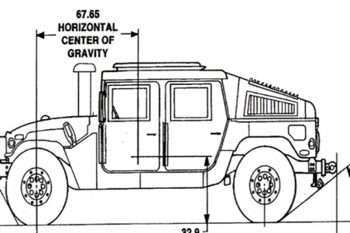
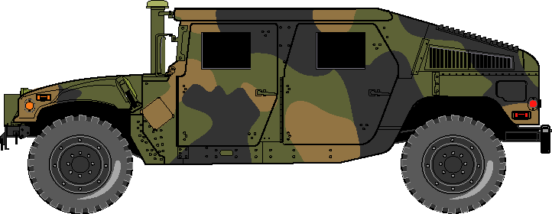
Rollover Avoidance
Factors:
Human Factors:
  Driving speed and maneuvering
  Driver/crew physical state, training, experience, risk management, teamwork
Environmental Factors:
  Weather and visibility
  Terrain, obstacles, explosive devices, etc.
  Road, shoulder, bridge conditions
Vehicle Factors:
  Vehicle condition
  Center of Gravity (CG)
  Vehicle stability characteristics
CG
& Risk
Notes:
INSTRUCTOR NOTE
This slide and the next (i.e., rollover factors and types) are used to set-up the discussion of the rollover avoidance guidelines by providing the students with an understanding of the things that contribute to rollovers.

Slide 14
Rollover Avoidance Cont.
Types of Rollover:
Fall Initiated:
  Soft shoulder or ground surface gives way; unstable bridge; bridges with no side rails; etc.
Maneuver Initiated:
  Swerving to avoid an object with improper tire inflation; taking a corner too fast given weather conditions; driving on a slope that is too steep; etc.
Impact Initiated:
  Hitting a curb, pothole, or other vehicle; initiating an explosive device; etc.
Notes:
INSTRUCTOR NOTE
Inform Marines that MRAP weight and the road conditions in theater have resulted in a number of vehicle “fall initiated” type rollovers. Between November 2007 and January 2010, the majority of the MRAP rollovers have been fall initiated²¹.
Footnotes:
²¹The Safety Corner, MCCLL, Feb 2010.

Slide 15
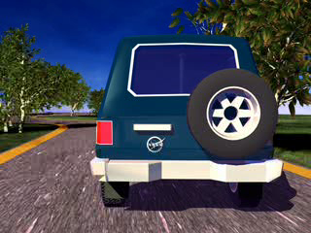
Rollover Avoidance Cont.
Avoidance Guidelines:
Slow down.
Notes:
INSTRUCTOR NOTE
Remind Marines that many of the following avoidance guidelines are dependent on tactical conditions.
Slow down.
INSTRUCTOR NOTE
Click the video in the presentation for an illustration of a HMMWV rollover caused by excessive speed for the road conditions (i.e., speeding, turning, gravel).
INSTRUCTOR NOTE
Click the animation in the presentation for an illustration of how the CG shifts as the vehicle changes direction and how when the vehicle’s turn and/or speed is too fast, it can cause the vehicle to rollover, even on a flat side slope.
Never exceed posted speed limits or unit SOPs.
Speed is the overriding cause in most HMMWV rollover situations²².
Avoid sharp curves and steep slopes, if possible.
Curves and slopes generate centrifugal force that acts sideways on the vehicle, increasing the chance of rollover. As speed increases, the centrifugal force increases, and consequently, the chances of rolling over increase.
Slow down and brake or downshift early. Avoid shifting in the curves.
Adjust the vehicle speed to allow a "speed cushion" for maneuvering (when approaching a curve, reduce your speed by at least 10 miles per hour below the posted speed limit).
Slowly accelerate out of the curve.
Faster speeds decrease available driver response time.
Ensure convoy speeds are established and enforced.
Footnotes:
²²The Safety Corner, MCCLL, 31 Oct 2008 referencing Army rollover mishap study for period January 2003 through April 2006.

Slide 16
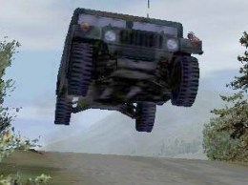
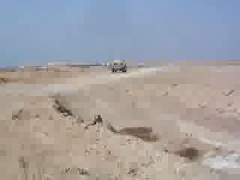
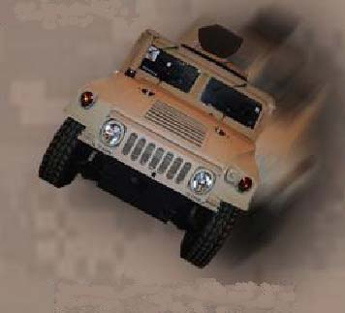
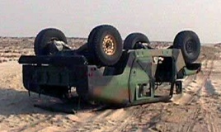
Rollover Avoidance Cont.
Avoidance Guidelines Cont.:
Use caution when cresting hills/changing attitudes.
Notes:
INSTRUCTOR NOTE
Click the video in the presentation for an illustration of a HMMWV rollover caused by someone cresting a hill too fast without ground guides.
Use caution when cresting hills/changing attitudes.
Use caution before cresting hills/changing attitudes. When a moving vehicle changes direction, especially when it is traveling fast, is on a slope, and/or when the slope itself changes (like when a vehicle crests a hill), the chance of the vehicle rolling over increases because the CG (above ground) shifts one direction as the vehicle’s wheels (ground level) try to take the vehicle in a different direction. In situations like this, vehicles can rollover even when traveling on an acceptable side slope.
The Gunner is often in the best position to see around the entire vehicle and should be main the eyes and ears for the driver.
Use a ground guide, when appropriate.

Slide 17
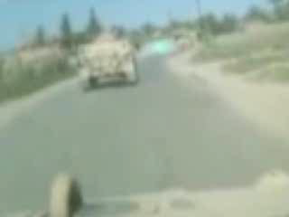
Rollover Avoidance Cont.
Avoidance Guidelines Cont.:
Avoid panic.
Notes:
INSTRUCTOR NOTE
Click the video in the presentation for an illustration of a panic rollover. Notice how the driver panicked, jerked the steering wheel, was going too fast, and caused the vehicle to rollover. The IED does not make the vehicle roll; it is the driver’s response to it that does.
Avoid panic.
Do not jerk the steering wheel. At highway speeds, jerking the steering wheel can cause the vehicle to slide sideways and rollover.
Avoid the temptation to brake hard. Hard braking can accelerate a skid, contributing to loss of control and rollover. Instead, it is better to release the accelerator and downshift to slow down.

Slide 18
Rollover Avoidance Cont.
Avoidance Guidelines Cont.:
Practice safe maneuvering techniques.
  Avoid driving on steep slopes/terrain. Plan your route.
  Avoid sudden maneuvers and overcorrecting.
  Maintain a "space cushion."
  Allow greater clearance from the edge of roads, especially near drop offs and water.
  If you drive off the edge of the road, gradually reduce speed and ease back onto roadway.
  Do not rely on a "seat of the pants"
  Steer into the skid.
Notes:
Practice safe maneuvering techniques.
Avoid driving on steep slopes/terrain (greater than 20 degrees up/down slope and 13 degrees side slope²³). Plan your route of travel.
Avoid sudden maneuvers and overcorrecting.
Maintain a "space cushion" (i.e., distance between your vehicle, the edge of the road, other traffic, and all other objects around your vehicle) so the driver has a safe maneuvering distance to compensate for errors in judgment, weather, road conditions, and poor driving by other motorists.
Allow greater clearance from the edge of roads while operating, especially those that drop off or near water.
If you drive off the edge of the road, gradually reduce speed and ease the vehicle back onto the roadway.
Do not rely on a "seat of the pants" sense to judge speed and vehicle maneuverability. New suspensions and chassis set-ups give a false sense of control.
Steer into a skid (horizontally as well as downhill). It is possible (at least in the ODS) to get both a Cat I and Cat II FPII MRAP on two or three wheels on a side slope and recover from it by turning down the hill.
Footnotes:
²³The Safety Corner, MCCLL, 31 Oct 2008.

Slide 19
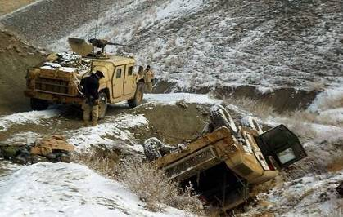
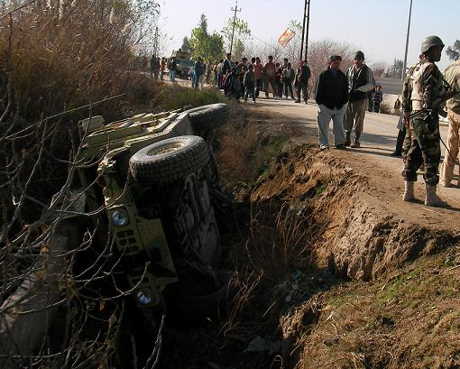
Rollover Avoidance Cont.
Avoidance Guidelines Cont.:
Exercise extra caution on rural roads.
  Nearly 75% of rollovers occur on rural roads¹⁶.
Notes:
Exercise extra caution on rural roads.
Nearly 75% of rollovers occur on rural roads²⁴.
Use extreme caution when driving on single-lane roads, steeply crowned roads, roads with soft or no shoulders, culverts, and especially any road bordering water (canal, irrigation ditch, pond, etc.).
Many road shoulders in underdeveloped countries are not built to U.S. standards and may collapse under the weight of heavy military vehicles, especially when the road is above grade and can fall to lower ground (ditches and canals).
The majority of MRAP rollovers have been due to the road/shoulder/bridge approach giving way under the vehicle’s weight²⁵.
Footnote:
¹⁶Deployments and Operations Task Force (DSOC) Brief on Rollover Prevention & Survivability 06 Oct 2008.
¹⁷The Safety Corner, MCCLL, 31 Oct 2008.

Slide 20
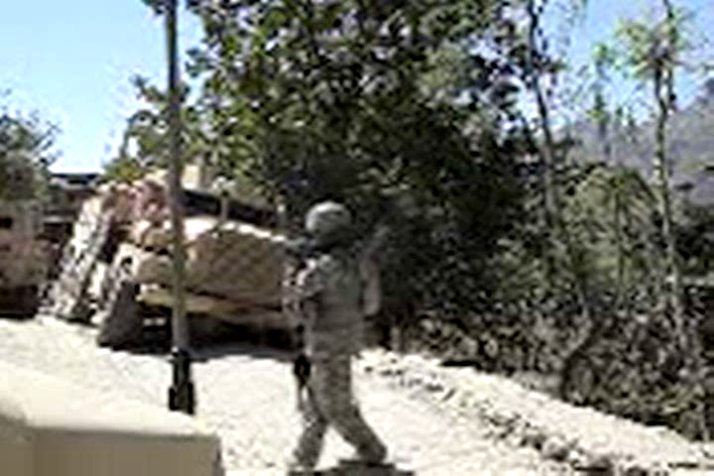
Rollover Avoidance Cont.
Avoidance Guidelines Cont.:
Exercise extra caution on rural roads Cont.
Notes:
Exercise extra caution on rural roads continued.
INSTRUCTOR NOTE
Click the video in the presentation for an illustration of a MRAP rollover caused by parking too close to the edge of a rural road in an underdeveloped country that is not built to U.S. standards which gives way under the weight of the vehicle.

Slide 21
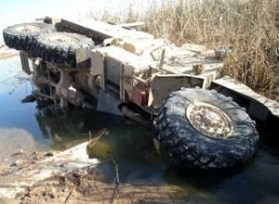
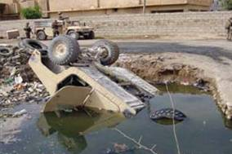
Rollover Avoidance Cont.
Avoidance Guidelines Cont.:
Exercise extra caution around water. (If tactical conditions permit:)
  Reduce speed and stop vehicle.
  Inform all that operating near water hazards.
  Assess risk of terrain and route before proceeding.
  Unlock combat doors.
  Ensure all loose gear and cargo is secure.
  Use ground guides, as needed.
  Maintain secure seating position by wearing seatbelts.
  Turn on filtered dome lights.
Notes:
INSTRUCTOR NOTE
Inform the Marines that it is recommended that they complete Underwater Egress Training (UET) to learn more about underwater egress procedures.

Slide 22
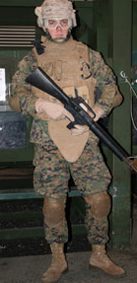
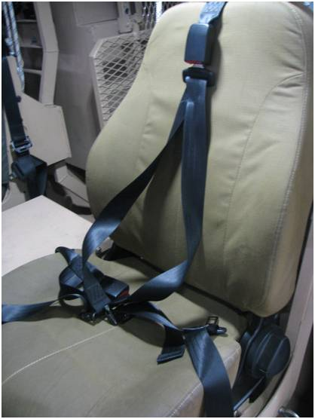
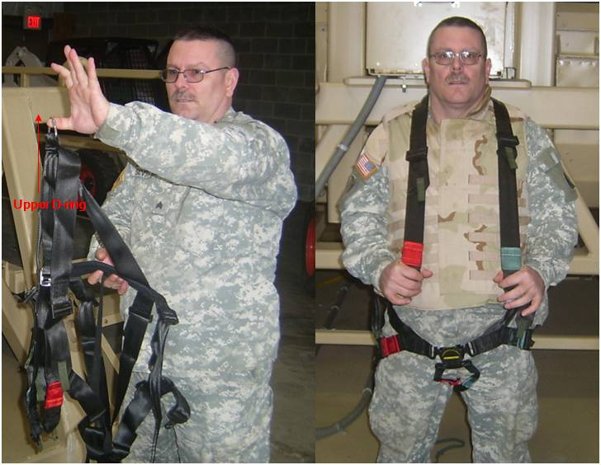
Rollover Avoidance Cont.
Avoidance Guidelines Cont.:
Use personal protective equipment.
  No restraint = 300% greater risk of fatality during tactical vehicle operations²⁶.
Notes:
Use personal protective equipment.
No restraint equals 300% times greater risk of fatality during tactical vehicle operations²⁶.
All Marines are required to wear their seatbelts (when available) while riding/driving²⁷.
Restraints secure occupants, prevent ejection, and reduce potential of blunt force trauma.
Seatbelt secures the driver in place and helps the driver control the vehicle.
All Marines should wear their Kevlar helmet and flak jacket while riding/driving in a tactical vehicle²⁸.
Helmets and body armor protect vital body parts during an accident.
Vehicle Commander enforces use of seatbelts and other personal protective equipment.
Footnote:
²⁶Deployments and Operations Task Force (DSOC) Brief on Rollover Prevention & Survivability 06 Oct 2008 referencing OIF/OEF CY03-04, USACHPPM study.
²⁷TMCO 5100.19E, SD, 29 Dec 00 and The Safety Corner, MCCLL, 31 Oct 2008.
²⁸The Safety Corner, MCCLL, 31 Oct 2008.

Slide 23
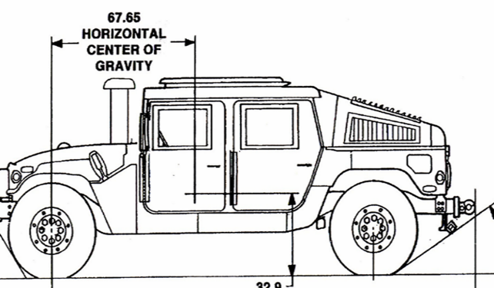
Rollover Avoidance Cont.
Avoidance Guidelines Cont.:
Pay attention to vehicle factors.
CG
& Risk
The Higher the CG,
the Higher the Risk
Notes:
Pay attention to vehicle factors.
Worn or improperly inflated tires increase the risk of rollover.
Worn tires may cause the vehicle to slip and/or tire failure. Both increase the chances of rollover.
Proper tire pressure helps maintain vehicle control and reduces tire wear.
Poor condition or failure of the tie rods and suspension can lead to a rollover.
Proper PMCS and pre-operations checks prior to a mission will help ensure these vehicle issues are identified and resolved before operation.
Keep the vehicle’s CG low. Load heavier items low in the vehicle. Avoid loading one side more than the other. Secure the load to avoid CG shifting.
Do not overload vehicle.
Secure gear inside the cab with cargo nets, straps, clips, or available approved alternative, to avoid creating potentially deadly projectiles in the cab during an accident.
Vehicles towing trailers are much more prone to rolling over, especially in curves and during sudden steering maneuvers, as a result of the exaggerated motion of the trailer. Adjust speed accordingly.

Slide 24
Rollover Avoidance Cont.
Avoidance Guidelines Cont.:
Manage risk.
  Train.
  Retrain after vehicle modifications.
  Pair experienced drivers with less experienced drivers.
  Incorporate potential for rollovers in risk assessment.
  Perform route reconnaissance.
  Plan for adequate time. Avoid the need for speed.
  Plan for operations without drive or blackout headlights.
  Ensure hazards and alternate routes are briefed.
  Assess conditions, driver experience and fatigue, etc.
  Use personal protective equipment.
  Maintain vehicle.
Notes:
Manage risk.
Ensure drivers and crews are well trained on their vehicle variants. Rehearse egress drills.
Retrain drivers and crews after vehicle modifications, especially changes that impact vehicle control and stability such as add-on armor.
Pair experienced drivers with less experienced drivers.
Incorporate potential for rollovers in risk assessment.
Perform route reconnaissance. Ensure weight, height, and width clearance. Assess bridges, terrain, low hanging power lines and trees, and especially roads along water/canals during route planning. Use combat engineers as needed. Plan for alternate routes.
Plan for adequate time. Avoid the need for speed.
Make sure NVGs are present and in working order in case you have to operate without drive or blackout headlights.
Ensure hazards are briefed prior to missions and brief your options for alternate/ bypass routes.
Assess weather, visibility, road conditions, driver experience and fatigue, etc. before and while operating.
Use personal protective equipment.
Maintain vehicle.

Slide 25
Rollover Avoidance Cont.
Avoidance Guidelines Cont.:
Work as a team.
  Maintain team member positioning within vehicle - fields of view/sectors.
  Identify terrain or conditions for a rollover.
  Alert driver if too close to the edge of the road, approaching a pothole/obstacle, etc.
  Use the Gunner as the eyes and ears for the driver.
  Use ground guides or spotters whenever driver needs additional eyes on the ground, especially near bodies of water or when cresting hills.
  Use intercom system to pass visual information to driver, but rehearse shouted voice commands and hand signals in case of intercom failure.
Notes:
Work as a team.
Maintain team member positioning within the vehicle - fields of view/sectors.
Identify terrain or conditions for a rollover and communicate with the driver.
Alert the driver if getting too close to the edge of the road, approaching a pothole/obstacle, etc. Tell the driver what is to the left, right, rear, and overhead.
Use the Gunner as the eyes and ears for the driver.
Use ground guides or spotters whenever driver needs additional eyes on the ground, especially near bodies of water or when cresting hills.
Use intercom system to pass visual information to driver, but rehearse shouted voice commands and hand signals in case of intercom failure.

Slide 26
Review
Review
Review
Questions?
Comprehension Check (click)
Given that tactical conditions allow for it, name some situations where you should use ground guides to help avoid a potential rollover?
What type of rollover can occur when driving over unstable bridges?
When you are the driver and your wheels go off the edge of the road, what should you do?
Fall initiated rollover
Gradually reduce speed and ease the vehicle back onto the roadway.
When cresting a hill
When operating near water
Whenever driver needs additional eyes on the ground
Review
Rollover factors
Types of rollovers
Avoidance guidelines
Notes:
TRANSITION: This concludes the section on rollover avoidance. Do you have any questions?
INSTRUCTOR NOTE
After answering the Marines’ questions, ask the following suggested comprehension check questions, and/or your own questions, and remediate as needed before proceeding. Click on the PowerPoint screen to display each suggested question and answer in turn.
Question: What type of rollover can occur when driving over unstable bridges? Answer: Fall initiated rollover
Question: When you are the driver and your wheels go off the edge of the road, what should you do? Answer: Gradually reduce speed and ease the vehicle back onto the roadway.
Question: Given the tactical conditions allow for it, name some situations where you should use ground guides to help avoid a potential rollover?
Answer:
When cresting a hill
When operating near water
Whenever driver needs additional eyes on the ground
Review:
In this section you learned the factors that contribute to rollovers, the different types of rollovers, and guidelines for avoiding a rollover accident. Key points to recall include:
Rollover factors - Rollovers can be caused by human, environmental, and/or vehicle factors.
Types of rollovers - Rollovers can be fall, maneuver, and/or impact initiated.
Avoidance guidelines - Keeping the following guidelines in mind can help you avoid being in a rollover accident:
Slow down.
Use caution when cresting hills/changing attitudes.
Avoid panic and practice safe maneuvering techniques.
Exercise extra caution on rural roads and around water.
Use personal protective equipment.
Pay attention to vehicle factors.
Manage risk.
Work as a team.
In the next section, you will learn the procedures you will perform before and during a dry rollover accident.

Slide 27
Rollover Procedures Cont.
Vehicle Driver:
Upon entering the vehicle, establish an egress plan with reference points.
Recognize an impending rollover situation.
Release the accelerator.
Yell, “Rollover, Rollover, Rollover!”
Continue to navigate the vehicle
Assume brace position.
Notes:
INSTRUCTOR NOTE
Inform the Marines that the rest of the lesson will take a detailed look at the proper procedures required by each Marine before, during, and after a dry rollover to egress, account for crewmembers, and establish security.
STEP 1 - INSTRUCTOR NOTE
Instruct Marines that, before each mission, they need to plan how to egress from their specific vehicle under different conditions.
Explain that they should become thoroughly familiar with how the seatbelt works, the location of each available egress point, and how to open each exit. They should plan how to get to a primary and secondary egress point while maintaining positive control of at least one physical reference at all times (if at all possible) in the event of a low/no visibility or underwater egress situation. Remind Marines to use lighting techniques, such as chemical and flash lights, to improve visibility in the dark. Remind them to recall the earlier discussion over egress considerations when the vehicle comes to a rest in different orientations when selecting primary and secondary escape routes.
STEP 4 - INSTRUCTOR NOTE
Inform the Marines that yelling “Rollover” is important in order to ensure that everyone is aware of the situation in case someone is not paying attention, and to prompt everyone to recall this training.
STEP 5 - INSTRUCTOR NOTES
Explain that the driver should continue to drive and navigate the vehicle to help avoid/minimize the accident. The driver should steer in the direction of the skid/roll to attempt to recover control of the vehicle.
STEP 6 - INSTRUCTOR NOTES
Explain the importance of a proper brace position. A good brace position is one of the best ways to avoid sustaining serious injury during an accident. In survivable accidents, impact injuries may lead to death because they may incapacitate Marines and prevent them from egressing under time-critical situations such as with fire or submersion. These incapacitating injuries usually manifest themselves as contact or flailing injuries that result when a part of the body (e.g., head, arms, hands, legs, etc.) strikes some part of the vehicle on impact. Assuming a proper brace position, in conjunction wearing seatbelts, is the best way to prevent these types of injuries. In general, a good brace position is one where all limbs and head are tucked in close to the seat-belted body, preventing them from flying around during impact.
Describe the driver’s brace position. The driver should keep hands on the steering wheel (initial reference point) with arms extended but not locked, use right foot for brake/accelerator as needed, plant free left foot firmly on the floor without locking knee, tuck chin into chest, keep eyes up to navigate, and press back firmly into the seat. The driver should hold this position until the accident is averted or the violent motion stops.

Slide 28
Rollover Procedures Cont.
Gunner:
Upon entering the vehicle, establish an egress plan with reference points.
Recognize an impending rollover situation.
Yell, “Rollover, Rollover, Rollover!”
Push/pull self down into the cab and assume brace position.
Notes:
INSTRUCTOR NOTE
Explain the additional concerns of the Gunner’s position, when applicable. Of all the vehicle occupants, the likelihood of injury to the Gunner is disproportionately higher than those of the others. Those occupying the Gunner’s position must exercise particular diligence in securing restraints, bracing for the rollover, and staying mindful of their increased risk of injuries.
STEP 4 - INSTRUCTOR NOTE
Explain that the Gunner’s restraint system is only designed to prevent the Gunner from being ejected from the vehicle; it does not pull the Gunner back into the vehicle. The Gunner should duck down into the cab as quickly as possible, attempt to hold onto a stationary object, and tuck head, arms, and legs into body. While these actions do not eliminate the bouncing around inside the vehicle, they minimize flailing injuries and substantially reduce the likelihood of decapitation by putting the roll cage/turret armor of the vehicle between the Gunner and the accident site.
Emphasize that the Gunner should never attempt to leap from a rolling vehicle.
Explain that the Gunner should not place hands or fingers in turret, if possible, as the turret’s movement can cause additional injuries.

Slide 29
Rollover Procedures Cont.
Other Crewmembers:
Upon entering the vehicle, establish an egress plan with reference points.
Recognize an impending rollover situation.
Yell, “Rollover, Rollover, Rollover!”
Closest occupants to the Gunner attempt to pull the Gunner into the vehicle and hold down.
Assume brace position.
Notes:
STEP 4 - INSTRUCTOR NOTE
This step does not apply to the front seat passengers. If you are in the front seat, do not attempt to reach behind you to grab the Gunner due to the risk of additional personal injury to arm, back, neck, etc.
Inform Marines that if their vehicle is equipped with Gunner seat quick release pull cords, pulling these cords is the quickest way to help the Gunner fall/get into the cab.
STEP 5 - INSTRUCTOR NOTE
For the other crewmembers that are not driving or manning the turret, explain brace position.
Marines should:
Secure weapon with one hand (more below).
Tuck other hand under leg and grip the front of the seat (initial reference point).
If the Marines cannot grab the front of their seat due to the shoulder straps, with their free hand, they should cross their body and firmly hold onto the opposite side shoulder strap.
Tuck chin into their chest.
Plant feet firmly on the floor without locking knees.
Press lower back into the seat.
Wait until the violent motion stops.
To secure weapon, Marines should:
Place one end of the weapon on the ground (outside of one leg - not in between legs).
Hold onto the other end with one hand.
Place trigger side away from face/body.

Slide 30

Review
Review
Review
Review
Questions?
Comprehension Check (click)
Describe the differences between the procedures performed by the Vehicle Driver, Gunner, and other crewmembers before and during a rollover.
Explain how to assume a proper brace position if you are a passenger that is not near the Gunner.
You should:
Secure weapon with one hand.
Tuck other hand under leg and grip the front of the seat (or) grab opposite side shoulder strap with free hand.
Tuck chin into their chest.
Plant feet firmly on the floor without locking knees.
Press lower back into the seat.
Wait until the violent motion stops.
To secure weapon, you should:
Place one end of the weapon on the ground (outside of one leg - not in between legs).
Hold onto the other end with one hand.
Place trigger side away from face/body.
The Vehicle Driver releases the accelerator and continues to navigate the vehicle through the accident. The driver does not attempt to grab the Gunner.
The Gunner tries to get into the vehicle first and foremost, and then tries to avoid placing hands or figures in the turret to avoid additional potential injuries.
Review
Vehicle driver
The Other Crewmembers (except those in front seat or not near the Gunner) attempt to pull the Gunner into the vehicle, hold him/her down, and secure their weapons.
Gunner
Other crewmembers
Notes:
TRANSITION: This concludes the section on the procedures performed before and during a dry rollover accident per crew position. Do you have any questions?
INSTRUCTOR NOTE
After answering the Marines’ questions, ask the following suggested comprehension check questions, and/or your own questions, and remediate as needed before proceeding. Click on the PowerPoint screen to display the suggested question and answer.
Question:
Describe the differences between the procedures performed by the Vehicle Driver, Gunner, and other crewmembers before and during a rollover.
Answer:
The Vehicle Driver releases the accelerator and continues to navigate the vehicle through the accident. The driver does not attempt to grab the Gunner.
The Gunner tries to get into the vehicle first and foremost, and then tries to avoid placing hands or figures in the turret to avoid additional potential injuries.
The Other Crewmembers (except those in front seat or not near the Gunner) attempt to pull the Gunner into the vehicle, hold him/her down, and secure their weapons.
Question:
Explain how to assume a proper brace position if you are a passenger that is not near the Gunner.
Answer:
You should:
Secure weapon with one hand.
Tuck other hand under leg and grip the front of the seat (or) grab opposite side shoulder strap with free hand.
Tuck chin into their chest.
Plant feet firmly on the floor without locking knees.
Press lower back into the seat.
Wait until the violent motion stops.
To secure weapon, you should:
Place one end of the weapon on the ground (outside of one leg - not in between legs).
Hold onto the other end with one hand.
Place trigger side away from face/body.
Review:
INSTRUCTOR NOTE
Remediate the Marines’ answers to the comprehension check question above to review this section.
In the next section, you will learn about the procedures you will perform after a dry rollover accident to egress, account for crewmembers, and establish security.

Slide 31
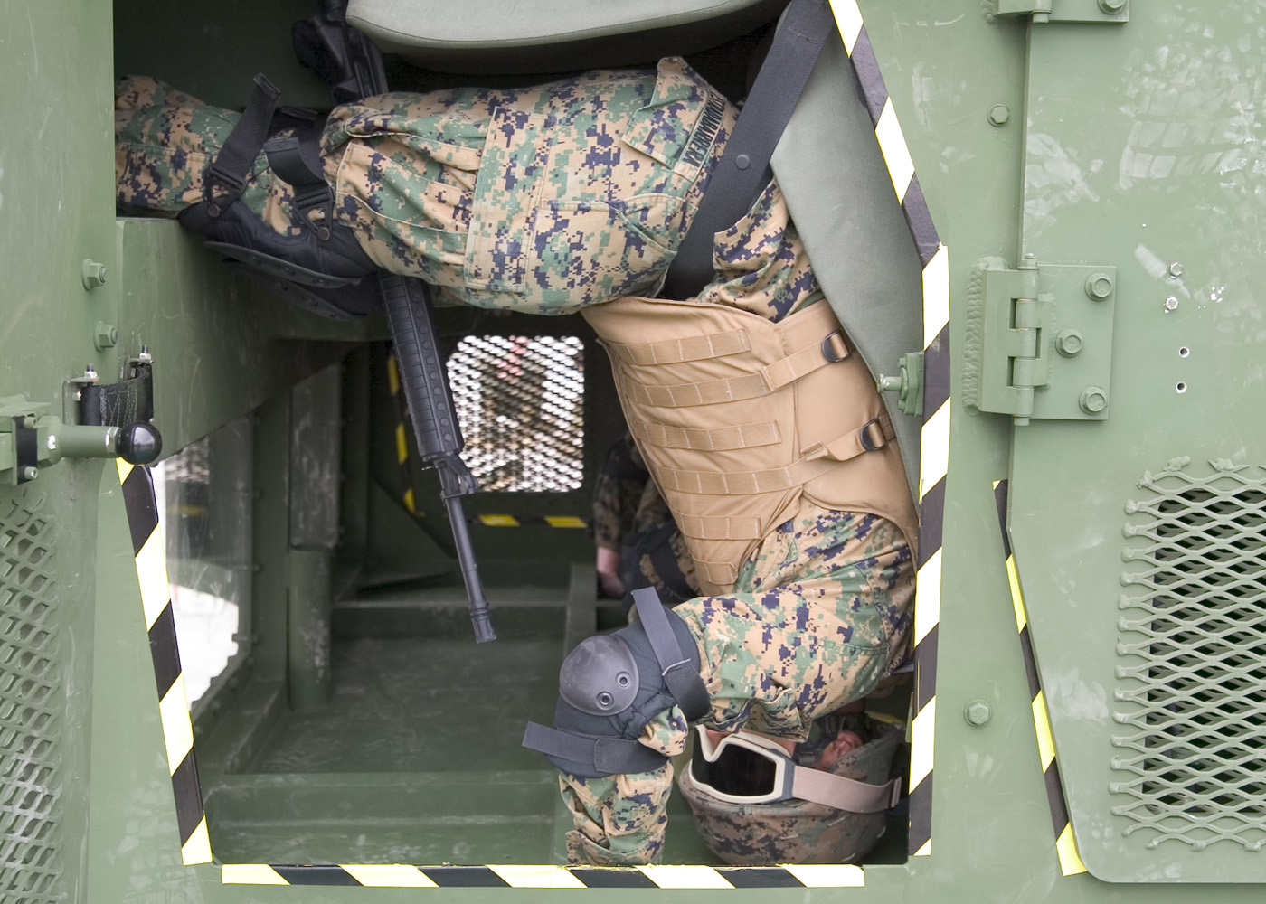
Accountability, Egress, & Security Procedures Cont.
Crew Dry Egress Procedures:
  Maintain brace position until violent motion stops.
  Turn off engine (Driver).
  Disconnect headset.
  Get re-orient.
  Support yourself in the downward direction.
  Plan your fall.
  Unfasten seatbelt and immediately place hands in the direction of the fall.
  Right yourself and re-gain orientation.
  Assess status of body, gear, and weapon.
  Assess injuries of nearby crewmembers.
  Administer buddy-aid for major injuries.
Notes:
INSTRUCTOR NOTE
Inform the Marines that these procedures focus on dry, not wet, egress, but that key points about wet egress and rescue will be integrated throughout and discussed at the end.
STEP 4 - INSTRUCTOR NOTE - Explain that to re-orient given visibility, Marines should keep seatbelts engaged, hold onto reference, sit up straight, look around to regain orientation relative to the rest of the vehicle, determine where they will fall when they release their seatbelt, and determine if another Marine is located in their landing spot. If someone is in the landing spot, allow them to get out of their seatbelt first in order to help you get down. Communicate!
Explain that to re-orient given a no visibility dry environment, Marines should keep seatbelts engaged, hold onto reference, sit up straight, recall their orientation relative to the rest of the vehicle, anticipate where they will fall when they release their seatbelt, recall if another Marine was in the landing spot before the accident, and recall what reference points are available from that position. If someone may be in the landing spot, attempt to establish communication with them (or others) to allow them to get out of their seatbelt first and then help you get down.
Remind Marines to use lighting techniques, such as chemical and flash lights, to improve visibility when they are in the dark.
STEP 5 - INSTRUCTOR NOTE - Describe how Marines may be hanging and will need to brace one hand against the roof, other seats, etc. depending on the direction they are being pulled by gravity.
STEP 6 - INSTRUCTOR NOTE - Describe how Marines push against supports to release the tension from the seatbelt buckle. Emphasize that Marines should not unlatch their seatbelt until they have properly braced themselves. They should be prepared to fall! They should protect their necks at all costs by tucking their head!
STEP 7 - INSTRUCTOR NOTE - Emphasize how they need to be aware of their buddies so they do not kick or jabbed them! Emphasize how their gear may get caught on something. Emphasize how they must maintain general weapon awareness at all times in a combat zone because they will be in condition 1!
STEP 8 - INSTRUCTOR NOTE - Describe to the Marines how dropping out of their seats after a dry rollover is more disorienting than they might expect. Simple things can become complicated and they should remain calm and get re-oriented. They should locate preplanned physical reference points if little or no visibility.
STEP 10 - INSTRUCTOR NOTE - Crewmember accountability and injury assessment is crucial prior to exiting the vehicle under dry conditions.
Describe how the Vehicle Commander or senior Marine should ascertain the injury status of each crewmember, determine if anyone needs immediate medical assistance or help getting out of the vehicle, use verbal/non-verbal communication (as appropriate) to indicate status/need for assistance.
Advise Marines of the importance of establishing some sort of non-verbal communication amongst themselves before going on a mission.
Describe how, in water and blackout conditions, Marines may not be aware that an injury requires immediate attention until after egress.
STEP 11 - INSTRUCTOR NOTE - Describe to the Marines how they should administer buddy-aid and apply a tourniquet immediately to stop major bleeding injuries before dry egress unless immediate evacuation is necessary due to smoke, fire, submersion, etc. Because time is extremely limited in submersion conditions, it is critical for each Marine to egress as quickly as possible before attempting to help others.

Slide 32
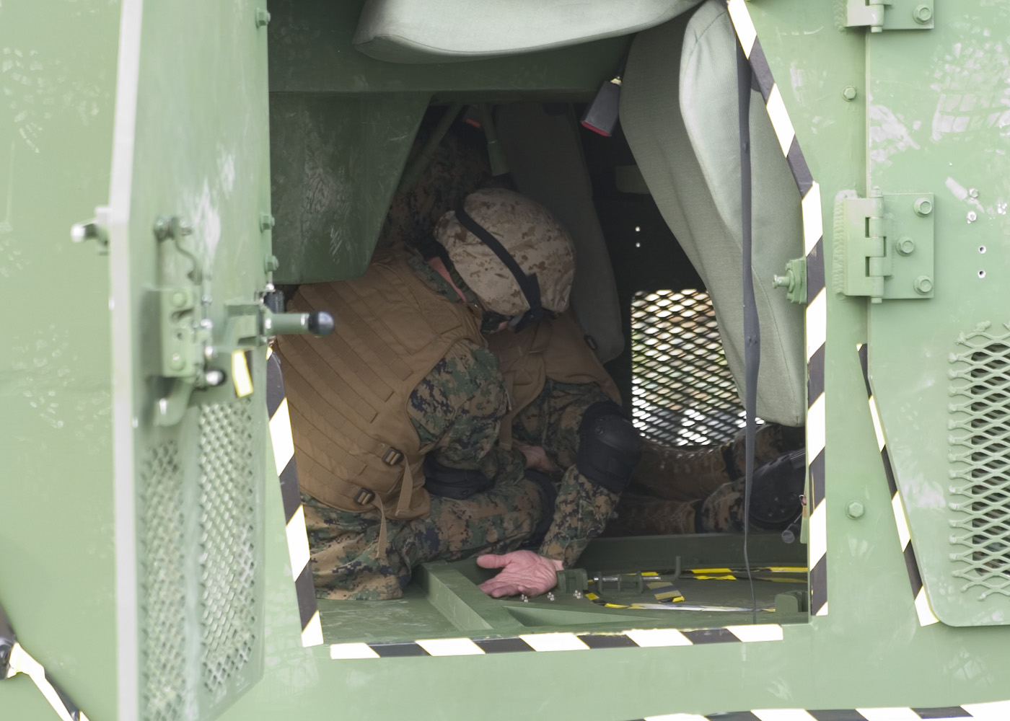
Accountability, Egress, & Security Procedures Cont.
Crew Dry Egress Procedures Cont.:
  Determine if primary or secondary egress plan is best suited for vehicle orientation.
  Move to exit and try to unlock and open. Assist crewmembers to open exit, if needed.
  Move to alternate egress point, if exit cannot be opened.
  Shout “Open door (and the location)!” once available egress point is found.
Notes:
Crew Dry Egress Procedures Cont.
STEP 12 - INSTRUCTOR NOTE
Remind the Marines of the issues to consider when attempting to exit from the various egress points when the vehicle comes to a rest in different orientations and how this plays into their selection of a primary and secondary egress plan.
STEP 13 - INSTRUCTOR NOTES
Describe to the Marines how they should locate and follow preplanned reference points if no visibility.
Remind the Marines that doors may be very difficult or impossible to open when the vehicle comes to a rest on its side because of the weight of armored doors. Armored doors can weigh far in excess of 200 pounds each, and are not meant to be inverted. More than one Marine may have to really lean into the door to get it opened if this is the only viable exit point. Climbing and bracing on radio racks, seat sides, etc. will be necessary to get enough leverage and distance to fully open door.

Slide 33
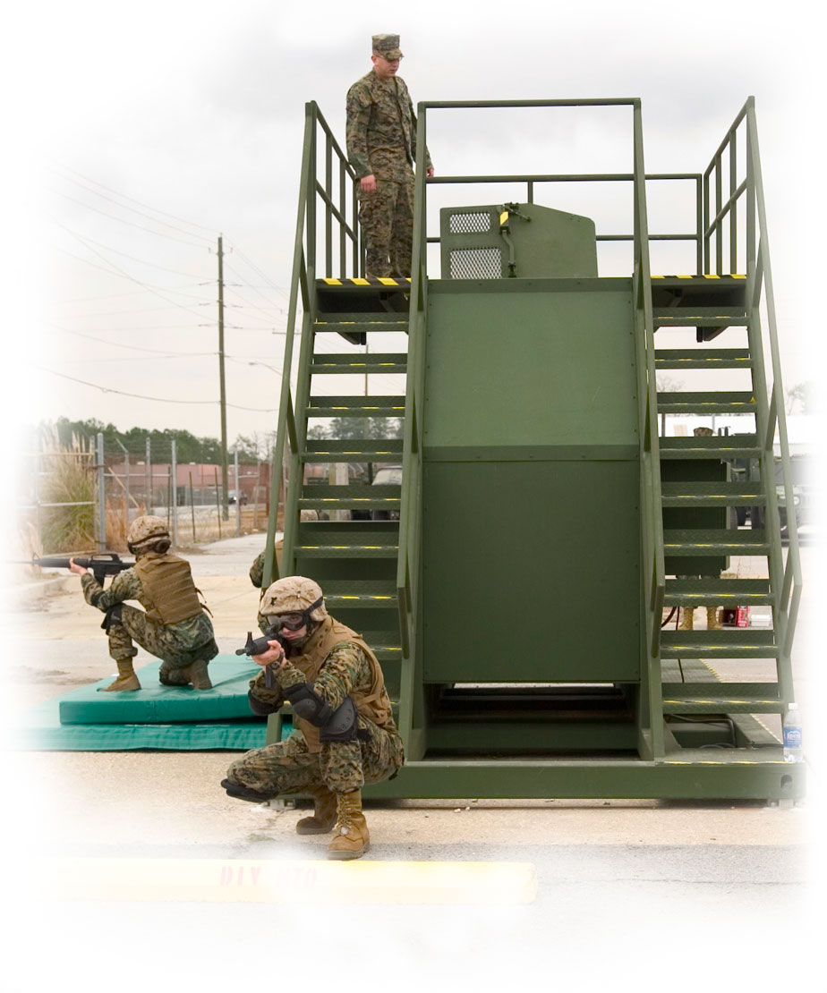
Accountability, Egress, & Security Procedures Cont.
Crew Dry Egress Procedures Cont.:
  Crack door/hatch and check for flames and/or incoming fire.
  Activate fire extinguisher, as needed.
  Ensure crewmembers know where the opening is and are heading for it.
  Determine if crewmember(s) need assistance exiting the vehicle.
  Assist moving injured crewmember(s), as needed.
  Exit vehicle with weapon.
  Establish security.
  Once security is established:
Provide first aid and summon medical aid.
Inspect vehicle for fires and fire hazards.
Recover weapons, ammunition, and sensitive items.
Notify rescue personnel, remain at a safe distance, secure site.
Assist in vehicle recovery, as required.
Report mishap to higher headquarters.
Notes:
Crew Dry Egress Procedures Cont.
STEP 19- INSTRUCTOR NOTE
Describe how the Vehicle Commander or senior Marine will determine the best method for moving injured crewmember(s) and use verbal/non-verbal communication, as appropriate, to indicate best method.
STEP 20 - INSTRUCTOR NOTE
Emphasize how coordination, communication, and teamwork are the keys to efficiently moving Marines out of a rolled over vehicle and into a secure area for first aid.
STEP 21 - INSTRUCTOR NOTE
Emphasize to Marines that if a rollover occurs outside the wire, it is treated as a tactical element. Emphasize that they should look before they leap! They should not rush out of the first exit only to get shot, blown up, or expose others inside cab! They should expect the enemy to show up. Chances are they are already there! They should look before they exit and exit with their weapons.
However, emphasize that under submersion conditions, Marines should drop their weapon in order to use both hands to maintain positive control of at least one physical reference at all times as they move themselves to an exit.
STEP 22 - INSTRUCTOR NOTE
Briefly describe how the first Marine out of a dry rollover establishes security at the exit to cover the other Marines. The remaining Marines will establish security posts 360 degrees around the vehicle - ensuring they retain cover from incoming fire. This is explained in detail on the next series of screens.
STEP 23b - INSTRUCTOR NOTE
Emphasize to the Marines that they should inspect vehicle for fires and fire hazards such as leaking oil, fuel, and hydraulic fluid. They should use the portable fire extinguisher, as need. If hazardous/explosive materials are involved, the driver should take actions according to the instructions accompanying the load.
STEP 23c - INSTRUCTOR NOTE
Remind Marines that Vehicle Commander or senior Marine is accountable for all Marines and sensitive items in the vehicle once security is established.

Slide 34
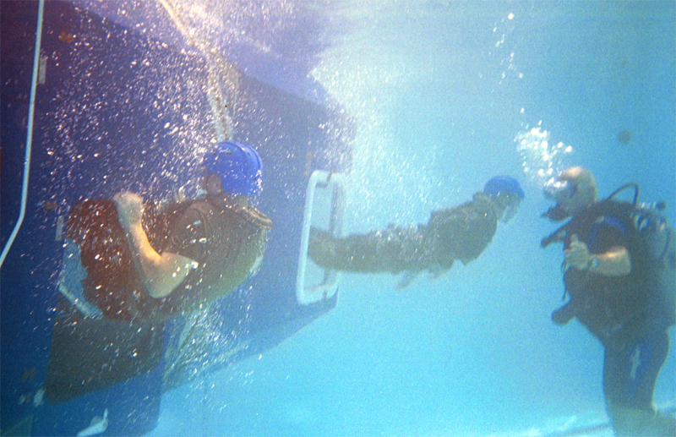
Accountability, Egress, & Security Procedures Cont.
Crew Wet Egress Procedure Differences:
Use reference points and get out!
Notes:
Crew Wet Egress Procedure Differences
INSTRUCTOR NOTE
Remind the Marines that the above procedures focused on dry, not wet, egress. Stress that the following information is for familiarization only and if at all possible, Marines should complete UET to learn more about underwater egress procedures.
In most cases your vehicle will be in relatively shallow water (possibly still deep enough to completely submerge vehicle), but not so deep as to make eventual egress and surfacing impossible.
The most important differences between what you should do if you are involved in a wet/submerged rollover versus a dry rollover include:
Maintain firm, continuous contact with physical references as you work your way to the exit to avoid floating and becoming disoriented.
Exit the vehicle and get to the surface as soon as possible because time is extremely limited.
Do not worry about things like turning off the engine, helping other crewmembers, exiting with weapon, etc. Instead, simply get to the surface and survive.
If you cannot immediately get out of the vehicle due to water rushing in or being unable to push a door open - DO NOT PANIC. There will be air pockets in the vehicle and you will be able to breathe in those pockets for a short time. Once the water pressure inside equalizes with the outside, you will have an easier time opening doors and/or egressing through openings.
After reaching the surface, you can then attempt to assist other crewmembers.

Slide 35
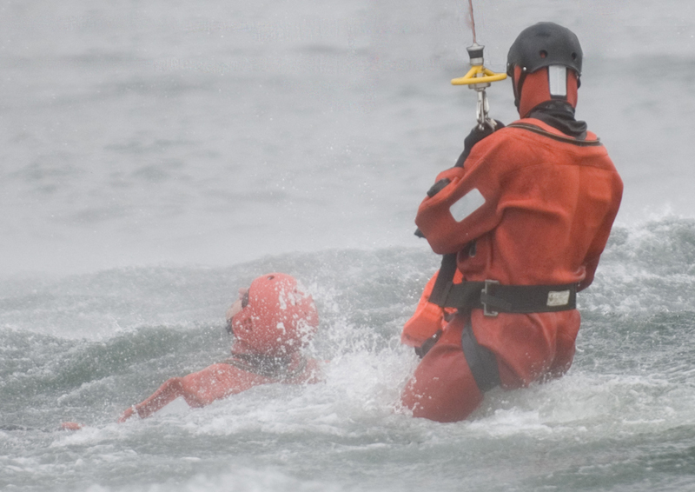
Accountability, Egress, & Security Procedures Cont.
Wet Rescue Procedures:
http://commons.wikimedia.org/wiki/User:Hebster
Notes:
Wet Rescue Procedures
Secure the accident site.
Stay in contact with the vehicle; hold onto the vehicle and kick/swim to high point in buddy teams.
INSTRUCTOR NOTE
Emphasize that before each mission, non-swimmers should be identified and assigned a buddy that is a swimmer. The body of water may be deep enough that Marines must swim to shore.
Rescuers tie a rope/cable to the vehicle to aid in rescue.
Open doors and hatches.
If door and hatches are not accessible, rescuers must immediately use all available means to elevate the vehicle to allow air to get in or roll the vehicle on its side to gain access to the Gunner’s turret.
Ensure that all survivors have air and are able to breathe.
Seek out the highest point on/in the vehicle.
Check for other injuries and apply first aid.
Carefully move injured personnel to the highest point on the vehicle.
Remove excess equipment, to include body armor in deep water.
Evacuate from vehicle high point to safest location, depending on:
Enemy situation
Water level and flow
Water temperature
Distance to water’s edge
Anticipation of rescue

Slide 36
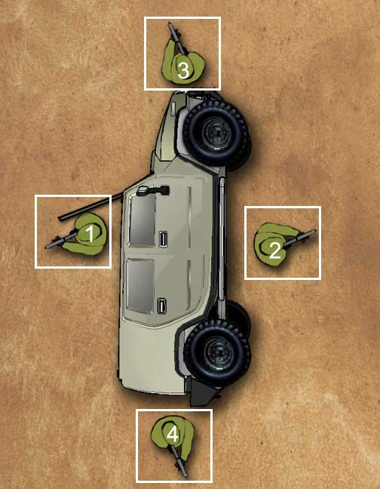
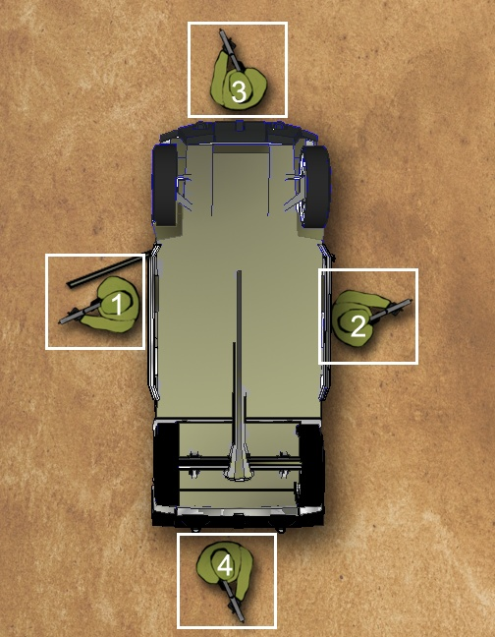
Accountability, Egress, & Security Procedures Cont.
Establishing Security After Egress:
Without Injuries
Notes:
Establish Security after Egress
INSTRUCTOR NOTE - Discuss the security positions displayed in the graphic.
Without Injuries
Marines should egress and establish security in the following order, unless directed otherwise by unit SOPs or the senior Marine:
The 1st Marine to exit shouts “(Last Name), out!” and stays by the exit while the other Marines egress.
INSTRUCTOR NOTES - Remind the Marines that when the vehicle comes to rest on its side (90/270 degrees), they need to consider exiting through the Gunner’s or rear hatch, if applicable, when the doors are too heavy to open.
Remind the Marines that when the vehicle comes to rest on the roof (180 degrees), the Gunner’s and rear hatches may not be usable, if applicable, but the side doors should be easier to open than when it is on its side.
Explain that in some cases, the only possible egress point will be the target of incoming fire. Emphasize that Marines may have to egress through that fire to reach a safe, covered position.
If there is incoming fire, the 1st Marine will yell which way he is moving around the vehicle and move in that direction to a covered position where he will lay down covering fire for other Marines.
The 2nd Marine to exit shouts “(Last Name), out!” and establishes a security position on the opposite side of the vehicle as the 1st Marine (6 o’clock position).
INSTRUCTOR NOTE - Explain that if there is incoming fire directed at the egress point, the 2nd Marine will move to a covered position at the opposite end of the vehicle from the 1st Marine and add covering fire.
The 3rd Marine and subsequent Marines to exit shout “(Last Name), out!” and fill in the remaining gaps around the vehicle.
INSTRUCTOR NOTE - Explain that if there is incoming fire directed at the egress point, all Marines will assume covered positions.
The last Marine to exit taps the 1st Marine on the head/body upon exit, shouts “(Last Name), Last Marine out!”, and moves to a covered position.

Slide 37
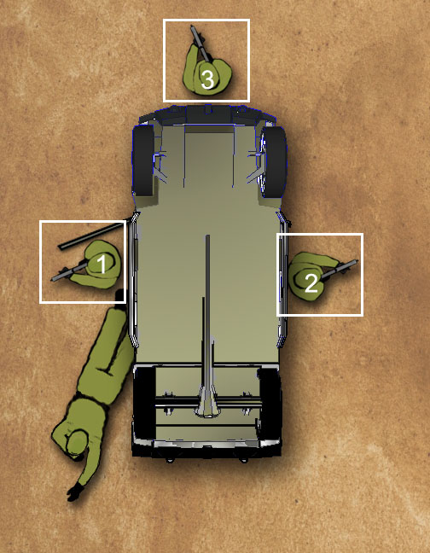
Accountability, Egress, & Security Procedures Cont.
Establishing Security After Egress Cont.:
With Injuries
Notes:
Establish Security after Egress Continued
INSTRUCTOR NOTE
Discuss the security positions displayed in the graphic.
Inform Marines that depending on the tactical conditions and the severity of the injuries, an injured Marine may assist with security.
With Injuries
Marines will egress and establish security as described on the previous slide, expect that the last two uninjured Marines will work together to evacuate the injury(ies). Again, the last Marine to exit taps the 1st Marine on the head/body upon exit, yells “Last Marine!”, and moves to uncovered position.

Slide 38
Review
Review
Review
Review
Questions?
Comprehension Check (click)
What is the most important thing to do before you release your seatbelt after a dry rollover?
After a dry rollover, where should the 2nd Marine to egress post security?
If a Marine has a major bleeding injury after a dry rollover, what should you do?
What should you use to maintain your orientation after a rollover given little or no visibility?
After a dry rollover, what should you check/determine before releasing your seatbelt to reduce the chances of injuring one of your fellow crewmembers?
You should not unlatch your seatbelt until you have properly braced yourself. You should be prepared to fall! You should protect your neck at all costs by tucking your head!
The 6 o’clock position relative to the 1st Marine
Administer buddy-aid and apply a tourniquet immediately to stop major bleeding injuries before dry egress unless immediate evacuation is necessary due to smoke, fire, submersion, etc.
Determine where you will fall when you release your seatbelt and if another Marine is/may be located in your landing spot. If someone is/may be in the landing spot, attempt to communicate with them (or others) to allow them to get out of their seatbelt first and then help you get down.
Physical reference points
Review
Egress
Account for crewmembers
Establishing security
Wet egress differences
Wet rescue
Notes:
TRANSITION: This concludes the section on the procedures you will perform after a dry rollover accident to egress, account for crewmembers, and establish security. Do you have any questions?
INSTRUCTOR NOTE - After answering the Marines’ questions, ask the following suggested comprehension check questions, and/or your own questions, and remediate as needed before proceeding. Click on the PowerPoint screen to display each suggested question and answer in turn.
Question: After a dry rollover, what should you check/determine before releasing your seatbelt to reduce the chances of injuring one of your fellow crewmembers? Answer: Determine where you will fall when you release your seatbelt and if another Marine is/may be located in your landing spot. If someone is/may be in the landing spot, attempt to communicate with them (or others) to allow them to get out of their seatbelt first and then help you get down.
Question: What is the most important thing to do before you release your seatbelt after a dry rollover? Answer: You should not unlatch your seatbelt until you have properly braced yourself. You should be prepared to fall! You should protect your neck at all costs by tucking your head!
Question: What should you use to maintain your orientation after a rollover given little or no visibility? Answer: Physical reference point.
Question: If a Marine has a major bleeding injury after a dry rollover, what should you do? Answer: Administer buddy-aid and apply a tourniquet immediately to stop major bleeding injuries before dry egress unless immediate evacuation is necessary due to smoke, fire, submersion, etc.
Question: After a dry rollover, where should the 2nd Marine to egress post security? Answer: The 6 o’clock position relative to the 1st Marine
Review: In this section you learned procedures you will perform after a dry rollover accident to egress, account for crewmembers, and establish security, as well as some critical differences given a wet rollover. Key points to recall include:
Egress:
Before releasing your seatbelt, determine if someone is/may be in your landing spot and communicate with them, tuck your head, brace one hand against the roof, and protect your neck.
After a dry rollover with little or no visibility, locate preplanned physical reference points at landing spot.
Assess status of body, gear, and weapon before attempting to egress.
Consider the issues related to each potential egress point given how the vehicle comes to a rest.
Shout/listen for “Open door (and the location)!” Help buddies if needed.
Look before you leap! Exit with your weapon.
Establish security.
Call for help and recover sensitive items.
Account for crewmembers:
Vehicle Commander or senior Marine assesses the crew for injuries after a rollover.
Administer buddy-aid and apply a tourniquet immediately to stop major bleeding injuries.
Coordination, communication, and teamwork are the keys to efficiently egressing an injured Marine.
Establish security:
Marines will establish security posts 360 degrees around the vehicle.
The first Marine out covers the exit for the other Marines.
The 2nd Marine covers the 6 o’clock position.
All other Marines to exit fill in the gaps.
The last two uninjured Marines work together to evacuate the injury(ies).
The last Marine taps the 1st Marine, yells “Last Marine!”, and moves to an uncovered position.
In the next section, we will shift gears and learn about the characteristics and prevention of motion sickness and heat exhaustion; two possible illnesses you may experience while training in the dry rollover egress trainers.

Slide 39
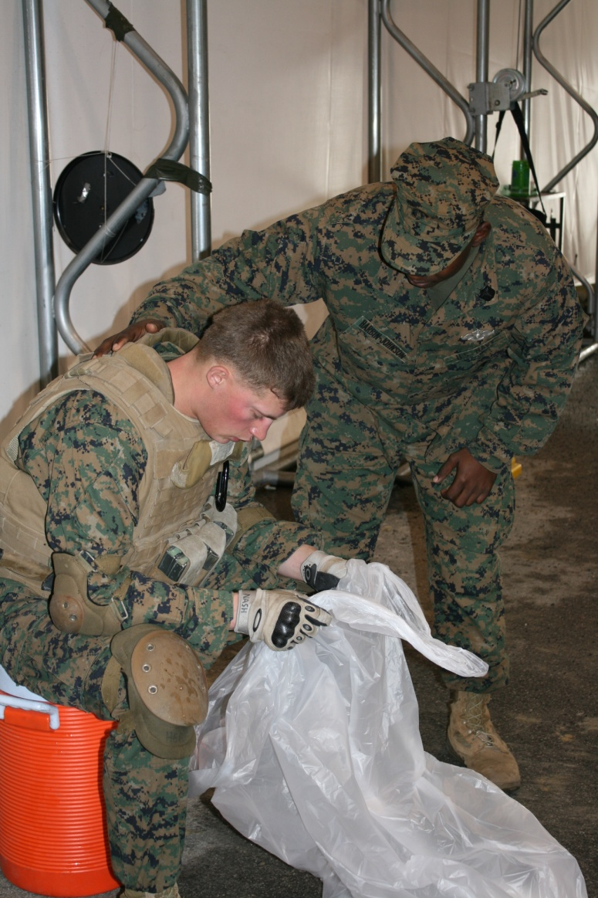
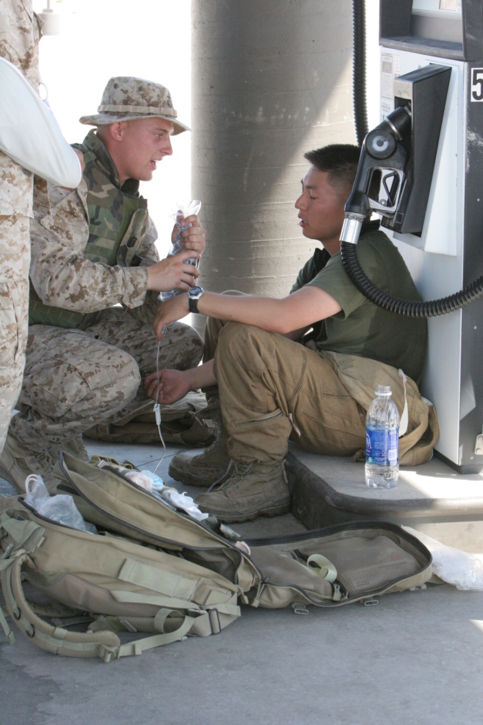
Treating Motion Sickness and Heat Exhaustion
Notes:
Motion Sickness Overview
Because the dry rollover egress trainers rotate and invert, you may experience motion sickness.
Motion sickness is a normal response to real, perceived, or anticipated motion.
Though motion sickness is usually minor, it can be debilitating in some cases.
Motion sickness occurs when the body, inner ear, and the eyes send conflicting signals to the brain.
Motion Sickness Symptoms
Common symptoms of motion sickness include:
Dizziness; Headache; Increased salivation; Nausea or vomiting; Paleness of the skin; Cold sweats; Fatigue; Feels like a hangover
Preventing Motion Sickness
The following methods may help you prevent motion sickness symptoms:
Reduce anxiety and fears (i.e., concentrate on breathing, etc.).
Maintain proper ventilation in simulator to decrease foul odors.
Avoid bulky and greasy meals, or overindulgence in food or alcoholic beverages prior to training.
Avoid dairy products prior to training.
Monitor yourself for signs of motion sickness.
Heat Exhaustion Overview
Because you will be wearing a heavy uniform and gear, and the dry rollover egress trainers are usually sheltered in an environment that is not temperature controlled, you may experience heat exhaustion during training. Heat exhaustion can occur :
Over several days; From exposure to high temperatures environments; From loss of fluids; From loss of electrolytes; If you cannot sweat enough to cool your body
Heat Exhaustion Symptoms
Common symptoms of heat exhaustion include:
Heavy sweating; Fatigue; Muscle cramps; Pale, cool, and/or moist skin; Fast and shallow breathing; Fast and weak pulse; Dizziness; Headache; Nausea or vomiting; Fainting
Heat exhaustion can lead to heat stroke if untreated, requiring immediate emergency medical treatment. Inform your instructor or the Corpsman immediately if suspected!
Preventing Heat Exhaustion
The following methods may help you prevent heat exhaustion symptoms:
Avoid alcoholic and caffeinated beverages before and during training.
Drink plenty of fluids before, during, and after training.
Stay in the shade, or cool area, when not training.
Wait to don gear until just prior to the training activity.
Monitor yourself for signs of heat exhaustion.
SAFETY NOTE
Inform Marines that if, at any time, they feel the onset of motion sickness or heat exhaustion during training, they should yell “Cease Training” and they will be immediately removed from the trainer, examined, and treated, as needed

Slide 40
Review
Review
Review
Review
Review
Questions?
Comprehension Check (click)
What are some of the most common symptoms of motion sickness?
What are some of the most common symptoms of heat exhaustion?
Dizziness
Headache
Increased salivation
Nausea or vomiting
Paleness of the skin
Cold sweats
Fatigue
Feels like a hangover
Heavy sweating
Fatigue
Muscle cramps
Pale, cool, an/or moist skin
Fast and shallow breathing
Fast and weak pulse
Dizziness
Headache
Nausea or vomiting
Fainting
Review
Motion sickness
Heat exhaustion
Notes:
TRANSITION: This concludes the motion sickness and heat exhaustion section. Do you have any questions?
INSTRUCTOR NOTE
After answering the Marines’ questions, ask the following suggested comprehension check questions, and/or your own questions, and remediate as needed before proceeding. Click on the PowerPoint screen to display each suggested question and answer in turn.
Question: What are some of the most common symptoms of motion sickness? Answer: Dizziness; Headache; Increased salivation; Nausea or vomiting; Paleness of the skin; Cold sweats; Fatigue; Feels like a hangover
Question: What are some of the most common symptoms of heat exhaustion? Answer: Heavy sweating; Fatigue; Muscle cramps; Pale, cool, an/or moist skin; Fast and shallow breathing; Fast and weak pulse; Dizziness; Headache; Nausea or vomiting; Fainting
Review:
In this section you learned how to prevent, recognize, and treat motion sickness and heat exhaustion. Key points to recall include:
Motion Sickness:
Cause – A normal, minor condition that can be debilitating caused by conflicting signals to the brain from the body, inner ear, and eyes.
Symptoms – The most common symptoms include: dizziness, headache, increased salivation, nausea or vomiting, paleness of the skin, cold sweats, fatigue, and feels like a hangover.
Prevention – Control breathing and avoid bulky, greasy, dairy, or alcoholic foods and beverages before training. Monitor your physical state and call to cease training if needed.
Heat Exhaustion:
Cause – Occurs when you lose more fluids and electrolytes than you replace and your body cannot keep itself cool.
Symptoms – The most common symptoms include: heavy sweating; fatigue; muscle cramps; pale, cool, and/or moist skin; fast and shallow breathing; fast and weak pulse; dizziness; headache; nausea or vomiting; and, fainting.
Prevention – Avoid dehydrating beverages, drink plenty of fluids, and stay cool when not training. Monitor your physical state and call to cease training if needed.

Slide 41
Summary
The classroom instruction introduced you to:
Rollover-relevant characteristics, components, and considerations of tactical wheeled vehicles
Guidelines for avoiding a wheeled vehicle rollover accident
Emergency procedures performed to react to an imminent rollover
Emergency procedures performed after a dry rollover accident
Characteristics and prevention of motion sickness and heat exhaustion
Notes:
SUMMARY:
The classroom instruction introduced you to the:
Rollover-relevant characteristics, components, and considerations of tactical wheeled vehicles
Guidelines for avoiding a wheeled vehicle rollover accident
Emergency procedures performed to react to an imminent rollover
Emergency procedures performed after a dry rollover accident
Characteristics and prevention of motion sickness and heat exhaustion
TRANSITION: This concludes the academic portion of your training.

Slide 42
Next Steps
Next Steps:
10 minute break
Written test
Observe MET training
Complete MET scenarios
Observe HEAT training
Complete HEAT scenarios
Notes:
NEXT STEPS:
Next, you will:
(1) Take a short 10 minute break.
(2) Complete the written exam.
(3) Observe other Marines completing MET training.
(4) Complete MET training yourself.
(5) Observe other Marines completing HEAT training.
(6) Complete HEAT training yourself.
INSTRUCTOR NOTE
Provide the class with a brief overview of what they can expect during the practical application scenarios. Specifically, they will complete scenarios in the MET followed by HEAT. Scenarios will include exiting from different cab orientations, with blocked/inaccessible doors, and with and without visibility, debris, and injuries.
Do not explain exactly what will happen in each scenario ahead of time so the Marines will have to plan, communicate, and search for and find injured personnel and operational exits.
(BREAK – 10 MINS)
EVALUATION. Administer multiple-choice written exam. Allow 30 minutes to complete.

